Slide 1
Gardening with Culinary Herbs and Benefits for Pollinators
Presented by:
Jennifer Fishburn
Extension Educator, Horticulture
Notes:
Hello, I’m Jennifer Fishburn and I am a horticulture educator for the University of Illinois Extension.
Today, I am going to talk about growing culinary herbs that you can enjoy using in food dishes.
And as an extra benefit these herbs are also enjoyed by pollinators.

Slide 2
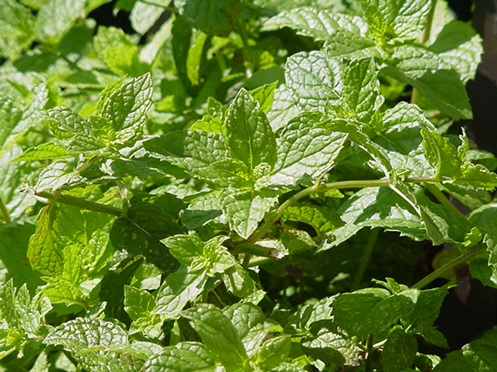
What is an Herb?
Plant with an aromatic quality used for one or more of the following:
Scenting
Cooking and flavoring
Decorative
Medicinal purposes
Notes:
Growing herbs can be a great hobby that produces tasty results.
Herbs have been used for centuries, many being linked to spiritual well-being, religion and love. Herbs were the world’s first vitamins and medicines.
Herb uses can include flavoring food, decorative purposes and medicinal purposes.
The focus of this presentation is culinary herbs.
Herbs can also be used for decoration such as in potpourris, dried flower arrangements, garlands and wreaths.

Slide 3
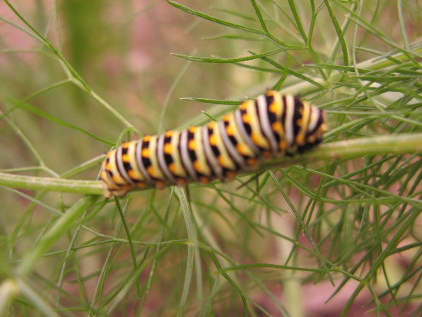
Why Grow Herbs?
In general, herbs are easy to grow
Herb plants have few insect and disease problems
Add fragrance to the garden
Inexpensive compared to purchasing fresh herbs from the grocery store
Many if allowed to bloom are attractive to pollinators
Notes:
Growing herbs is a fun and rewarding experience for gardeners and cooking enthusiast.
In general herbs are easy to grow, as they have few insect and disease problems.
In addition, herbs add fragrance and texture to the garden.
Growing your own culinary herbs can be less expensive than buying fresh herbs.
Another great reward of herb plants is that many of them are used by pollinating insects. Some herb plants are larval food sources, while others provide pollen or nectar.

Slide 4
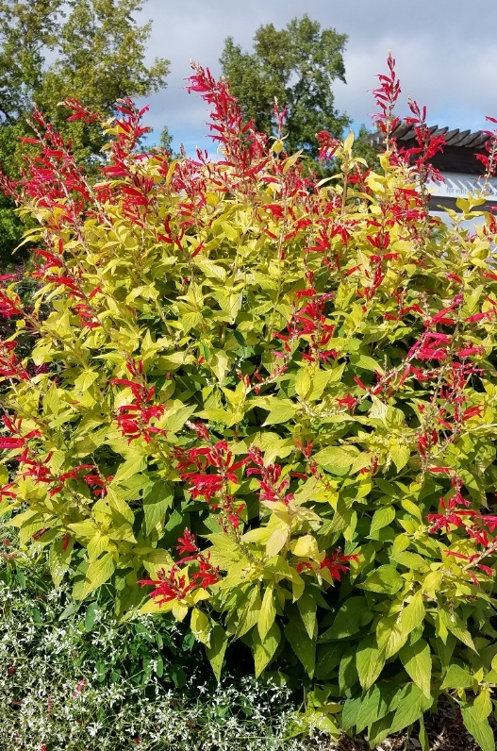
Herb Garden Site
Most herbs need at least 6 hours of sunlight
Most herb plants tolerate a wide range of soils
Do not tolerate wet, poorly drained soils
Avoid high fertility soils and fertilizers
Plants need good air circulation
Include herbs in the vegetable garden
Notes:
A successful herb garden location should meet the following criteria.
Herbs prefer to grow in a sunny location with at least 6 hours of sunlight.
If possible, grow herbs in containers or in a small garden that is located close to the kitchen.
Herb plants will grow best in average soil fertility as highly fertile soil causes excessive growth and reduced flavor components.
The preferred soil pH is Neutral.
Good drainage is a must as herbs do not like wet feet. So avoid planting herbs in wet, poorly drained soils. If planting herbs in containers, make sure the container has a drainage hole.
If mulching the garden, use a light covering and avoid getting mulch near the stem.
To prevent disease issues, give plants proper spacing to allow for good air circulation.

Slide 5
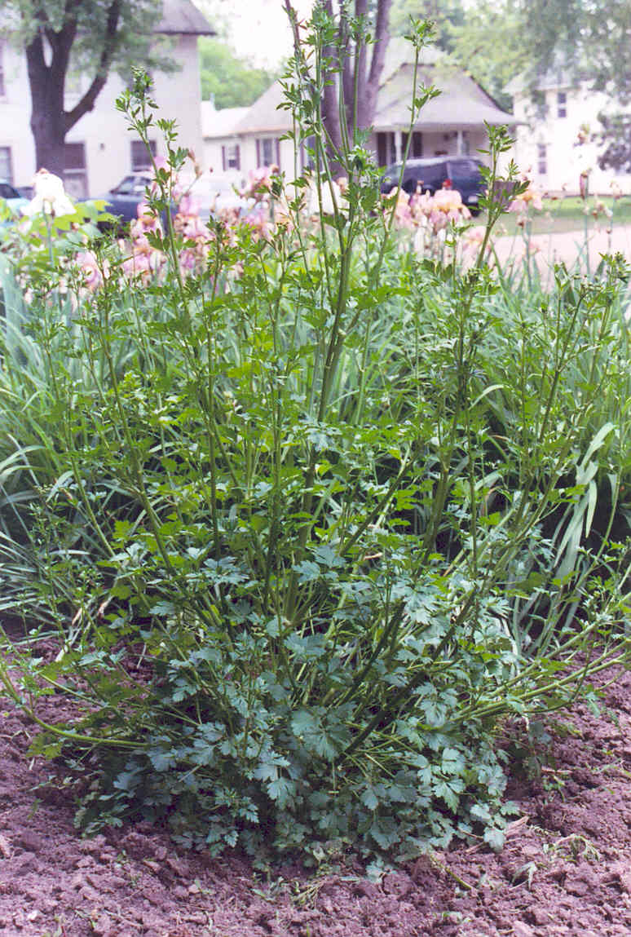
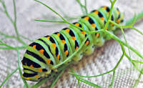
Herbs for Pollinators
For cooking purposes the flavor of herb leaves is best just before plants flower
Flowers provide nectar for bees, butterflies, hover flies, parasitic wasps
Some herb plant leaves are good for larvae- fennel, dill, parsley
Notes:
Many culinary herb plants are also good plants for pollinating insects. Pollinators that you might find visiting herb flowers include native bees, honey bees, butterflies, hover flies, parasitic wasps and hummingbirds.
If inviting insects to your garden, you may need to do a few things differently.
For example, culinary herbs are generally cut back just before the plants flower.
However for the benefit of pollinators, avoid giving herb plants a haircut until the flowers blooms begin to fade.
For a few pollinators, herb plant leaves are a good food source for larvae. Black swallowtail larvae feed on fennel, dill and parsley leaves.
When planting fennel, dill and parsley be sure to plant a few extra plants for a larval food source.
Now I will discuss a few of the insect pollinators that may visit your herb plants.

Slide 6
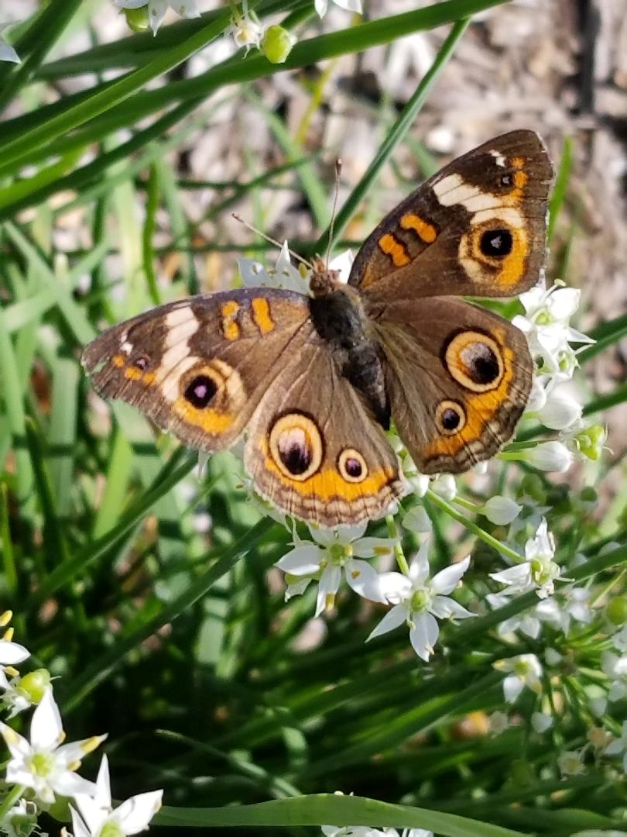
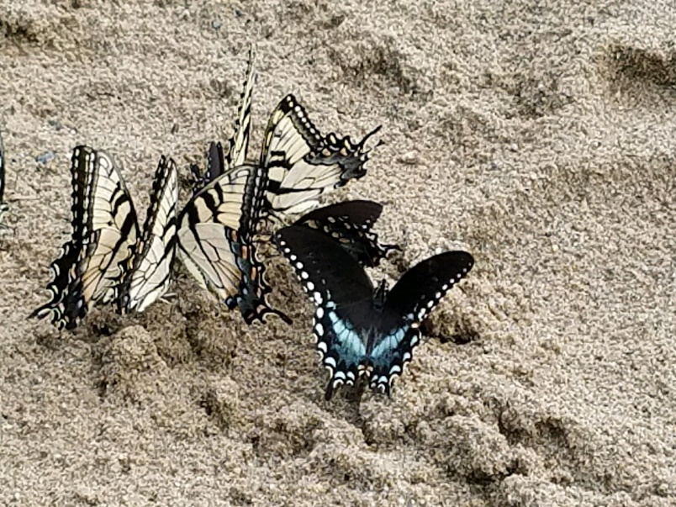
Pollinators- Butterflies
Buckeye
Kathy Iler
Black Swallowtail
Barbara Rogers
Barbara Rogers
Notes:
Herbs that attract butterflies include chives, mint, parsley, and thyme just to name a few.
Here are examples of two butterflies that may visit your garden, black swallowtail butterfly and the buckeye butterfly.

Slide 7
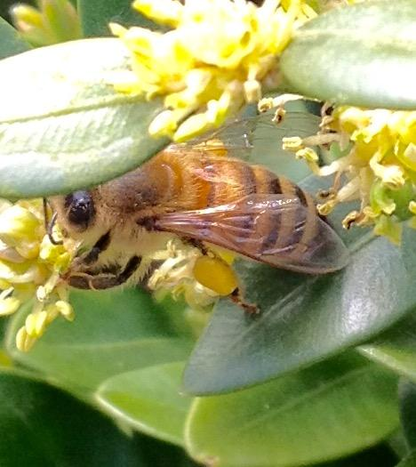
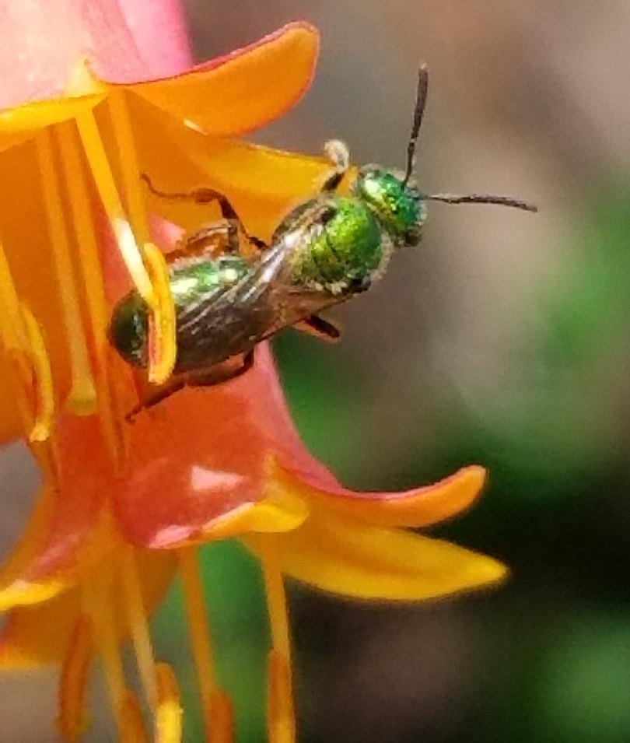
Pollinators- Bees
Honey Bee
Green Metallic Bee
Steve Petrilli
Barbara Rogers
Notes:
Herbs that attract bees include basil, borage, chamomile, dill, germander, hyssop, lavender, lemon balm, rosemary, and thyme to name a few.
Examples of bees that may visit your garden include honey bees and green metallic bees.

Slide 8
Pollinators- Wasp
Wasp
Barbara Rogers
Barbara Rogers
Notes:
While not a favorite of most gardeners, wasp may also be attracted to herb flowers.
When the garden is buzzing with pollinators be sure to work slowly, avoid wearing perfume, and wear closed toed shoes while walking through and around the garden.

Slide 9
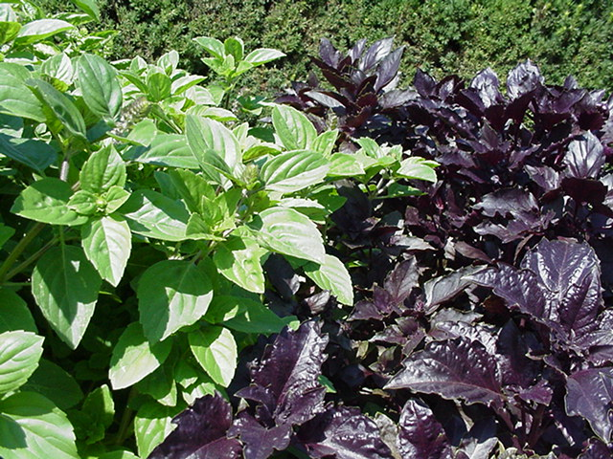
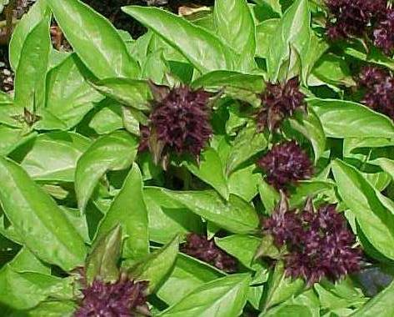
Basil
Ocimum basilicum
Annual
1 to 2.5’ tall
Loves heat
Food dishes- leaves
Pollinators- flowers
Notes:
The next several slides I will discuss how to grow, use several culinary herbs and how they are used by pollinators.
Basil is an warm loving annual that prefers well-drained, rich soil. Depending on the cultivar it grows one to two and a half feet tall.
The top photo shows green basil and purple ruffles basil. The bottom left photo is Siam Queen Thai basil.
Basil can be started from seed in mid-May, or set plants in the garden at this time.
Prune plants back to one-half to one-third the size as flowers fade. Avoid letting seeds set as plant vigor will decrease.
Basil leaves can be used fresh. They can also be dried or frozen.
Before the first fall frost, take stem cuttings, put them in water and place in a sunny location. Replace water every few days. You should be able to enjoy fresh basil leaves for several months.
A few popular food dishes that basil is used in include pesto, tomato sauce, flavored vinegar, and pasta dishes.
Insects attracted to basil flowers include bumblebees, leaf cutter bees and honey bees.

Slide 10
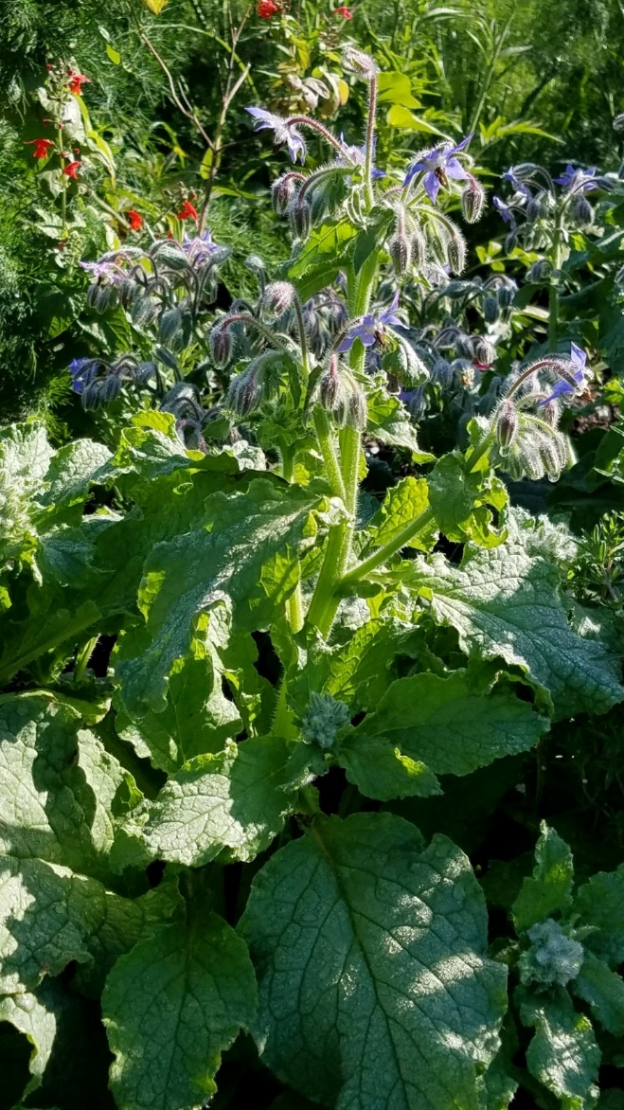
Borage
Borage officinalis
Annual
2’ tall
Food dishes- leaves and flowers; cucumber flavor
Pollinators- flowers
Notes:
Borage is an annual herb that grows best in a sunny, dry location. This 2 feet tall plant can tolerate poor, dry soils.
Start from seed after danger of frost
The edible leaves and stems have bristly hairs. Finely shredded borage leaves taste like cucumbers and are used in salads, cold drinks. Young leaves can be boiled.
Borage’s blue flowers make an attractive garnish either fresh or candied. The flowers are also attractive to bees and butterflies.
Borage self sows easily. If seeds are allowed to shatter, they will come up in the same location year after year.

Slide 11
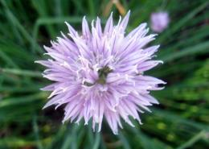
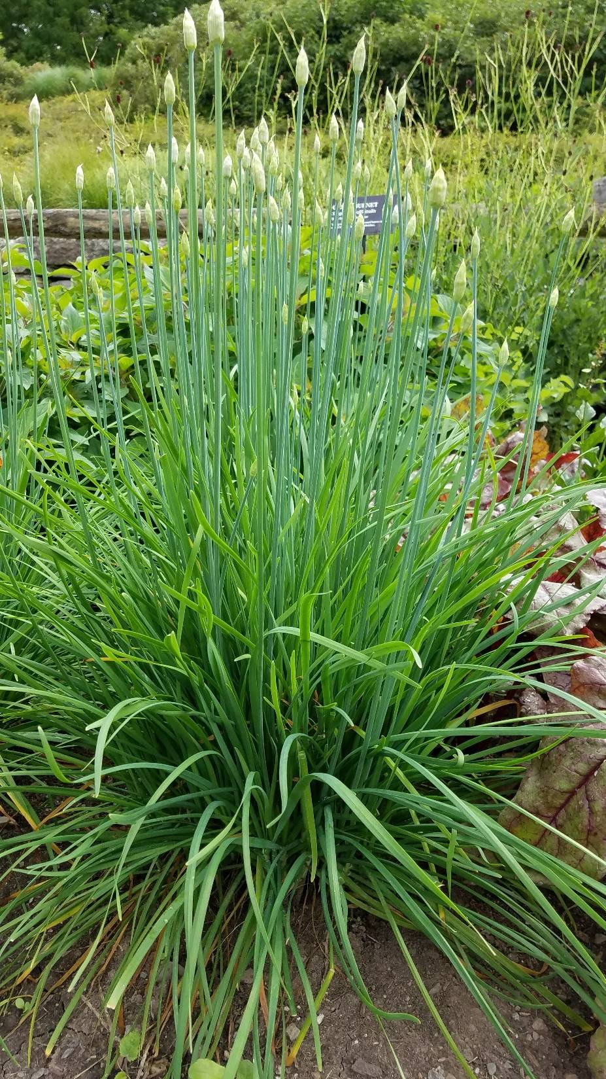
Chives
Allium schoenoprasum
1 to 1.5’ tall
Deadhead prior to seed formation
Food dishes- leaves and flowers
Pollinators- flowers
Top photo, chives
Bottom photo, garlic chives
Notes:
Chives are a perennial herb growing up to 18 inches tall.
Chives is easy to divide and share with fellow gardeners.
Common chives have globe shaped pink- purple flowers, while garlic chives have white flowers.
Bumblebees, leafcutter bees, mason bees and honeybees are attracted to chive flowers.
After flowering, cut the entire plant back to about two inches tall. This will encourage regrowth.
Avoid allowing garlic chives to self sow as they will spread uncontrollable.
Common chives have a mild onion flavor and make a good addition to salads, soups, vegetables, sauces and potato salad.
Flower heads are used as a garnish for soups and salads.
Garlic chives has a mild garlic flavor.

Slide 12
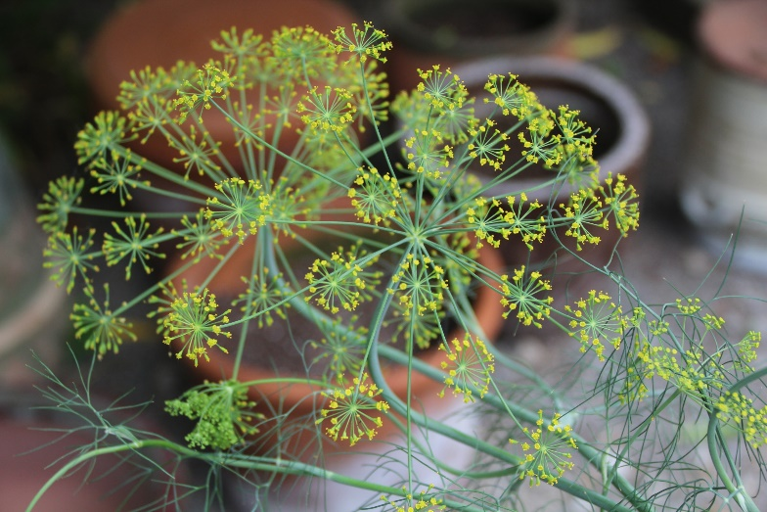
Dill
Anethum graveolens
Annual, self sows easily
2 to 4’ tall
Remove seed heads before turn brown
Food dishes- leaves and seeds
Pollinators- flowers and foliage
E. Wahle
Notes:
Dill is an annual herb that grows 2 to 4 feet tall.
Dill is easy to grow from seed.
Dill is an annual, flowering then bolting, going to seed, during hot dry weather.
The yellow flowers are attractive to bees and butterflies.
Swallowtail butterflies will lay their eggs on dill and the larvae enjoy munching on the foliage.
Remove seed heads when seeds turn light brown, as dill self-seeds easily.
To dry, hang seed heads upside down in paper bags.
Leaves can be used fresh or dried. Used in egg dishes, with rice, potato dishes, fish, chicken, on leafy green salads.
Fresh flower heads and foliage can be used to flavor pickles.

Slide 13
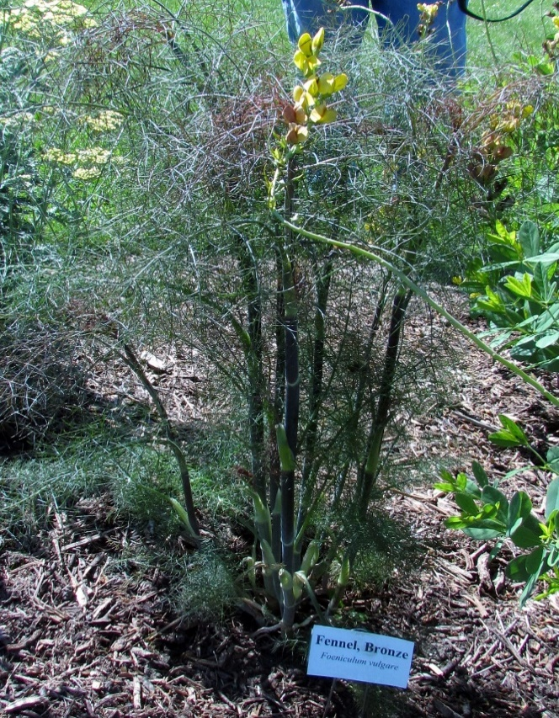
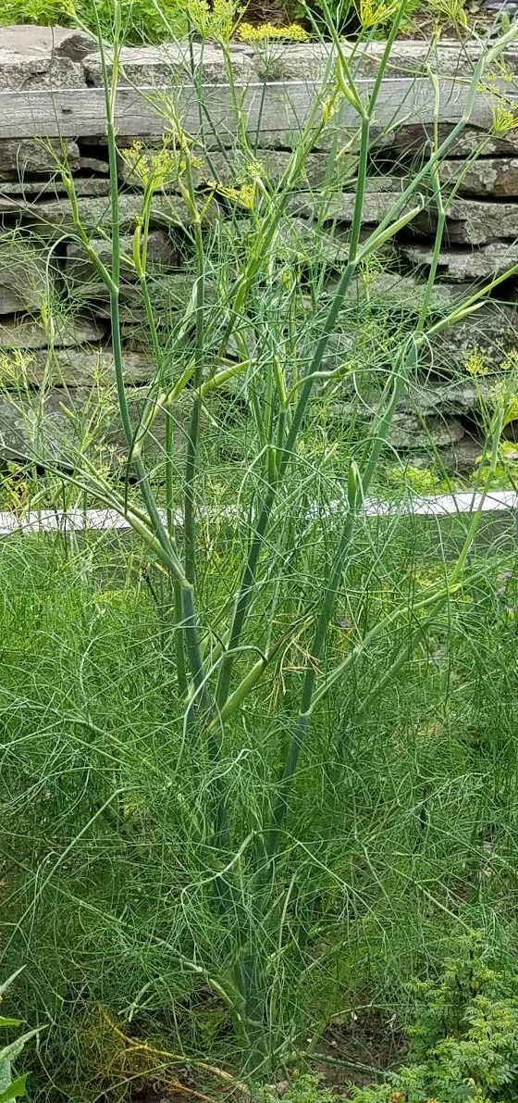
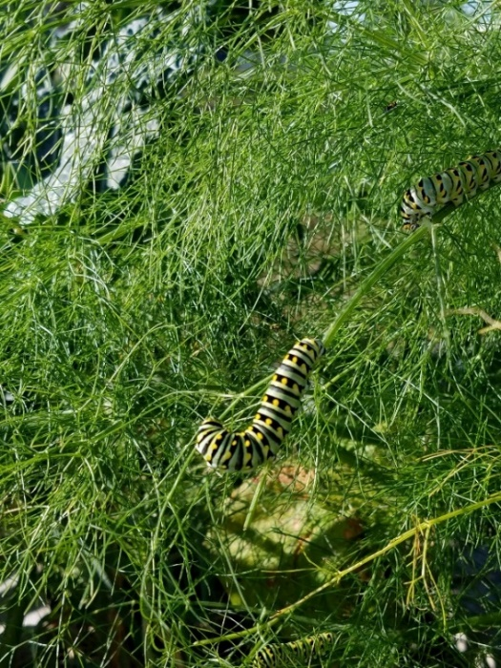
Fennel
Foeniculum vulgare
Perennial
3 to 5’ tall
Food dishes- leaves and seed
Pollinators- foliage and flowers
Notes:
Fennel is a perennial herb growing 3 to 5 feet tall.
Flat heads of small yellow flowers that are attractive to solitary bees, bumblebees, mining bees, hoverflies, lady bugs, lacewings, and honeybees.
The flowers are rich in nectar and pollen.
Swallowtail butterflies will also lay their eggs on fennel and the larvae eat the foliage.
Remove seed heads as they turn light brown and before they shatter, as fennel will self-sow easily.
The foliage and seeds are anise licorice flavored.
The foliage can be used fresh or dried. The leaves make a nice addition to salads, potatoes, fish, cooked vegetables.
Fennel seeds are used in sausage.

Slide 14
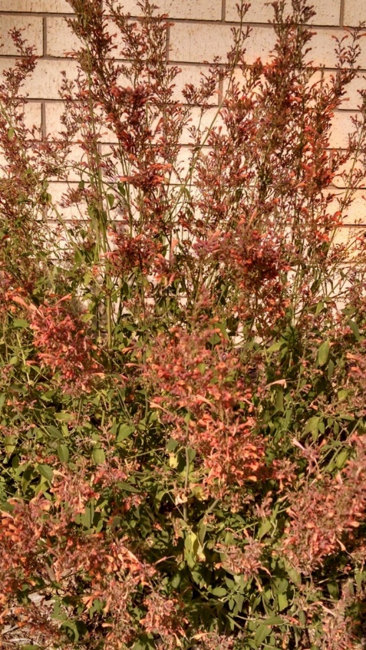
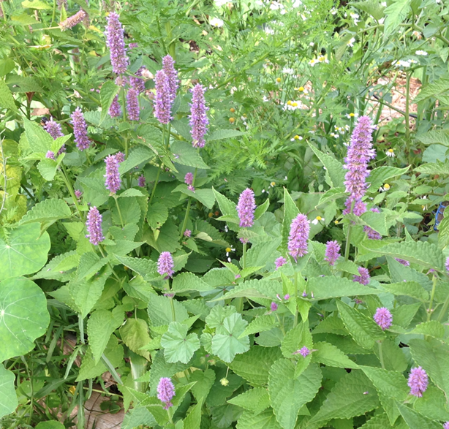
Hyssop
Agastache foeniculum, Anise Hyssop, native
2 to 4’ tall
Lavender blue flowers
Food dishes- leaves and seeds
Pollinators- flowers
Notes:
Anise hyssop, Agastache foeniculum, is a native plant that grows 2 to 4 feet tall.
Plants grow best in moist soil, but once established will tolerate dry soil.
Blue or violet spike flowers are in bloom June to August.
The deep throated flowers are attractive to longer tongued insects. Flowers can be covered with many different pollinating insects including bees, butterflies, and hummingbirds.
Strong flavored, licorice mint leaves and flowers can be used in soups, salads, herbal teas and jellies.
There are several hybrids and cultivars. Most grown for their ornamental characteristics. Pictured in the upper right is Kudos Mandarin, which is hardy to zone 5.

Slide 15
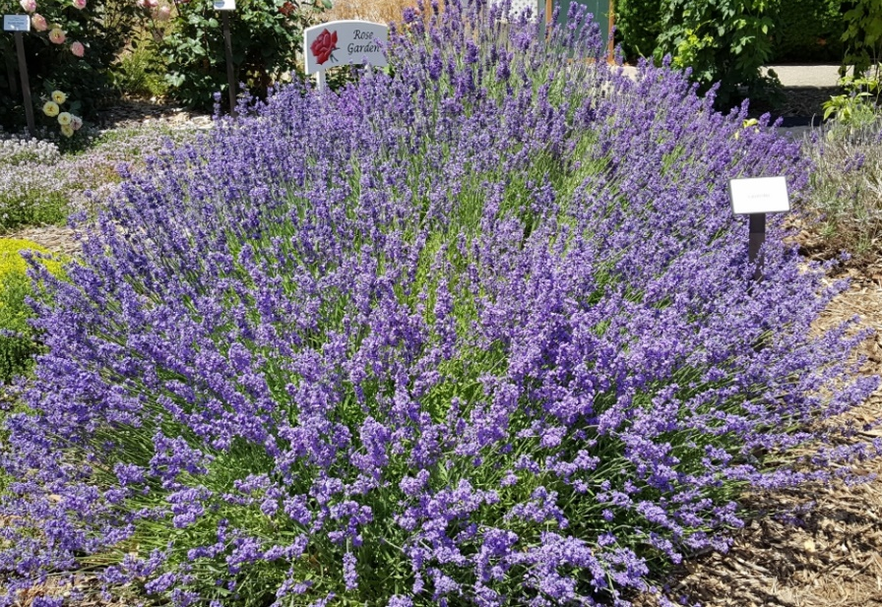
Lavender
Lavandula sp.
Perennial
2 to 2.5’ tall
Lavender flowers
Food dishes- leaves
Pollinators- flowers
Notes:
Lavender is a perennial that grows to around 2 feet tall.
The lavender purple flowers bloom up to four weeks in mid-summer.
These nectar producing flowers attract bees and butterflies. ‘Grosso’ a French hybrid which is hardy to zone 6, has shown to have more nectar.
Lavender does not like high humidity.
A commonly grown cultivar, ‘Hidcote’ lavender is hardy to zone 4. While zone hardy, sometimes can be difficult to overwinter so be sure to provide winter protection
Lavender plants will benefit from a hard prune after new growth appears in the spring.
Plants become woody and may need replaced every three years.
Leaves and flowers can be used in cookies, quick breads, jelly, and syrup.
Flowers and leaves may be dried and used in potpourri.

Slide 16
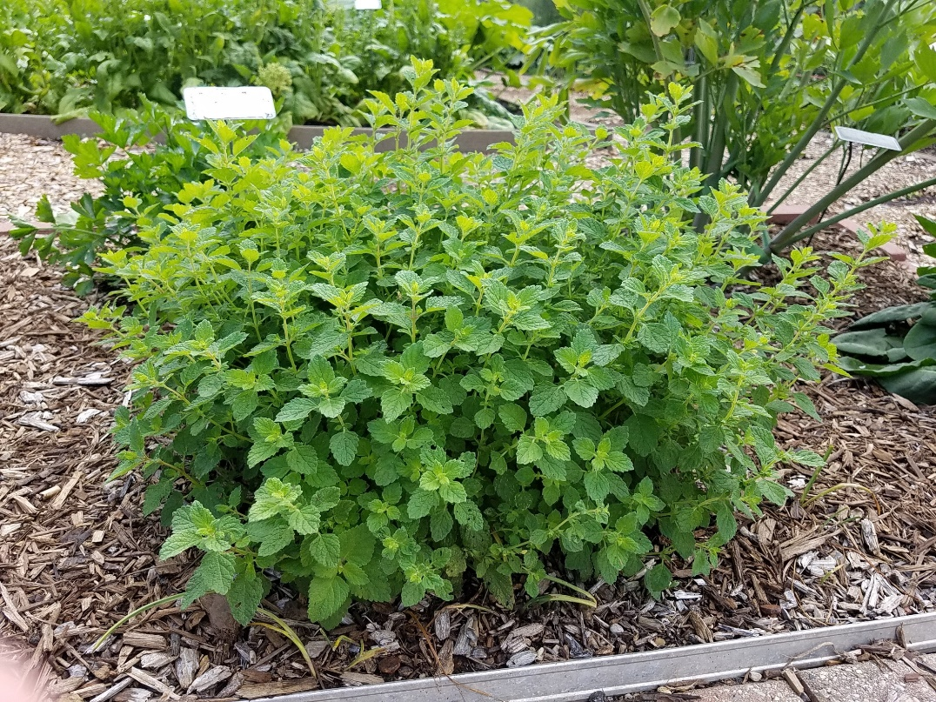
Lemon Balm
Melissa officinalis
Perennial
2’ tall
Food dishes- fresh leaves
Pollinators- flowers
Notes:
Lemon balm is a perennial plant that grows 2 feet tall.
It is a member of the mint family, but its spread is easier to control. Another easy to divide plant.
The nectar producing white to pale yellow flowers are attractive to bumblebees and honeybees.
Prune plants back after flowering.
Fresh leaves add a lemony flavor to teas, fruit salads, soups, and sauces.
Give plants proper spacing to minimize powder mildew.

Slide 17
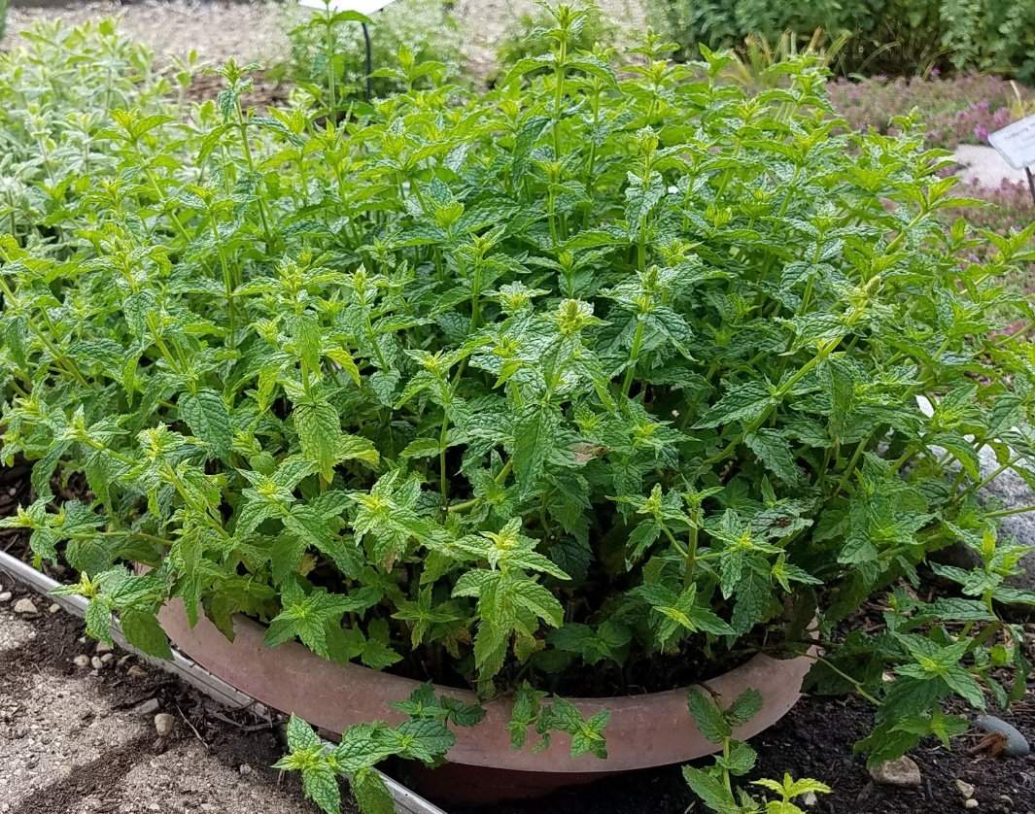
Mint
Mentha sp.
Perennial
Spreads
1.5 to 2’ tall
Food dishes- fresh leaves
Pollinators- flowers
Notes:
Mint is perennial herb that grows 18 to 24 inches tall.
Mint makes a great groundcover as it is an aggressive spreader.
Grow mint in containers or give it space to spread.
Mint comes in a range of flavors including peppermint, spearmint, apple mint, chocolate mint, orange mint, and pineapple mint, just to name a few.
Fresh mint can be used to flavor teas, fruits, desserts and garnish. Mint is best used fresh or freeze in ice cubes.
Depending on the type of mint grown, flower colors are purple, pink or white. Cut back plant after blossoms fade
Flowers are visited by bees and hoverflies.

Slide 18
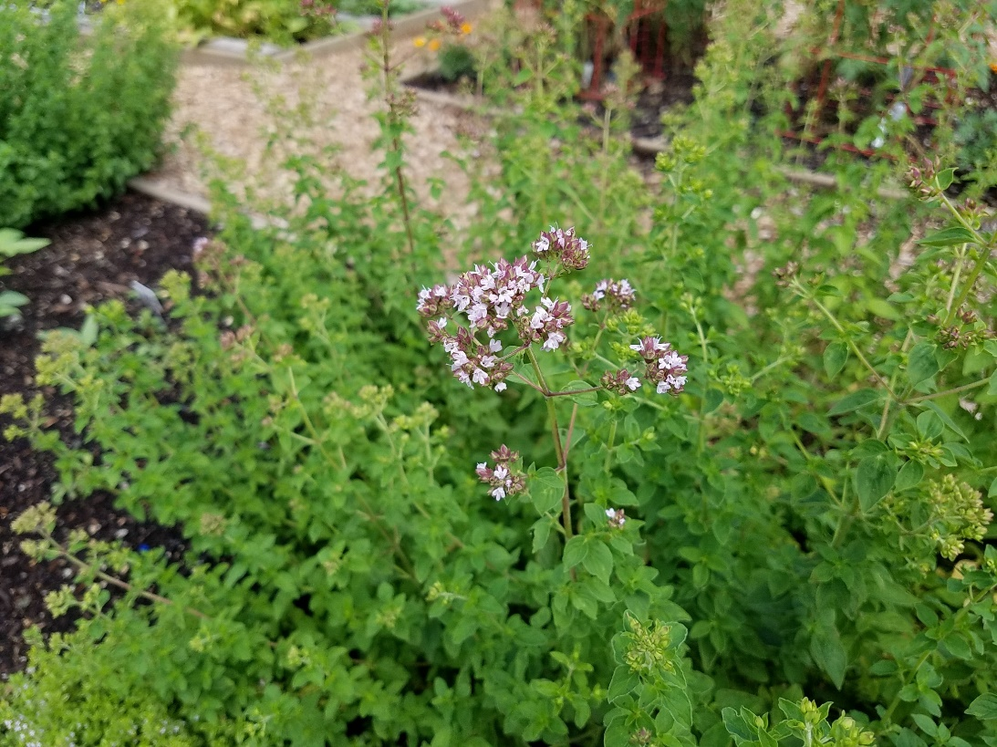
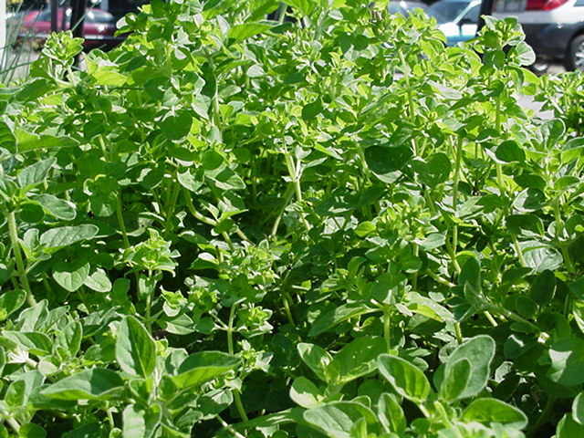
Oregano
Origanum vulgare hirtum
Perennial
1 to 2’ tall
Divisions or plants, not true to seed
Food dishes- leaves
Pollinators- flowers
Notes:
Greek oregano used in cooking dishes. It is best to start this from a reliably sourced plant or transplant.
Oregano has good heat and drought tolerance
To prevent plant from becoming woody, cut back to the ground in the spring.
The nectar producing flowers are a pollinator magnet especially to bees.
Use oregano fresh or dried in pizza sauce, tomato dishes and Italian cooking.
Leaf flavor can vary due to climate and growing conditions.

Slide 19
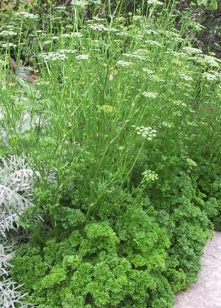
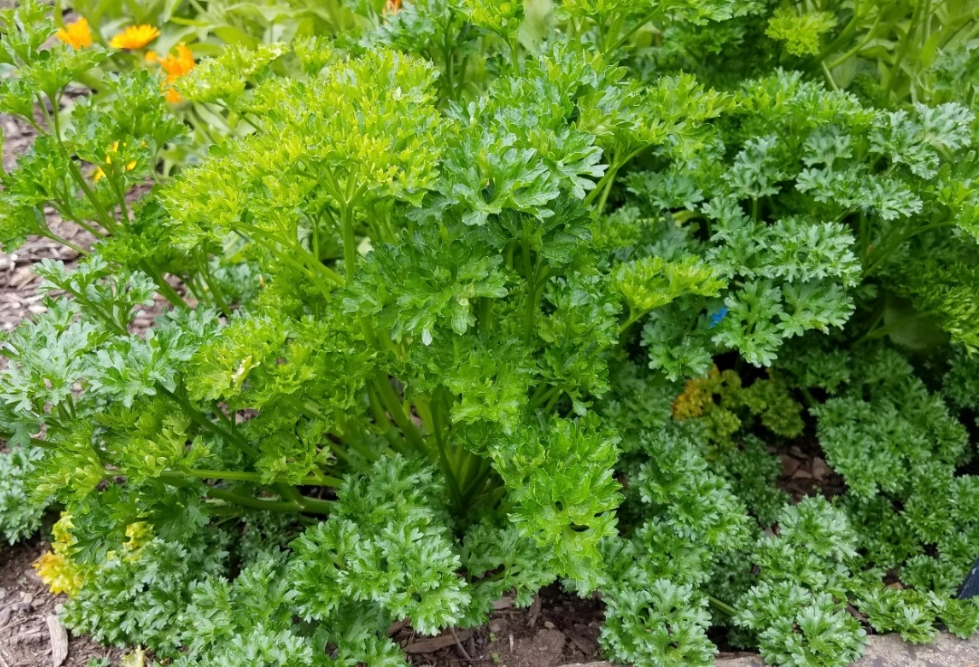
Parsley
Petroselinum crispum
Biennial- flowering 2nd year
Curly and Italian (flatleaf)
18” tall
Food dishes- leaves
Pollinators- leaves and flowers
Notes:
Parsley a biennial plant prefers rich soil.
For culinary purposes plant new plants each year.
Italian parsley is preferred for cooking purposes as it has a stronger flavor than curly parsley.
Plant leaves loose flavor the second year, but leave plants as they will bloom the second year.
Bees, hoverflies and butterflies are attracted to yellowish-green flowers
Swallowtail caterpillars eat the leaves.
Use fresh or dried leaves for flavoring soups, salads, potatoes, fish and much more.

Slide 20
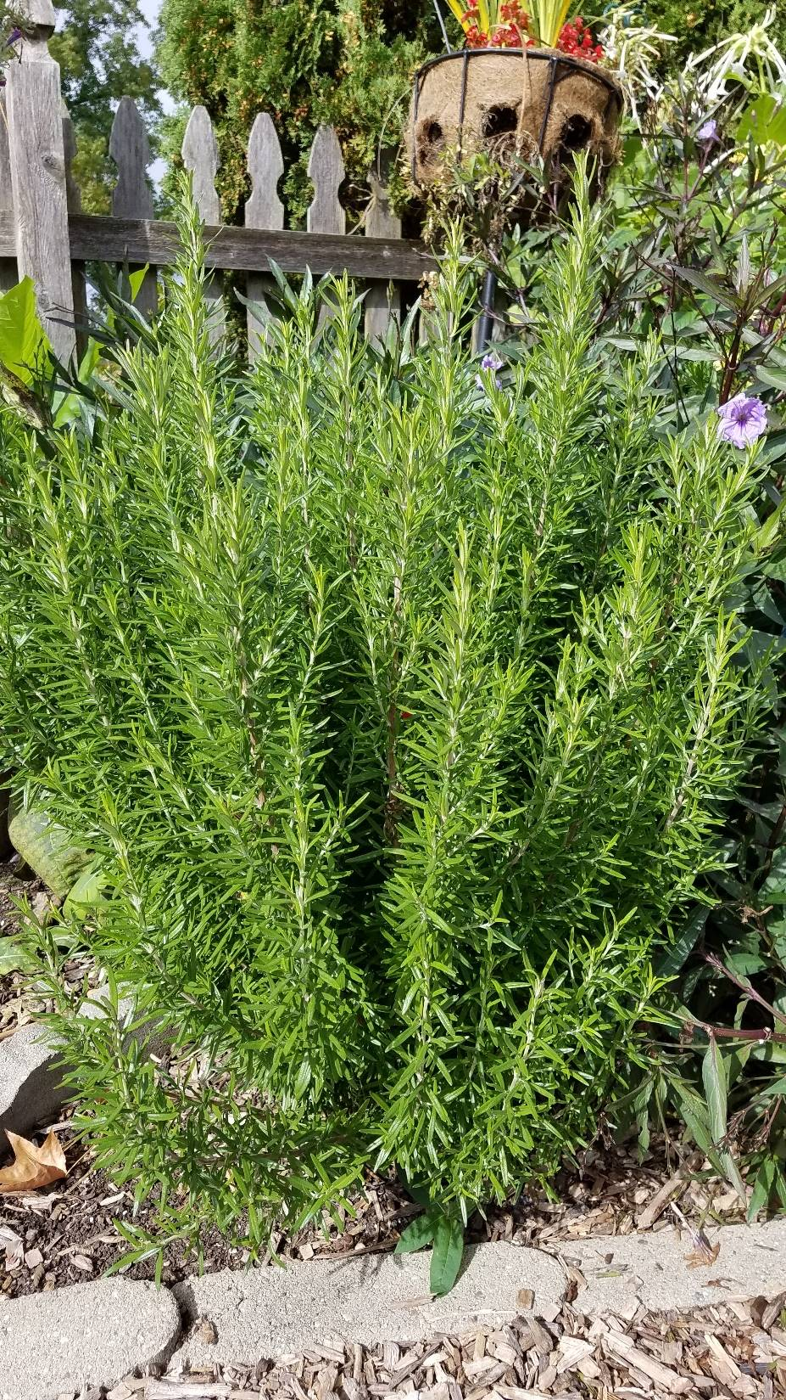
Rosemary
Salvia rosemarinus
Tender perennial
2 to 3’ tall
Food dishes- leaves
Pollinators- flowers
Notes:
Rosemary is a tender perennial in central Illinois.
This evergreen shrub can be grown in a container. To overwinter, place the container in an unheated garage. Throughout the winter, water occasionally. Allow the soil to dry out, but not completely dried out.
Plants will grow best in a full sun locations, in a well-drained soil.
Rosemary has strong scent and strong flavor.
Leaves and flowers can be used in food dishes.
Leaves can be used fresh or dried. Added to herbal vinegars, butter, breads, stews or to meat dishes.
Stiff, strong stems can be used as barbeque skewers.
The blue-purple, nectar producing flowers are attractive to mason bees, bumblebees and honey bees.

Slide 21
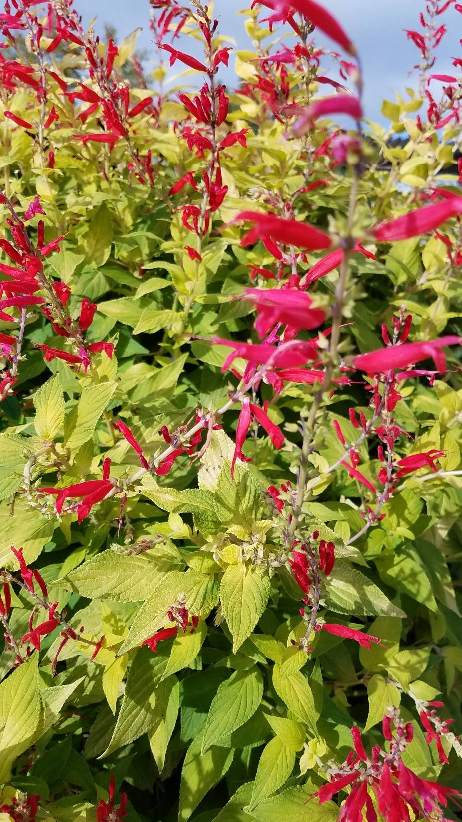
Sage, Pineapple
Salvia elegans
Annual
3’ tall
Food dishes- leaves
Pollinators- flowers
Notes:
Pineapple sage is a tender perennial as it is hardy to zone 8.
To overwinter, cut back and winter indoors.
Pineapple sage grows to 3 feet tall.
The plant has a pineapple, fruity aroma and flavor.
The bright tubular red flowers are attractive to bees, butterflies, hummingbirds,
Fresh leaves can be added to salads.
Flowers can be used as a garnish, in fruits, salads or jelly.
Both leaves and flowers can be used to make iced or hot tea.

Slide 22
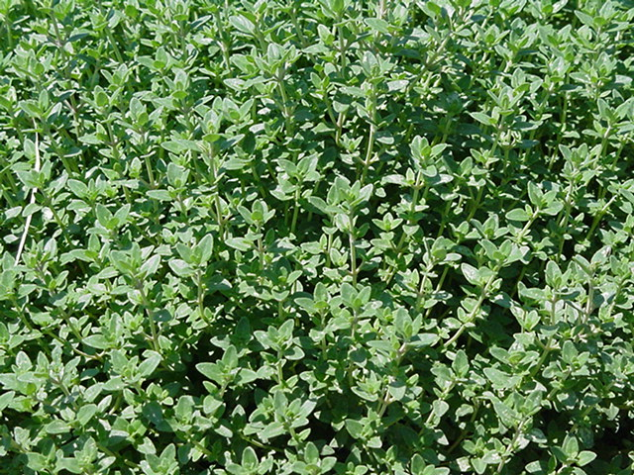
Thyme
Thymus sp
Perennial
Up to 12” tall
Food dishes- leaves
Pollinators- flowers
Notes:
Thyme is a perennial plant.
Depending on the cultivar thyme plants will grow a few inches to 1 foot tall.
Great plant for borders, rock gardens, along pathways
Some common types of thyme include Lemon, English, and French,
Thyme plants will benefit from a hard pruning in the spring. Cut back after plants start to turn green.
Pollinators frequent the pale purple, white or pink flowers. The nectar producing flowers are visited by butterflies, bumblebees, honeybees, mason bees, and leafcutter bees.
Thyme foliage can be used fresh or dried in soups, stews, sauces, chicken, fish, cookies, and sweet breads.

Slide 23
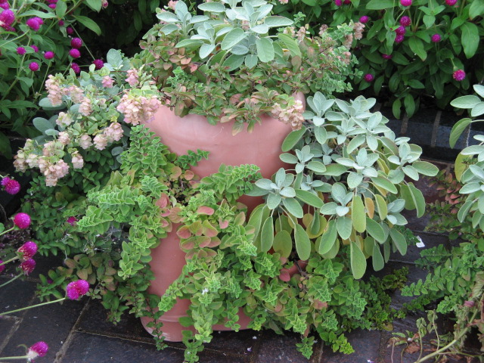
Herbs in the Landscape
Groundcovers
Containers
Mix with flower garden or vegetables
Notes:
Herbs are a great addition to any landscape.
Herbs can be used as groundcovers, grow well in containers and mix well with flowers and vegetables.

Slide 24
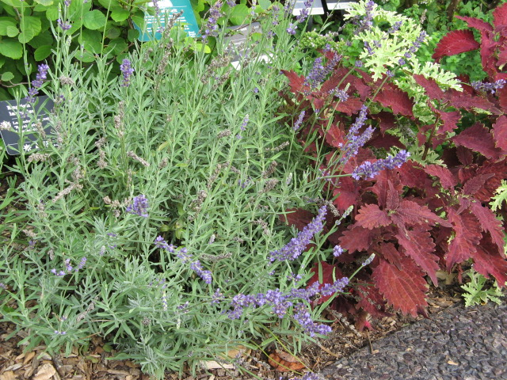
Notes:
This is a border planting of lavender and coleus

Slide 25
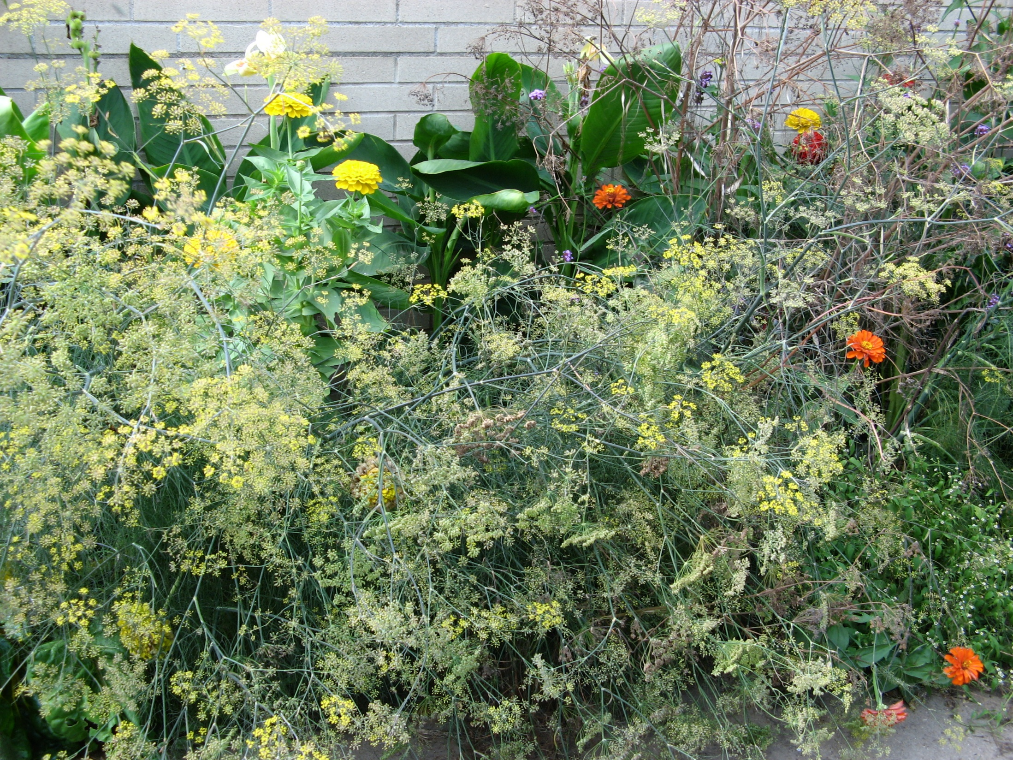
Notes:
This planting is a combination of cannas, zinnias and fennel.
A little overcrowded, but the zinnias and fennel flowers are great for pollinators

Slide 26
Notes:
Using herbs in pathways.
This is thyme growing in between stepping stones

Slide 27
Growing Herbs in Containers
Great for herbs that need good drainage
Container must have adequate drainage, 1/4” holes
Tender perennials
Watering needs
Notes:
Container gardens are an attractive and useful asset to a patio, balcony, doorstep or placed in the garden.
Containers are a great choice for people with little or no garden space.
They are provide an easier way to garden for those with limited mobility.
A container can be almost anything but must have drainage holes. Preferable ¼ inch holes.
Consider growing tender perennial herbs in containers. Then they can be overwintered in a garage.
During the hot, dry summer be sure to check soil moisture daily. Apply water until it comes out of the drainage holes. Avoid getting water on the leaves as this can encourage development of foliar diseases.

Slide 28
Container Combinations
Sharing the same root and growing space
Plants in the same container must have the same growing needs
Growing media should be lightweight, well-aerated, fast draining yet retain moisture
Notes:
Success of a container garden depends on several factors:
Proper site location for the herb plants, prefer full sun.
Container is the appropriate size for the number and mature size of plants. You want the planting to look full, but avoid overcrowding plants.
Also be sure to put plants in a container that have the same growing needs.
Use a quality sterile lightweight potting media in containers. Herbs need well-drained soil and they do not like wet feet.
Group plants in containers based on growing needs

Slide 29
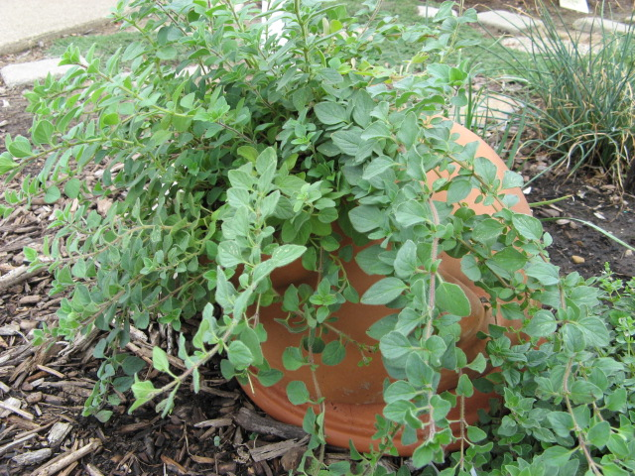
Slide title
Point 1
Point 2
Point 3
Point 4
Notes:
Greek oregano growing in a terra cotta pot.

Slide 30
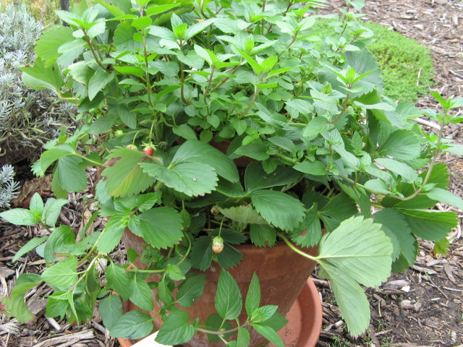
Notes:
Chocolate mint and strawberry plant growing in a terra cotta pot.

Slide 31
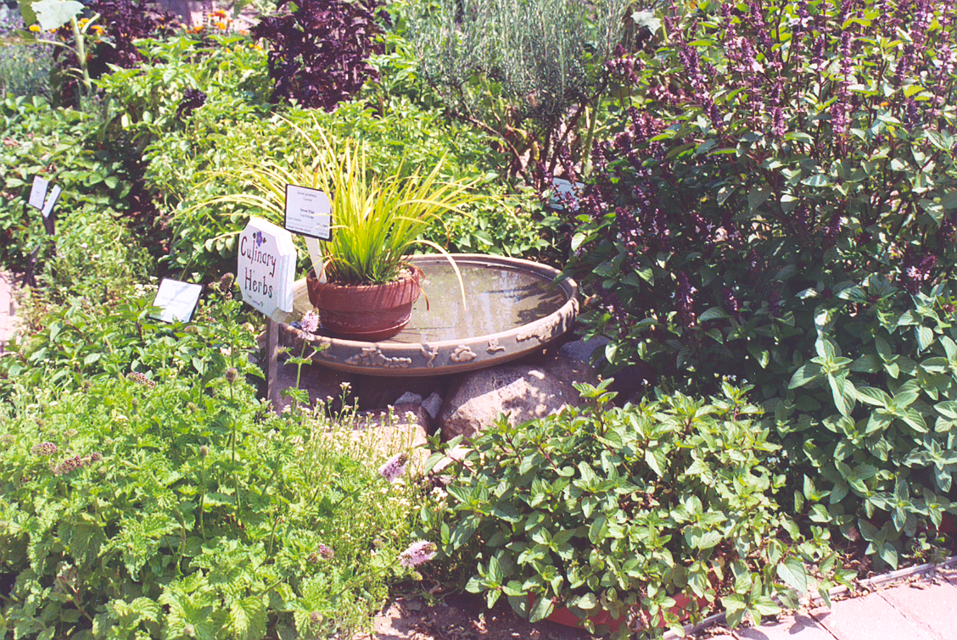
Notes:
In addition to plants, consider including features in your garden. For example, this shallow container provides water for the birds. Be sure to replace water at least once a week.
For visiting pollinators such as butterflies, place coarse sand in a shallow dish such as a bird bath. Add water to moisten the sand. Butterflies congregate in puddles, drinking water and extracting minerals from damp puddles
Container with sloping slides

Slide 32
Herb Garden Tips
For the benefit of pollinators, leave plant residue
Leave some soil uncovered
Dead wood for nesting
Mud and water for moisture
Notes:
Inviting pollinators to your herb garden can be a rewarding experience.
For the benefit of pollinating insects include a few more features in your herb garden.
Leave a small pile of dead wood for nesting.
A shallow source of water, or mud and water.
Leave some soil uncovered. This area can be used by ground nesting bees.
In the fall leave plant residue in place for overwintering insects.

Slide 33
Contact Information
Jennifer Fishburn
Extension Educator, Horticulture
University of Illinois Extension Logan/Menard/Sangamon Unit 700 S. Airport Drive Springfield, IL 62707 Phone: 217-782-4617 FAX: 217-524-6662 fishburn@illinois.edu
Notes:
Here is my contact information.
If you have gardening questions, please contact your local extension office.

Slide 34
University of Illinois ~ U.S. Department of Agriculture ~ Local Extension Councils Cooperating University of Illinois Extension provides equal opportunities in programs and employment.
If you need a reasonable accommodation to participate in any program, please contact the county Extension Office. Issued in furtherance of Cooperative Extension work, Acts of May 8 and June 30, 1914, in cooperation with the US Department of Agriculture by the Director, Cooperative Extension Service, and University of Illinois.
© Copyright 2018 University of Illinois Board of Trustees

