Slide 1
Marketing Hemp “ we grew it……now what?”

Slide 5
Overview

Slide 6
The Hemp Market

Slide 8
U.S. Production Estimates

Slide 9
Demand?

Slide 10
Increased Demand…..

Slide 12
Uses for Hemp

Slide 13
Three End Markets for I-Hemp

Slide 14
Hemp Uses

Slide 15
Hemp Uses

Slide 16
Hemp Uses

Slide 17
Hemp Uses

Slide 20
Market Potential

Slide 22
Seed and Grain Marketing

Slide 23
Fiber Marketing

Slide 24
CBD Marketing

Slide 26
Understand Risks

Slide 30
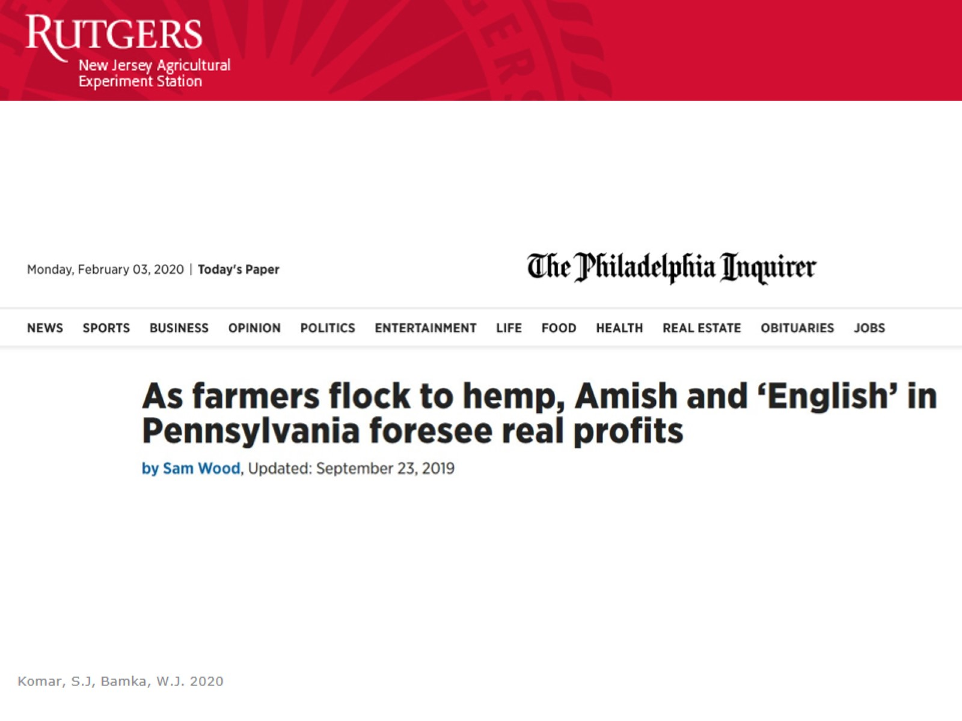

Slide 31
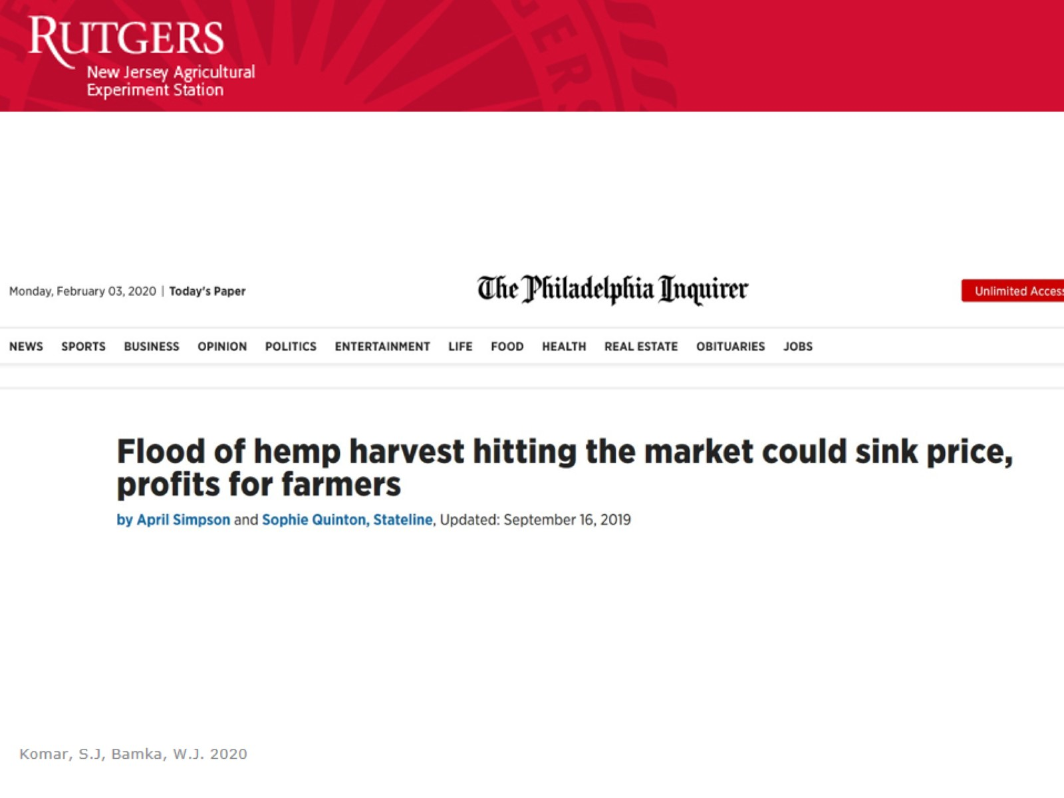

Slide 32
We are Not Alone

Slide 33
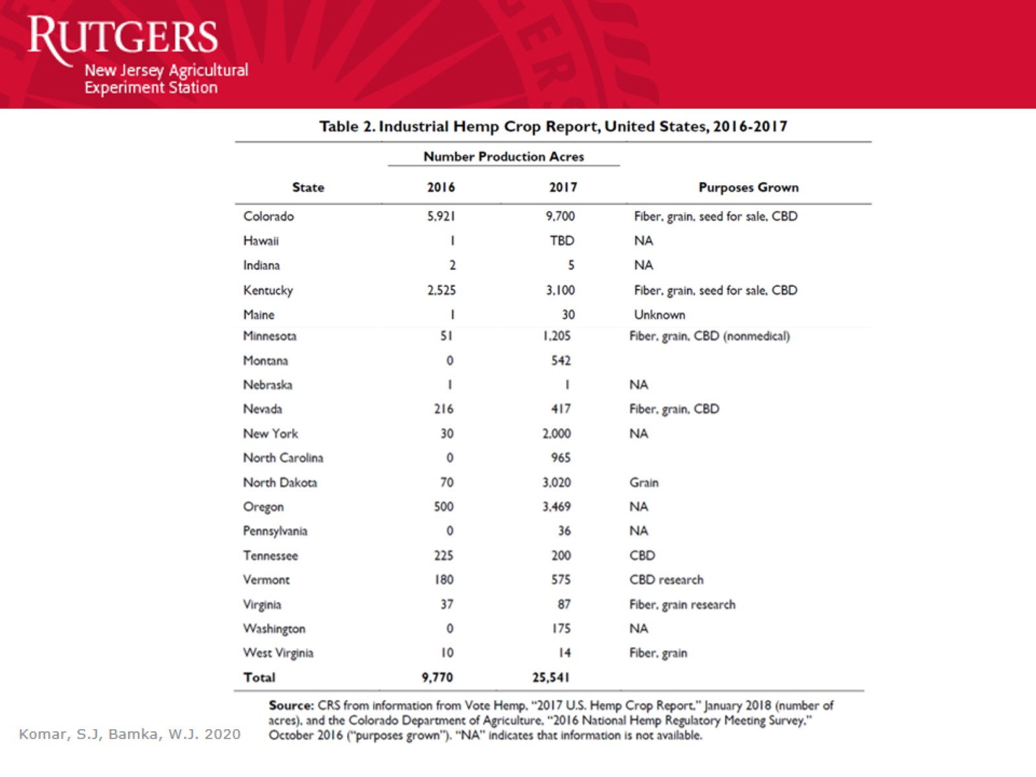

Slide 37
Conclusions

