Slide 1
Addressing Farm Stress and Mental Health Concerns
Emily Wilmes
Local Extension Educator, Livestock
Director, Rural Stress Task Force
Sustainable Farming Association Annual Conference
February 8, 2020
Notes:
Full disclosure: I am not a mental health provider/clinician. I am here today as an advocate for mental health and for farmers.

Slide 2
Some notes on well-being, mental health, & mental illness
Notes:
It’s important to start with some clarification on what we mean when we say well-being, mental health, and mental illness. Please note I will use the terms well-being and wellness interchangeably.

Slide 3
Notes:
3 legged stool of well-being: the legs are physical, mental, emotional well-being. The seat represents your overall well-being and ability to support your “load” (work, family, other responsibilities). If you ignore one leg, you may still be upright, but can’t support your full load confortably.
Mental vs. emotional health: A good way to think about mental and emotional health is like a tag team. Mental health refers to your ability to process information. Emotional health, on the other hand, refers to your ability to express feelings which are based upon the information you have processed. So, if your cognitive function is hindered by depression or anxiety, for example, you may struggle with accurately identifying a situation. This can then trigger inappropriate responses because those responses are based upon inaccurate thoughts.

Slide 4
Mental Health Narrative shifts
Old Narrative
Mental illness is exclusively a brain disorder
“Mental heath” is the same as “mental illness”
The only treatment is medical treatment
Mental illness represents a character flaw
Mental health is the same as “happiness”
Mental well-being is a choice
Mental well-being is optional
Credit: Cari Michaels, UMN Extension
Notes:
The following three slides were prepared with the help of Cari Michaels, Extension Educator with the Children, Youth, and Family Consortium. This first slide represents the old narrative that surrounded mental health and mental illness. As you can see, a lot of these points are tied to the stigma we see today.

Slide 5
Mental Health Narrative shifts
New Narrative
Brains are built through experience
Fear, trauma, chronic stress negatively impact MH
Where we live, learn, work, play impacts MH
Resilience is not enough in the face of oppression
Physical health and mental health are intertwined
Culture shapes definitions and understanding of MH
Positive relationships are central to MH
MH happens in and through community
MH requires a sense of purpose and power
Everyone has role and responsibility
Credit: Cari Michaels, UMN Extension
Notes:
As we have learned more about our brains, the narrative of mental health and mental illness has shifted. Our brains are built over a lifetime of experiences, and many, many factors can impact our mental health, both positively and negatively. The interconnectedness of mental health to our areas of health ties back to the three-legged stool example I shared at the beginning.

Slide 6
Optimal Mental Health
Quadrant 4
Good mental health
Mental illness Flourishing and Mental Illness
Quadrant 1
Good mental health
No mental illness
Flourishing
Severe
Mental Illness
No
Mental Illness
Quadrant 3
Severe stress on mental health Mental illness
Languishing and Mental Illness
Quadrant 2
Severe stress on mental health
No mental illness
Languishing
Poor Mental Health
Keyes, C. (2014). Mental health as a complete state: How the solutogenic perspectives completes the picture. In G.F. Bauer & O. Hammig (Eds.), Bridging occupational, organizational and public health: A transdisciplinary approach. New York: Springer Publishing.
Notes:
The Dual Continuum Model of Mental Health presents a way for us to look at mental health within this changing narrative.
We used to think of mental health and mental illness as the same thing, and then almost as opposites. We now separate them and realize that they are on 2 different spectra, but they intersect.
[Explain spectra and quadrants.]
This reminds us that a person can experience significant struggle without illness (quadrant 2) OR good mental health with illness (quadrant 4).

Slide 7
The nature of farm stress
Notes:
Now we’ll take a brief look at the nature of farmer stress and what impacts it

Slide 8
Stressors impacting farmers
High interest rates
Large debt loads
Commodity prices
Gov’t regulations
Weather/disaster
Long work hours
Farm transition
Livestock illness
Crop yield
Machinery breakdown
Illness/injury
Relationships
Barriers to help
Notes:
Many of these factors compound, the added pressure of another stressor can be the proverbial “straw that broke the camel’s back.” A lot of these stressors are outside of the farmer’s control which can increase the stress further.
[Include stories where applicable: barn roof collapses, injuries/fatalities, etc.]
We can look at all of these stressors and see many of them in our own lives, our neighbors’ lives, and other farmers we know or work with. However, there is another piece that always seems to be missing. Even with all of these stressors, farmers still try at all costs to persevere; why is that?

Slide 9
The agrarian imperative
“To farmers, ‘the land is everything.’ Ownership of a family farm is the triumphant result of the struggles of multiple generations. Losing the family farm is the ultimate loss – bringing shame to the generation that has let down their forbearers and dashing the hopes for successors.”
Rosmann, 2003
Notes:
That ambiguous “thing” we can’t put our finger on is what Dr. Michael Rosmann calls the Agrarian Imperative. Dr. Rosmann is a farmer and psychologist from Iowa.
[Read quote in full, pause for audience to think about words.]
In 2010, Dr. Rosmann followed up on this work and cast some additional light on the impacts of the Agrarian Imperative. (next slide)

Slide 10
The Agrarian Imperative
“…impels farmers to hang onto their land at all costs. The agrarian imperative instills farmers to work incredibly hard, to endure unusual pain and hardship, and to take uncommon risks.” (Rosmann, 2010)
Notes:
[Read quote in full, encourage discussion on how this impacts both farmers and the people that work with farmers.]

Slide 11
A brief on the farm economy
Notes:
The farm economy gets a lot of attention as being a major stressor to farmers, and there were several economics-related factors on the stressors slide; let’s take a quick look at what’s going on. These slides were prepared with the help of Megan Roberts, Extension Educator in Ag Business Management.

Slide 12
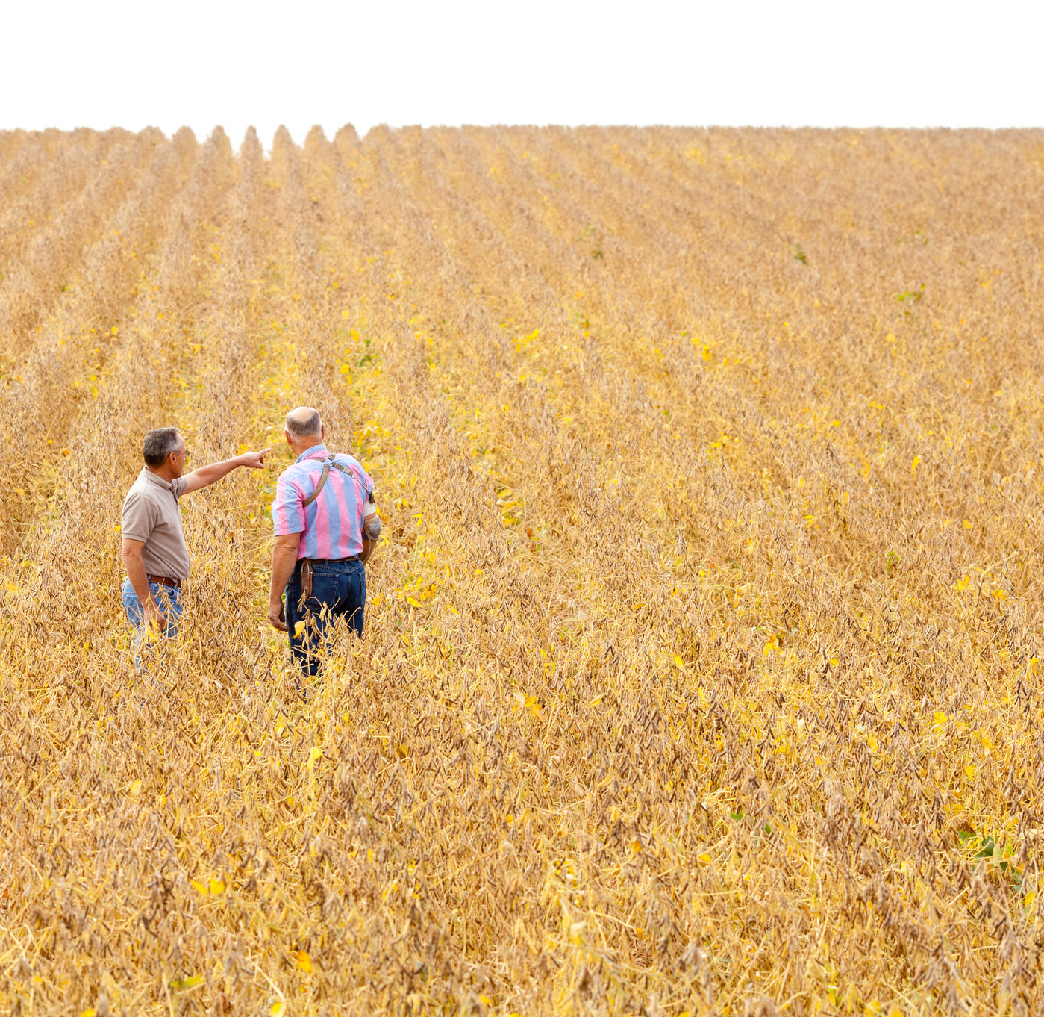
Rural Stress and Farming
For the sixth year in a row, low commodity prices and low profitability. Median net farm income was $26,055.
(University of Minnesota Extension FinBin and the Minnesota State College and University System, 2019)
Credit: Megan Roberts, UMN Extension
Notes:
Net farm income (gross income minus all production expenses) has been down for the past six years (2012 was our last substantive profit). Median net farm income across the state was $26,055 which is approximately the US poverty rate for a family of four.

Slide 13
Rural Stress and Farming
In a recent survey, 90% of agricultural respondents experienced occupational stress.
(Roberts & Mold, 2019)
90%
Credit: Megan Roberts, UMN Extension
Notes:
In a survey of specifically women in agriculture, 90 percent of respondents said agricultural work was a source of their stress. This underscores the issue of agriculture as a serious and persistent occupational stressor.

Slide 14
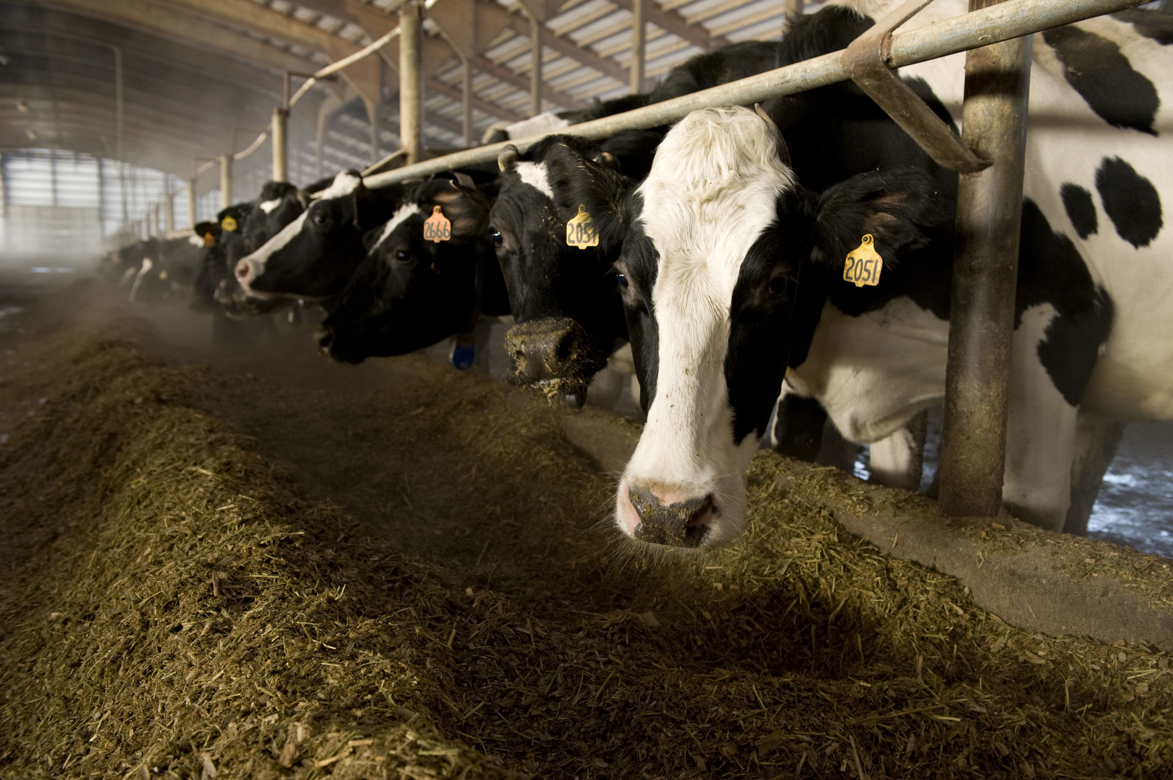
8% decline
of herds
Minnesota Department of Agriculture, 2019
Credit: Megan Roberts, UMN Extension
Notes:
We’ve lost a significant number of herds. Data from the MDA showed from July 2018 to July 2019, there was an 8% decline in Minnesota licensed dairy farms. When those cows are purchased by other farms, the rural main street implications of losing a dairy farm are relatively moderate (according to preliminary data by Bill Lazarous and Brigid Tuck). However there are now some counties that are losing cow numbers, which begins to hurt auxiliary businesses and small towns. From a non-financial standpoint it is difficult to measure the emotional stress of selling a dairy herd.

Slide 15
Rural Stress and Farming
Although profits are low, farmers must still buy products and services, employ workers, and pay bills; each farm generates substantial business activity. When farms are hurting, it impacts other parts of our rural economy.
(University of Minnesota Extension FinBin and the Minnesota State College and University System, 2019).
$
800k
Credit: Megan Roberts, UMN Extension
Notes:
The economic impact of a farmer getting out of farming will not necessarily be equal to the $800k they spend on average in their local community. Initial research is just beginning on the overall rural economic impacts of farm losses. It is likely that loses of livestock farms will have greater economic impacts than crop farm losses.

Slide 16
Identifying stress
Notes:
Now that we have spent some time becoming familiar with the nature of and causes of stress on the farm, let’s focus in on stress itself. Stress can manifest in many different ways; we likely know our own symptoms when we are under stress. Here are some signs to look for in others.

Slide 17
Recognize signs of stress
Physical | Emotional | Behavioral | Cognitive | Self-worth
Headaches Ulcers Backaches Eating problems Sleeping problems Frequent sickness Exhaustion Poor hygiene | Sadness Depression Bitterness Anger Anxiety Loss of spirit Loss of sense of humor | Irritability Acting out Passive-aggressive behavior Anger Increased drinking Taking drugs Isolation Violence | Memory loss Lack of concentration Difficulty with simple decisions | Feel like a failure Can’t do anything right Not being able to fix things
Notes:
[Take some time to go through the chart and review some signs in each category]
Stress can manifest in many different ways. It’s normal to have bad days every now and again, it’s when bad days become bad weeks and what we or others are experiencing becomes chronic stress…

Slide 18
Signs of prolonged stress
Previously identified signs have not improved or have multiplied
Change in routine
Appearance declines
Increase in illness
Increase in farm accidents
Family members show signs of stress
Notes:
As stress builds, previous signs may worsen or new ones may show up. Changes in routine like not showing up for church or neglecting volunteer responsibilities are common as well. The appearance of the individual, farm, or home may start to decline. As stress takes its toll on mental, emotional, and physical health, an increase in illness and farm accidents can be seen. Lastly, family members starting to show signs of stress is a major indicator of chronic stress in an individual.

Slide 19
Communicating with farmers under stress
Notes:
[You can take out “farmers” and add whatever word, depending on your audience]
A common question that comes up is, “how do I talk to someone who is stressed? I don’t want to make things any worse for them or say the wrong thing!”
There is no right answer or cookie-cutter response to this. Each individual is different, but there are some general tips you can follow to make you more comfortable with these conversations.

Slide 20
Preparing for the conversation
Ask yourself some questions
Get yourself in the proper mindset
Do you have empathy?
What is your role?
The goal: open, honest dialogue
Notes:
Questions to ask yourself:
Why are you going?
Who are you meeting?
What might you encounter?
What can you help them with?
Do you have resources?
[If you have time, the empathy vs. sympathy video (hyperlinked) is AWESOME and takes less than 3 minutes]
What is your role? I understand that in your professional duties, you may be limited in what you can do or how much support you can provide someone. Have a clear understanding of what you are willing and able to do, and have resources ready for people who may need assistance beyond what you can offer.

Slide 21
Be Prepared to listen!
Practice active listening
Ask—Probe—Attend
Restate—Paraphrase—Summarize—Reframe
Notes:
Active listening is great practice for any conversation you may have, and is especially effective when talking to someone who may need to vent. The active listening continuum is a great tool. It can seem overwhelming, but know it takes PRACTICE. The main goal is: listen to UNDERSTAND, versus listening to just RESPOND.
Asking is often when a conversation starts, when someone is invited to say something through voice or another communication mode.
Probing or guessing is a way to gently gather more information to help one understand.
Attending means paying attention, noticing the conventional or unconventional signals, linguistic or nonlinguistic expressions, and spoken or other communication modes.
Restating is simply repeating what one thinks was said.
Paraphrasing is using one’s own words to restate what the speaker said.
Summarizing is paraphrasing and adding the emotion that seemed to be expressed by the speaker.
Reframing is to state, in neutral or unbiased terms, what one thinks the speaker really wants.

Slide 22
Reach out if you are concerned
It can be uncomfortable, but reaching out is critical
Individuals experiencing stress typically feel isolated
Acknowledgment of someone’s suffering can offer them relief
Notes:
It can be difficult to know how to reach out to someone you’re worried about. However, no matter how difficult it may seem, it’s crucial that you do it. Many people under stress feel completely alone and like there’s no help. Even one comment or one question could make a huge difference, and could help a person see that there is help available. Many people under stress or experiencing a mental health crisis report feeling alone/like no one understands what they are going through. Simply taking the time to tell them you recognize their struggle can offer relief and open the door to them getting help.

Slide 23
Conversation Starters
I've been worried about you. Can we talk about what you are experiencing? If not, who are you comfortable talking to?
I am someone who cares and wants to listen. What do you want me to know about how you are feeling?
It seems like you are going through a difficult time. How can I help you to find help?
Notes:
Because it can be a delicate subject, you may find it’s best to use one of the following conversation starters from mentalhealth.gov. They are a great starting point as they are a simple comment followed by a question. They aren’t accusatory or confrontational, which could make a person withdraw more. They allow you to express your concern and offer help without making the person feel pressured.

Slide 24
The suicide question
Notes:
We are now going to briefly discuss suicide. It is a difficult subject as many people have been personally impacted by it. If at any time you feel the need to leave the room, please do so and someone will come check on you.
It can be hard to talk about suicide, but you may find yourself in a situation where you are concerned that a person may be suicidal. Here are some tips on asking that potentially life-saving question.

Slide 25
Suicide Warning Signs
Direct or indirect verbal clues
“I’m going to kill myself.”
“You’ll need to look after your mother when I’m gone.”
Behavioral clues
Previous attempt
Giving away possessions
Situational clues
Change in status
Death of family member/friend
Notes:
Take all signs SERIOUSLY, even if it seems like someone is being sarcastic, it’s better to check and make sure than assume.
A change in status can include a move, a divorce, selling land or livestock, a child getting expelled, etc.

Slide 26
Asking the question
If in doubt, don’t wait, ask the question
If the person is reluctant, be persistent
Less direct: “Have you been unhappy lately? So unhappy that you’ve been thinking about ending your life?”
Direct: “Are you thinking about killing yourself?”
Notes:
DO NOT WAIT:
Among people who nearly died in a suicide attempt, 24% said less that 5 minutes elapsed between deciding on suicide and making the attempt
Another 47% said under an hour
Only 13% said one day or more
You may have to ask again, if you don’t believe their answer. Ask gently and with empathy. Tell them you care and want to help them get help.
How NOT to ask: “You aren’t suicidal, are you?” “You wouldn’t do anything stupid, would you?”

Slide 27
What if they say yes?
Do not leave a suicidal person alone
Contact a family member, friend, healthcare provider, crisis team, or 911
1-800-273-TALK (8255)
Text “MN” to 741741
County Crisis Response Team
Notes:
Asking the question is scary enough, but then there’s the, “oh crap” moment. If a person tells you they are suicidal, they should not be left alone. The National Suicide Prevention Lifeline and the Crisis Text line are available not just for suicidal individuals but for those assisting them as well.
You can find the number of your local crisis team here: https://mn.gov/dhs/people-we-serve/people-with-disabilities/health-care/adult-mental-health/resources/crisis-contacts.jsp
[Encourage participants to add numbers to their cell phones]

Slide 28
Adjust your own oxygen mask
Notes:
As we think about all of these things, we need to remember to adjust our own oxygen mask.

Slide 29
Take care of yourself
You can’t pour from an empty cup
Practice intentional well-being
Notes:
It can be easy to want to rush in and help others, but we need to remember to take care of ourselves first. You can’t pour from an empty cup.
We can’t give 100% of ourselves if we aren’t at 100%
Find ways to take care of your physical, mental, and emotional well-being.

Slide 30
Strategies to promote wellness
Deep breathing
Meditation/Reflection
Positive self-talk
Physical Activity
Hobbies
Connect with people in your social network
Speaking with a mental health professional
Notes:
Think back to the three-legged stool: no single strategy is going to work for every situation. Find several strategies that you can keep in your “toolbox” to use.
Discuss each strategy and give examples.
Box breathing: inhale for 4 seconds, hold for 4 seconds, exhale for 4 seconds, rest for 4 seconds. Repeat 2-3 times.
Meditation/Reflection: apps, videos on YouTube, journaling, Gratitude Challenge, Five Good Things
Positive self-talk: if you wouldn’t speak to a friend this way, you shouldn’t speak to yourself this way
Physical activity: something OUTSIDE OF WORK that is strictly for yourself: exercise, walking the dog, playing with the kids/grandkids
Hobbies: something that allows you to enjoy other interests! Sports, hunting, fishing, cooking, reading, crafting
Connecting with our social network will reduce isolation and positively impacts our emotional health
Mental health professionals are for EVERYONE; if you are concerned about cost, there are some options for MN farmers

Slide 31
Resources for Farm Stress
Notes:
Review the MDA brochure, Farm & Ranch helpline, Extension Rural Stress webpage, if local partners are there allow them to share about their resources (faith community, county health & human services, etc.)

Slide 32
Resources
z.umn.edu/ruralstress
mnfarmstress.com
Rural Mental Health Specialists
Ted Matthews: 320-266-2390
Monica McConkey: 218-280-7785
MN Farm & Rural Helpline: 833-600-2670
Notes:
[Have MDA brochures available]
The Extension website a webpage full of great resources for coping with stress from all our centers; you can find information about free farm financial counseling, mental health, supporting youth, and family financial management.
The farm stress webpage is from the MN Dept of Ag and features resources from many organizations.
Monica and Ted are available to meet with farmers, there is no cost and no paperwork; they are paid for by the State of Minnesota.
The helpline is available for free, confidential, 24/7 help.

Slide 33
Remember:
It’s okay to not be okay
Bad days happen
You are not alone
It’s okay to ask for help
Notes:
We covered a tough subject today; I hope you are able to take some of what you learned and apply to your life.

Slide 34
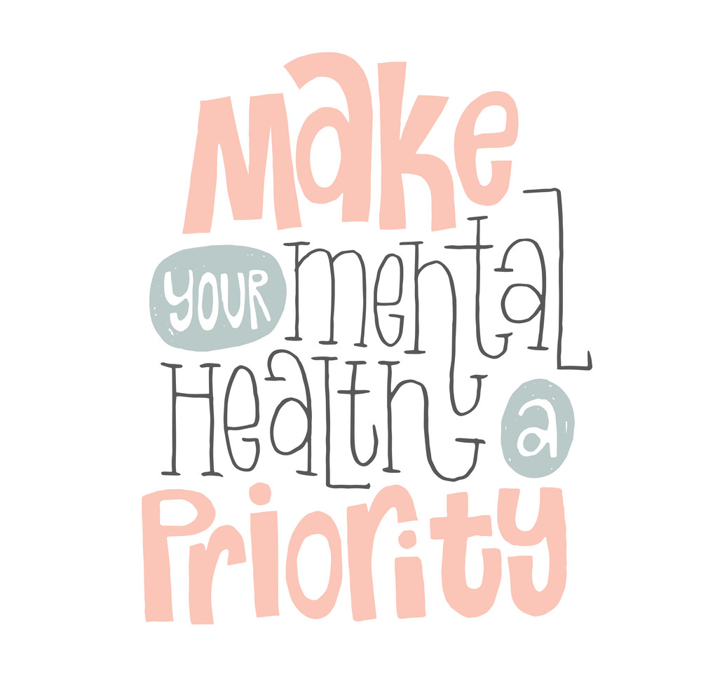
Emily Wilmes
612-756-3977
krek0033@umn.edu
Notes:
I am available to you or anyone that would like to talk.

