Slide 1
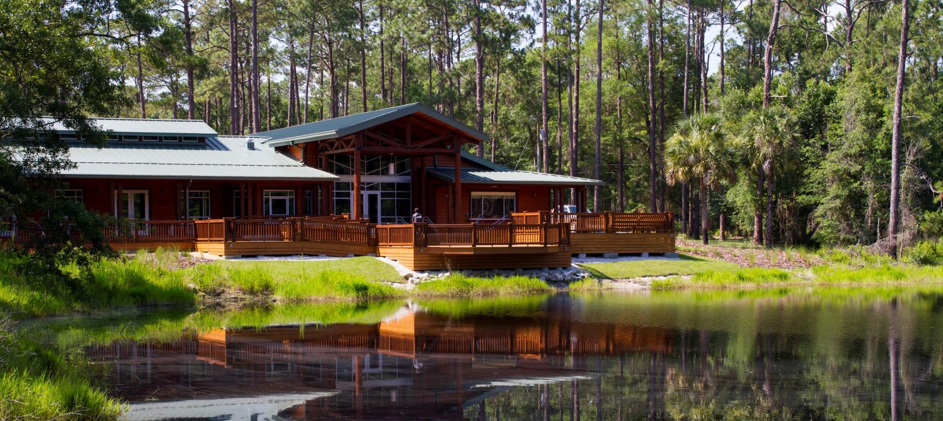
Beyond Installation
Designing with Maintenance in Mind
Dr. Taylor Clem
UF/IFAS Extension Alachua County
Environmental & Community Horticulture Agent II
Master Gardener Coordinator
Notes:
Good afternoon/morning, thank you all for coming. My name is Dr. Taylor Clem and I am the Environmental & Community Horticulture Agent and Master Gardener Volunteer Coordinator with University of Florida’s Institute of Food and Agricultural Sciences (UF/IFAS) Extension in Alachua County, Florida.
This afternoon’s/morning’s program is titled “Beyond Installation: Designing with Maintenance in Mind”
*ATTENTION GRABBER – ENGAGEMENT ACTIVITY*
When you consider the issues associated with landscape maintenance, what do you think about?
*DISCUSS RESPONSES – Are there any trends between participants’ responses that will be important to address that isn’t in the slides?*
Everything you all mentioned is great and there are many trends in your responses. Common landscape issues that you all, others, and myself have noticed with landscape maintenance relates to initial plant selection, changing landscapes, and maintenance requirements.
Properly designing a landscape is critical when we consider reducing water consumption via irrigation, fertilizing the landscape appropriately, and minimizing pesticide use. Whereas, improperly planned and designed landscapes can lead to mismanagement and negative impacts on our environment.

Slide 2
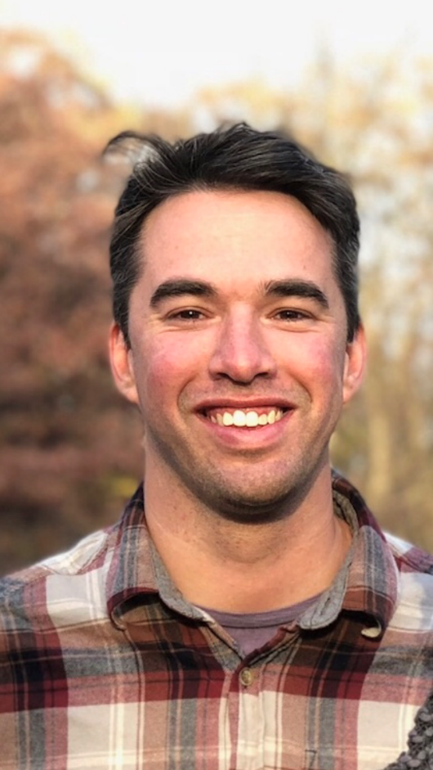
About
Taylor Clem, PhD
UF/IFAS Extension Environmental & Community Horticulture Agent II
Master Gardener Volunteer Coordinator
Education
Two Degrees in Landscape Architecture
University of Kentucky, BSLA
University of Florida, MLA
PhD in Horticulture Sciences
University of Florida
Notes:
Again I would like to thank everyone for attending the program, my name is Dr. Taylor Clem and I am the Environmental & Community Horticulture Agent with UF/IFAS Extension Alachua County.
When I consider problems associated with maintaining landscapes, I put on my “Landscape Designer” hat. I have two degrees in Landscape Architecture, one from University of Kentucky and another from University of Florida (Insert Rival School Joke), so my goal is to always consider the past, present, and future conditions of landscapes. Additionally, my interest in horticulture sciences and planting design always have me thinking about the role of plant material and landscape management.

Slide 3
Introduction
Notes:
*Audience Activity NOTE – Activity to determine who is in the audience. This helps speaker determine if program should focus talking points with designers, commercial landscapers, etc.*
Before we get started, I would like to know how many different backgrounds are in the room. Are some of you designers, interested homeowners, educators, Master Gardener Volunteers, or a landscape professional?
Use your phones to answer the following poll and we can see your responses pop-up on the screen.
*DISCUSS RESULTS*

Slide 4
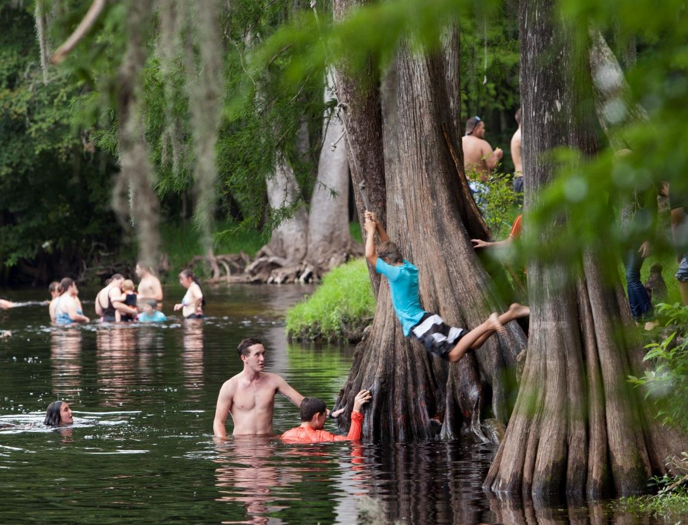
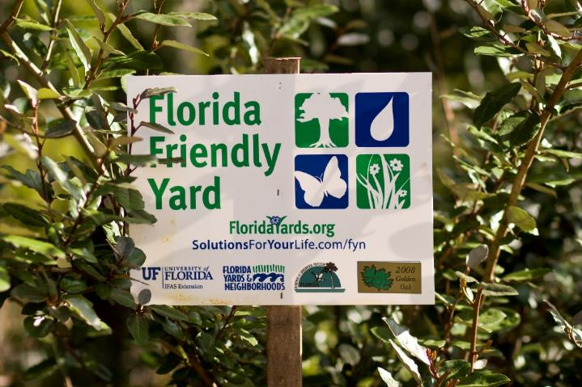
Essential Q
What principles do I need to consider when designing for long-term maintenance that ensures sustainable landscape management?
Photo Courtesy Of: UF/IFAS
Photo Courtesy Of: UF/IFAS
Notes:
Essential Question
At the conclusion of today’s discussion, I would like for you all to be able to comfortably answer this question…”What principles do I need to consider when designing for long-term maintenance that ensures sustainable landscape management?”
By doing so, you’ll be able to design and plan for landscapes that have a higher chance of success over time and minimizes water use, fertilizers, pesticides, and maintenance requirements.
So at the end of our time together we’ll come back to this question to see how we did…

Slide 5
Introduction
What is the purpose of landscape design?
Social, Economic, Environmental Benefits?
Self-, Others-, Environment?
Photo Courtesy Of: UF/IFAS
Photo Courtesy Of: UF/IFAS
Notes:
What is the purpose of landscape design? Is it for social, economic, and/or environmental benefits? Who are you designing for? Is it yourself, others, or for the environment?
DISCUSSION: Who would like to share? (Keep to short 2-3 Minute Discussion)
There are a near infinite number of reasons for why and who we design our landscapes for. I always like describe landscape design, or design in general, as “The combination of art and science to implement creative solutions.” All designs are a series of problem-solving activities to help achieve a certain outcome.
Here, in Florida, we are incredibly concerned with our water resources. To help protect our resources we follow the principles of the Florida-Friendly Landscaping™ Program, which is Florida’s sustainable landscape program. Its nine principles directly link landscape design and management to protecting the state’s critical water resources.
Regarding sustainable landscapes, a successful design considers maintenance. That’s why I have created the following model to help design with maintenance in mind…

Slide 6
A Maintenance Model
Selection
Maintenance
Site
Source
Social Capital
Time
Notes:
Current thought regarding landscape maintenance includes these three aspects: plant site, plant selection, and plant source. Although those three points are incredibly important, it doesn’t paint a complete picture.
*Click for Animation*
Commonly our designed landscapes do not consider time and social capital. Time relates to a landscape’s changes over time. Social Capital relates to those performing the maintenance and their capacity to address certain landscape maintenance needs.
I want us to five deeper into these three areas and show their relationship and role in designing with maintenance.
*Click for Animation*
The Three “S”s: site, selection, & source. Successful landscape depend on proper plant material selection for any landscape design.
*Click for Animation*
Time. Our landscapes are continually changing, sometime very quickly and sometimes very slowly. Understanding the role of time and the changing landscape allows us to think about the future landscape.
*Click for Animation*
Social Capital. Landscapes require maintenance. Social capital relates to the individuals performing the landscape maintenance, which includes the level of maintenance and type of maintenance they can feasibly perform.

Slide 7
Site, Source, & Selection
SITE
SELECTION
SOURCE
Photo Courtesy Of: UF/IFAS
Notes:
First I would like use to look at the three “S”s: Site, Selection, and Source. These three variables are commonly discussed in landscape design, but it is very important to consider their role in landscape maintenance. For example, plants that are properly used within the landscape significantly reduces water, fertilizer requirements, and overall maintenance requirements.

Slide 8
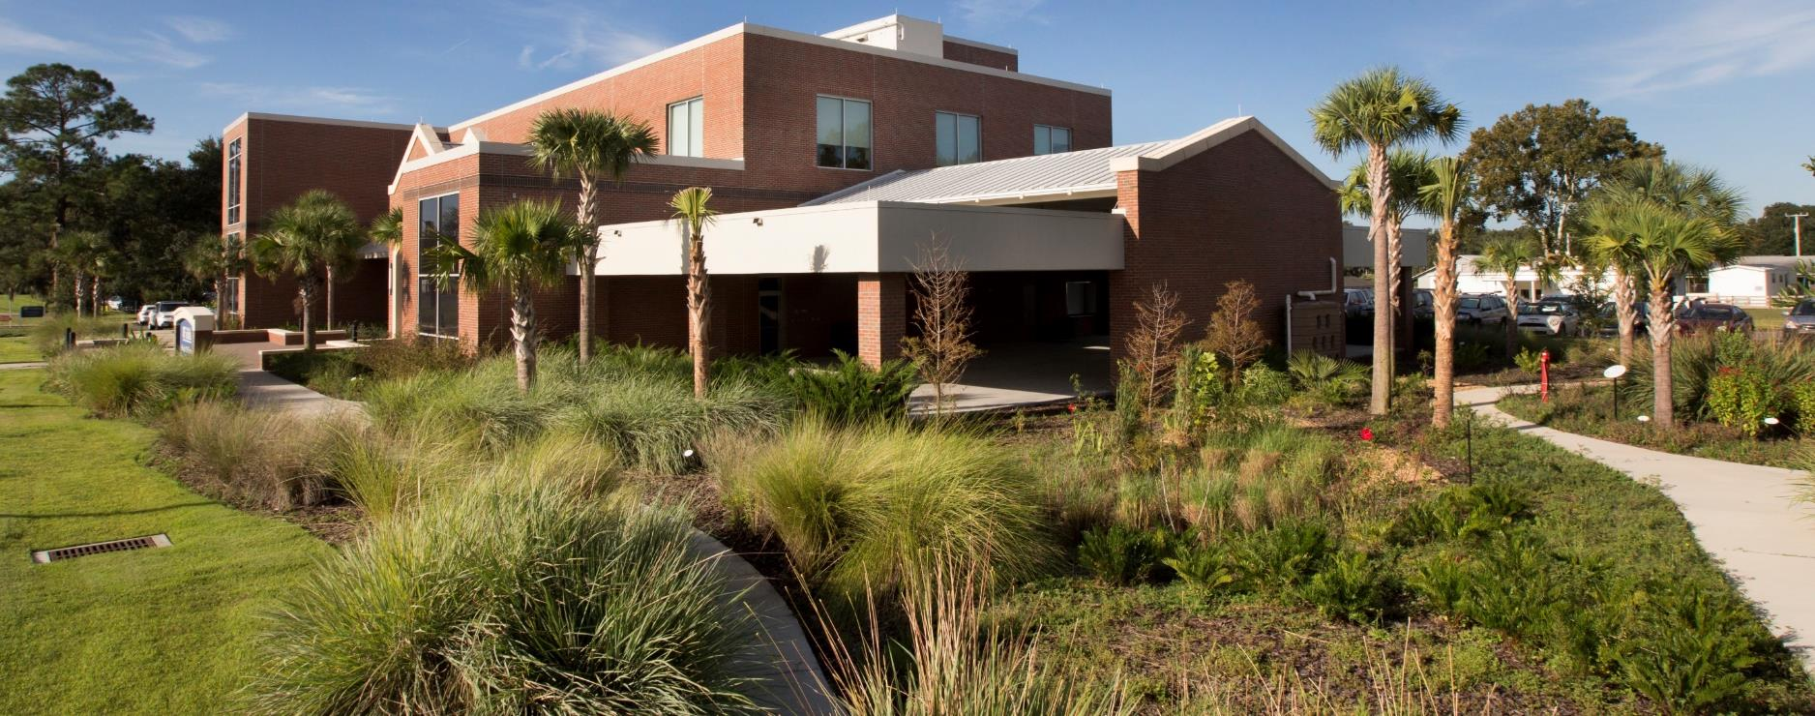
Site, Source, & Selection
SITE
Know The Site!!!
Right Plant, Right Place
Environmental Conditions
Landscape Function
Notes:
The first “S”, Site, refers to knowing your site. Where are you designing a landscape? A landscape you would design in Cincinnati, Ohio, would be completely different than a landscape designed in West Palm Beach, Florida.
The Florida-Friendly Landscaping™ Program’s (which is Florida’s nine-principle best management practices program) first principle is “Right Plant, Right Place”. If we match plants to the environmental conditions and a landscape’s function, there is an immediate reduction in a landscape’s required maintenance.
This image shows UF’s Straughn Center. The Straughn Center has a Florida-Friendly Landscapes and only requires quarterly maintenance for its landscape beds and uses an incredibly low-volume water. Its success is because it follows the principle of “Right Plant, Right Place”. Plants were specifically selected for functionality, matching the environmental conditions, and, of course, aesthetic quality.
DISCUSSION: What are some of the environmental conditions we need to consider when selecting plant material for our design sites? (DISCUSSION). (We should hear: climate, moisture requirements, sunlight requirements, utilities etc. A common unlisted response is size.)
Size: How much available space is there within the landscape? Commonly we install plants shrubs in 1, 3, 5, and upwards of 15 gallon containers. Trees could be delivered based on gallon or caliper. When planting, the plant material may seem loosely packed, but plants will grow into the spaces. Knowing the height and width of plant material is incredibly important because you don’t want plants crowding one another, growing into buildings or utilities, or outcompeting one another. Not considering plant size can lead to excessive maintenance in the future. Designing while considering the plant’s average mature size will significantly reduce maintenance requirements.
DISCUSSION: What are different landscape functions and how could landscape design be impacted? (DISCUSSION). (Typically discussion focuses on selecting plants that tolerate the landscape’s function, ie turfgrass for areas children will play versus wildflower gardens to attract pollinators.

Slide 9
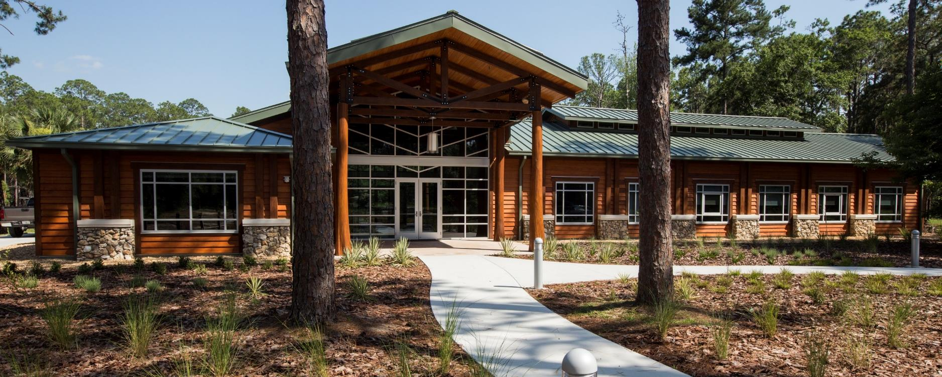
Site, Source, Selection
SELECTION
Drought Tolerant & Pest Resistant
Plant Matchmaking
Water
Fertilizer
Maintenance Needs
Notes:
Our second “S”, Selection, relates to proper plant selection to match your site, but also selection of drought tolerant and pest resistant plants, as well as, plant matchmaking.
The ebbs and flows of Florida’s climate presents many opportunities where we have plenty of rain or times of drought. Selecting plants that are appropriate to your environmental conditions, but also have a high tolerance to drought will reduce plant stress during the stressful, drier times. Additionally it will help your plants go longer periods of time without needing supplemental irrigation.
It is important to also consider selecting pest-resistant plants. Naturally resistant plants that have a higher tolerance to pest pressure will decrease the needs for maintenance within the landscape.
Lastly, it is important to match plant material together based on their needs. Plants with similar water, fertilizer, or maintenance needs should all be grouped together. This will ensure reduced maintenance because you have larger landscaped areas with similar needs rather than lots of smaller areas with different needs.

Slide 10
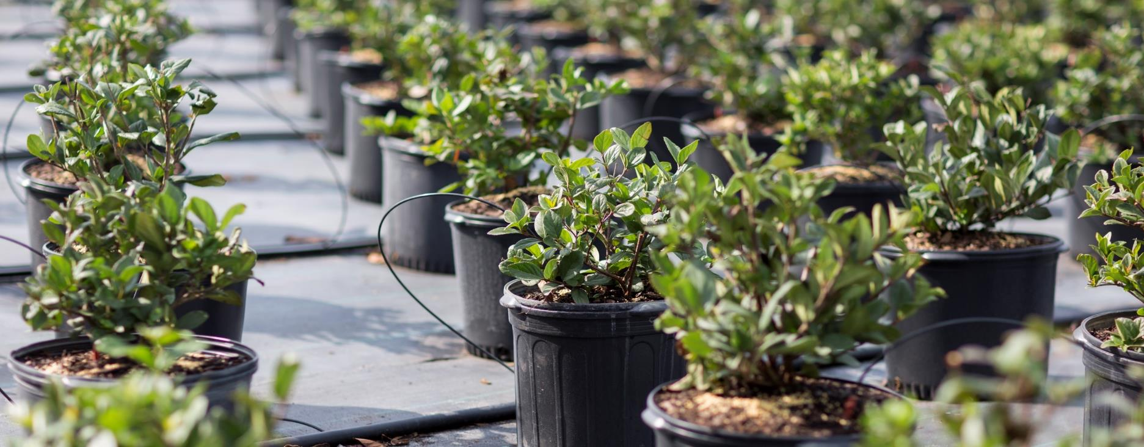
Site, Source, Selection
SOURCE
Plant Origins
Possible Issues
Inbreeding Depression
Outbreeding Depression
Cultivars of Native Plants
Notes:
Finally, our third “S”, Source. Source is commonly forgotten nor considered in many of our landscape projects. Just because plants are available from local nurseries or wholesale providers, does not mean you will have a high-quality plant.
I am originally from the Midwest. I first moved to Florida in 2000. That first summer was absolutely horrible-it was the most intense summer heat I have ever dealt with in my entire life….daily highs over 90 degrees F!? Why would anyone subject themselves to that kind of heat?!? I was not acclimated to those temperatures; whereas everyone living in Florida was already used to that heat. Plants are the same way.
Imagine two identical trees, one was propagated in a northern climate and the other a southern climate. If both trees were planted in a southern climate together, there’s a higher chance that the tree originally propagated from the southern climate will do better within the landscape. This is primarily due to the fact that the tree is already acclimated to that specific climate or environmental conditions.
Therefore it is very important to consider the origins of your plant material to ensure that they’re going to have the highest change of surviving and thriving in the landscape you are putting them.
In fact, many landscape architects while working on large projects will propagate and grow plant material for a project in a similar location to the one they are actively designing. This will ensure the plant material is as acclimated as possible to the site’s conditions.
Other concerns regarding plant source include inbreeding depression, outbreeding depression, and improper cultivar selection of Native Plants. Inbreeding depression relates to limited genetic diversity of native plants-making them more susceptible to disease or pest issues. Outbreeding depression relates to cross-pollinating with other plants that end up reducing the fitness, or genetic health, of future generations of the plant. Lastly, native plants do well in their natural conditions, but aren’t conditioned to be planted in disturbed or urbanizing landscapes. Choosing cultivars of native plants can be better suited for commercial or residential landscapes.

Slide 11
Site, Source, & Selection
SITE
SELECTION
SOURCE
Photo Courtesy Of: UF/IFAS
Notes:
Together we discussed the three “S”s for designing with maintenance in mind: Site, Selection, and Source.
The Three “S”s are very important, but only comprise of one major part of designing with maintenance in mind. That being said…

Slide 12
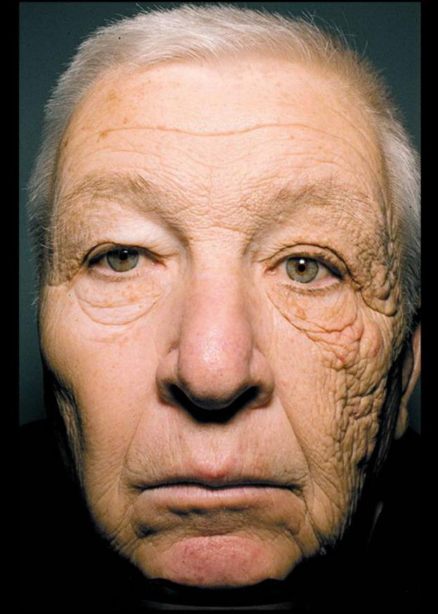
Time
Quick or Slow, Changes Associated with Time
Photo Courtesy Of: USA Today
Notes:
…time becomes the next major component we should consider when designing a landscape with maintenance in mind.
DISCUSSION: It may seem rather strange seeing this man’s face, especially when we’re discussing plants. But what do you notice about this man’s face? (Discussion – Many people will have reasons, someone may know).
This image was published by USA Today and shows the face of a truck driver. The left side of his face has dramatically aged compared to the right side of his face. This is due to years sitting in a truck cab with the left side of his face being exposed to more sunlight than the right side of his face.
Is this a change that happened very quickly or was it a slow change? (Wait for Answer)
Could this man notice the changes from day-to-day or was it something that he noticed developed over time? (Wait for Answer). (Many of the participants should now be thinking about the slow-changes associated with time).
Just like this driver’s face, our landscapes are very similar.

Slide 13
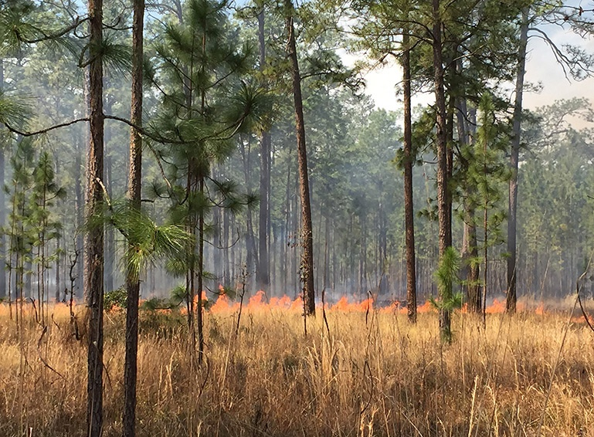
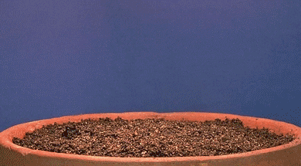
Time
Quick or Slow, Changes Associated with Time
How do landscapes change over time?
Daily
Seasonally
Annually
Lifetime
Photo Courtesy Of: Tall Timbers
Notes:
Our landscapes change constantly. Many things happen daily, seasonally, annually, or over a lifetime. Many of the changes are very apparent, while others are not.
What are some changes you see that can happen in a landscape daily? (Wait for Answers/Examples)
What about seasonal changes? (Wait for Answers/Examples) – Talk about Florida’s fire ecology. Fire is a seasonal, yet natural maintenance strategy. In fact, large portions of Florida’s natural environment has evolved around seasonal fires.
Annual changes? (Wait for Answers/Examples)
Lifetime changes? (Wait for Answers/Examples)
*Click for Animation*
It’s always important to recognize that our landscapes continually change.

Slide 14
Time
Shifting Landscape Functions
Plant Material Changes
Environmental Changes
Climate
Weather
Water
Notes:
To start thinking about a changing landscape, here are a few examples that are important to consider.
First is shifting landscape function. How will a landscape function’s change over time and is your landscape prepared to make those functional changes? A great example I think of is a family with young kids versus empty-nesters wanting a pollinator garden. Are the landscapes supposed to function exactly the same or will the needs be different? (Pause – Wait For Response).
A turfgrass area could be appropriate for a family with kids because it gives the kids and family opportunities to play outside, whereas the same requirements are not needed for someone with a pollinator garden. In these cases, always talk with your clients to determine the changing functional needs of a landscape. It’s easier to plan a landscape that can easily transition between functional needs rather than retrofit an entire landscape.
Second relates to plant material changes. Plants grow, plants age, plants change. How do plants change over time and how do those changes impact maintenance? A common landscaping pet peeve of mine is seeing Sweet Viburnums (V. odorotissium), a tall shrub/small tree that can reach 25’ tall that is planted in front of a window. It’s important to keep the view clear in front of windows, for safety reasons, so now the viburnum is going to require an excessive amount of pruning to keep at a reasonable size. In these cases, the plant’s mature size was not considered in the initial landscape design.
DISCUSSION: What are some other maintenance issues you have noticed related to changing plant material? (Discuss items brought up by participants).
Lastly, when considering time, it is important to think about environmental changes associated with time. Alachua County, Florida, used to be in USDA Hardiness Zone 8b, but now majority the entire county is recognized as being within zone 9a. That change can have a profound impact on plant material health, especially for some of our ornamental plants that needed cooler temperatures.

Slide 15
Social capital
LEVEL
TYPE
CASE STUDY
Notes:
So far we discussed the three “S”s, which are what? (Wait for responses). Then we discussed time with relationship to maintenance. The final component we are going to discuss together is Social Capital. Social capital, in this case, relates to the networks of people and resources working together to help manage a landscape.
Considering social capital and its relationship to landscape maintenance is commonly forgotten.
DISCUSSION: When you are planning a landscape do you think the a homeowners capacity to manage their landscape is different than a professional landscape company? (Wait for Responses). Why so? (Discuss Responses-Ask follow-up questions to elicit deeper discussion).
Those are all great responses. To help prepare for long-term maintenance and success of a landscape, we need to consider many of the points you all mentioned. Understanding who is managing a landscape and their skills to manage a landscape needs to be considered when we are designing any landscape, so that landscape can be successful.
I have broken the Social Capital component into two topics: Level & Type. Then I’ll discuss a small case-study.

Slide 16
Social capital
LEVEL
Do Available Resources Meet Requirement?
Objective-Based
Defined By Function
High- or Low-Intensity
Frequency
Notes:
Our first point, level, relates to maintenance level of the landscape. I always like to ask the question, “Do my available resources meet the maintenance level requirements?”
To help answer this question, we must know what the type of maintenance that is required to manage a landscape. I refer to this as objective-based landscape management, or simply put, our landscape’s maintenance is defined by its function.
This relates strongly with the phrase “Form follows Function”.
Once we identify the maintenance that is defined by the function of the landscape, determine if the required maintenance is high- or low-intensity and frequency of maintenance. Next it will be important to compare the maintenance level to the type of maintenance available. In general, high-intensity maintenance at a high frequency is not attainable for majority of our landscape managers, unless they have a specialized staff. Most homeowners are going to need a low intensity, less frequently managed landscape.

Slide 17
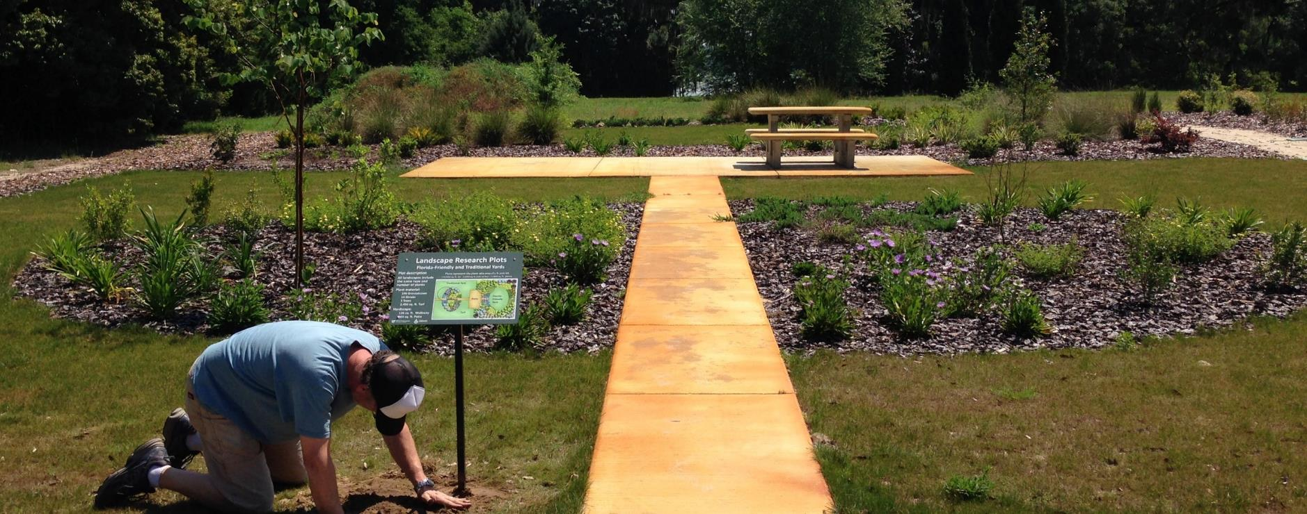
Social capital
TYPE
Decision Making & Leadership
Objective-Based
Maintenance Type Follows Skill
Available Resources
Notes:
When considering level of maintenance, you must also consider type of maintenance. Type of maintenance is strongly dictated by those whom maintain the landscape. I like to ask, “Does the type of maintenance exceed the client’s ability or capacity?” If so, I did something wrong.
A commonly forgotten person in the design process is the person in charge of maintenance. Their knowledge, leadership, and decision making is a critical tool for designing a landscape. While working on a design and going through the decision making process, their insight is essential.
As we go through the decision-making process, with someone from the maintenance crews being represented with the design team, our objective-based maintenance should address two key items: Maintenance following skill and available resources.
Maintenance type following skill is the crew’s ability to perform the desired maintenance. Do they have the existing skill? If they don’t, is training available? If the answer is no to both questions, then something needs to be changed.
Second is available resources. If the crew has the skill/training available to complete a task, you must ask, “do they have the appropriate resources to be successful?” If they don’t, then adjustments need to be made-otherwise the landscape will be mismanaged.
As an example, the image on the screen shows a research plot that compared maintenance inputs for a Florida-Friendly Landscape and a traditional-Florida landscape. Success of the research required a deep understanding of the individual maintaining the landscape, their skill level, and the tools available to them. Without that understanding, the study’s methodology would have been deeply flawed. In turn, the critical information we learned about Florida-Friendly Landscapes from this study was dependent on designing and planning for maintenance.

Slide 18
Social capital
CASE-STUDY
Building Social Capital
Who’s Managing Landscape?
Community Buy-In/Ownership
Long-Term Leadership
Notes:
My team and I once worked on a project for a client who oversaw a 2500-acre natural area. The client built a new facility on the property and asked my team to design the landscape. The employees, working on different crews, primarily managed the natural areas, not landscapes.
The design team created a very simple landscape design that was a low-maintenance, Florida-Friendly Landscape. The project was installed and the landscape looked wonderful…for the first couple years.
Overtime the landscape looked mangy and fell into disrepair. Essentially, nobody was maintaining the landscape. The initial leadership left their position without communicating with the management crews, so none of the crews ended up managing the landscape.
Our biggest oversight was the assumption the landscape was going to be managed properly – whoops. It doesn’t matter what kind of landscape you plan or design, if you do not engage those important stakeholders into the design process the landscape will be mismanaged and ultimately suffer.
That’s why it is incredibly important to engage the appropriate people in the design. Doing so will help determine who’s going to be managing the landscape. Additionally, working with the important stakeholders builds ownership and buy-in for a project. This will lead to the long-term leadership needed for a design to be successful over time.

Slide 19
Wrap-UP
Selection
Landscapes Dependent on Proper Design – Plant Selection
Landscapes Continually Change
Landscapes Require Social Captial
Maintenance
Site
Source
Social Capital
Time
Notes:
Ultimately, when you are designing with maintenance in mind, you will consider these big three components defining this model (CLICK).
Landscapes are dependent on proper design, which includes our Three “S”s. (CLICK)
Landscapes continually change. (CLICK)
And landscapes require maintenance from someone.

Slide 20
Wrap-UP
Selection
Tips
Plan For Long-Term Maintenance at Beginning
Anticipate the changing landscape
Select plant material suited for environmental conditions
Select plant material suited for maintenance requirements
Does desired maintenance match resources available?
Maintenance
Site
Source
Social Capital
Time
Notes:
In conclusion, I’d like to leave you with my general tips for designing with maintenance in mind.
Plan for long-term maintenance at the beginning
Anticipate the changing landscape
Select plant material suited for environmental conditions
Select plant material suited for maintenance requirements
And ask, “Does desired maintenance match resources available?”

Slide 21
Wrap-UP
Selection
Maintenance
Site
Source
Social Capital
Time
Notes:
So I highly recommend everyone to remember this model. Now is the time to take a picture with your phone, draw it on a piece of paper, or take good mental images.
When we consider long-term maintenance within our designs, we will create a landscape that can be successfully managed and use our water resources wisely and reduce nonpoint source pollution.

Slide 22
Essential Q
What principles do I need to consider when designing for long-term maintenance that ensures sustainable landscape management?
Photo Courtesy Of: UF/IFAS
Photo Courtesy Of: UF/IFAS
Notes:
(Review Essential Q)
At the beginning of our time together, our goal was to answer this question when finished: “What principles do I need to consider when designing for long-term maintenance that ensures sustainable landscape management?”
Now that we’re finished, how does everyone feel? Do you think you can adequately answer this question based on the information you have learned today? (Discuss – This information also allows for quick feedback/evaluation to help improve the program).

Slide 23
Thank You & Questions
Selection
Taylor Clem, PhD
UF/IFAS Extension Environmental & Community Horticulture Agent II
Master Gardener Coordinator
taylorclem87@ufl.edu
tclem@alachuacounty.us
(352)955-2402
Maintenance
Site
Source
Social Capital
Time
Notes:
Give thanks to everyone and open up the floor for additional questions.

Slide 24
Acknowledgements & References
Acknowledgements
The Native Plant Show
Florida Association of Native Nurseries
Florida-Friendly Landscaping Program
Center for Landscape Conservation & Ecology
References
UF/IFAS (2015). The Florida yards and neighborhoods handbook. Gainesville: University of Florida Institute of Food and Agricultural Sciences.
Norcini, J. (2019). Native plants: An Overview (ENH1045). Gainesville: University of Florida Institute of Food and Agricultural Sciences. Retrieved from https://edis.ifas.ufl.edu/ep297.
Valkenburgh, M.V. (2013, March). Landscapes over time. Landscape Architecture Magazine.
Photo Credits:
UF/IFAS Extension
USA Today

