Slide 1
Beginner Beekeeping Series
Class 2: Basic Bee Biology
Kimberly Post
Agriculture & Natural Resources Agent
Lanier & Clinch County Extension
Notes:
Good morning, everyone. My name is Kim Post, and this is the second class in the Beginner Beekeeping Series.
If you missed last month’s class, we covered the parts of a hive and actually assembled our hives in-class.

Slide 2
Agenda
Basic bee anatomy
Types of honey bees & life cycle
Nectar, pollen, and honey
Communication
Notes:
Today we will be covering basic bee anatomy, the three different bees that live in the hive, as well as their life cycle. We will also talk about pollen collection, nectar collection, and how they turn nectar into honey. Honey bees communicate with one another in a couple unique ways, so we will touch on that towards the end of today’s class.
We will introduce installing packages in your hives. Don’t worry, we will cover it again before your bees arrive in May!
There is going to be quite a bit of information today, so please do not hesitate to raise your hand as we go if you have a question. I want to make sure we understand the concepts I’m presenting and no one feels left behind. Remember, I want you to gain two new nuggets of knowledge in each class!

Slide 3
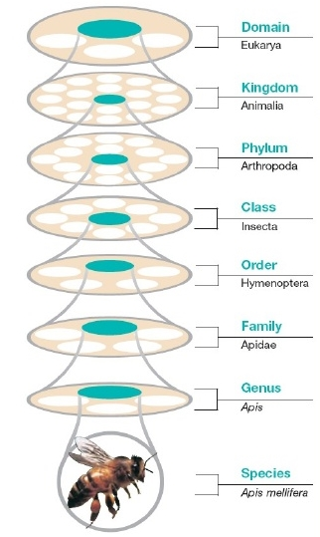
Species Classification
Honey bee
Apis mellifera
Wasps
Bees
Ants
Exoskeleton
Segmented body
Jointed appendages
Notes:
To start off, let’s take a look at how the honey bee is classified alongside other animals.
First, the honey bee is in the domain Eukarya. This means that their cells have a contained nucleus that holds their DNA.
They are in the kingdom Animalia, which means they are animals – just like us.
They are in the phylum Arthropoda. Arthropods have a hard exoskeleton and a segmented body, as well as jointed appendages. For the honey bee, they have three body segments and their legs have joints. Other arthropods are creatures such as spiders or crabs.
Honey bees are in the class Insecta, which establishes them as an actual insect with their six legs.
Insects are divided into many different orders, or sub-classes. Our honey bees are in order Hymenoptera, which includes all other bees, wasps, and ants. They are grouped this way based on their physical and genetic similarities.
They belong to the family Apidae. That includes over 5,000 species of bees, such as bumblebees and carpenter bees.
Finally, they are in the genus Apis, which identifies them as honey bees. There are a few different types of honey bees that all fall under Apis, but we will be talking about the species mellifera, which is our familiar European or western honey bee.
Are there any questions about the classification of the honey bee? Don’t worry, there’s no test on this! I like for people to have a general feel for what other type of creatures the honey bee is related to.

Slide 4
Races
Origins
Originated in Africa, spread north to Europe
Adapted to different environments
Honey bees were first introduced to North America in the early 1600s
We will discuss five races of honey bees
Map: Randy Oliver, ScientificBeekeeping.com
Notes:
Let’s orient ourselves to this map to start. *pointing* This is the top part of Africa, up here we have Europe. This is Spain, the UK, Germany, and so on.
Looking a bit closer at the origin of our honey bee…
They actually originated in Africa and spread up into Europe. There are mountains, forests, all kinds of different environments where the bees found their niche and adapted to those environments. As Europeans expanded westwards, honey bees were brought to North America in the 1600s.

Slide 5
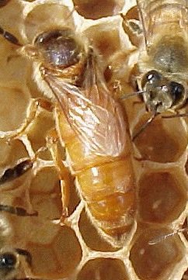
Races
Italian
Apis mellifera ligustica
Pros
Gentle, easy to work
Keep clean hives
Good honey production under good conditions
Cons
Prone to robbing
Moderate swarming
Do well in warmer climates
Photos: UGA Honey Bee Program (left), Map: Randy Oliver, ScientificBeekeeping.com (right)
Notes:
The first honey bee race is the Italian, Apis mellifera ligustica. As the name indicates, they originated in Italy.
(For those of you that ordered bees, these are the bees you will be receiving in May.)
Italian queens are a bit easier to find because they have these bright gold abdomens that really stand out among the other bees. The workers are also golden with black bands. Italians are pretty docile and easy to work with, which makes them less intimidating for beginners. They have good honey production, they are not extreme swarmers, and they usually do pretty well in warmer climates like Georgia.
Italians are very common. They are easy to find and purchase as packages and nucs.

Slide 6
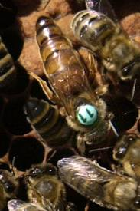
Races
Carniolan
Apis melllifera carnica
Pros
Gentle, easy to work
Not prone to robbing
Good honey production under good conditions
Cons
Build new comb slowly
Can be prone to swarming
Better suited to northern climates
Photos: UGA Honey Bee Program (left), Map: Randy Oliver, ScientificBeekeeping.com (right)
Notes:
Carniolans, Apis mellifera carnica, are another really common race you will find. They started out further east in Europe in Austria, Yugoslavia, and Slovenia. A lot of times you will hear them referred to as “Carns” or “Carnies.”
They a dark gold to brownish black color, so not as bright as the Italians. They are still docile like the Italians and have good honey production, but they build up a bit more slowly. They sometimes tend to swarm more readily as well. They are built more for northern climates, but can still be successful down here in Georgia. (When I still lived in Wisconsin, I had some Carniolans.)

Slide 7
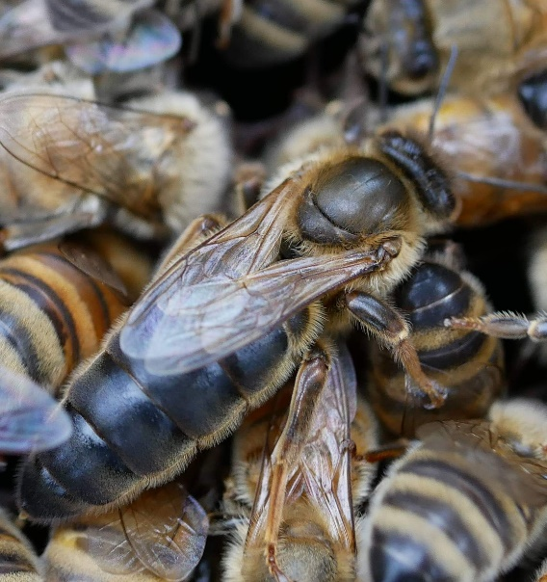
Races
Caucasian
Apis mellifera caucasica
Pros
Gentle, easy to work
Foragers earlier and in cooler temps
Good winter stores
Do well in hot/humid and cold/damp climates
Cons
Prone to robbing
Susceptible to disease
Hard to calm down once alarmed
Honey production fair/good
Photos: UGA Honey Bee Program (left), Map: Randy Oliver, ScientificBeekeeping.com (right)
Notes:
Next we have Caucasian honey bees, Apis mellifera caucasica. They originate in the region between the Black Sea and the Caspian Sea, which is now Russia, Ukraine, and Kazakhstan. They look like lead, their abdomens are nearly all black.
Caucasians are not as common in the United States. As with the others, they are very gentle and decent to work. Their honey production is not as good at Italians or Carns, but they will generally be solid enough to have good honey stores for winter. They will actually leave the hive and forage in cooler temperatures than Italians. They are a bit more susceptible to diseases and can be a little cranky. Caucasians are also propolis-crazy! They will gum up everything in the hive with excessive propolis, which can be a pain.
Again, they are not super common, so I do not anticipate that you will be working with Caucasians in your immediate beekeeping future.

Slide 8
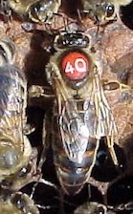
Races
German Black/Dark
Apis mellifera mellifera
Pros
Good in cold/damp climates
Honey production can be good
Cons
Runny, excitable
Prone to disease
Build up slowly in spring
Moderate swarming
Photos: UGA Honey Bee Program (left), Map: Randy Oliver, ScientificBeekeeping.com (right)
Notes:
Another really dark-looking bee in the German Black, Apis mellifera mellifera. You may hear it called the German Dark or the English Black. Some people called them plain old “black bees.” These are northern European honey bees, historically found in Germany and what is now the United Kingdom. German Blacks were the first bees that were brought over to America.
They do tend to be very excitable and were susceptible to European Foulbrood (which we will talk about more in our diseases class), so they fell out of favor in the United States. The Italians became much more popular and better to work with than the Germans. Because of this, they are also not very common anymore.

Slide 9
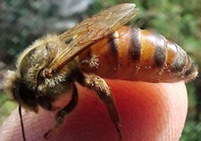
Races
Africanized
Apis mellifera scutellata
Pros
Reported resistance to varroa mites
Suited for warm/tropical climates
Cons
Extremely defensive, can be dangerous
Smaller colonies, less honey per hive
Photos: UGA Honey Bee Program (left), Map: USGS (right)
Notes:
Finally, we have arrived at the Africanized honey bee, Apis mellifera scutellata. When people are talking about “killer bees,” they are actually talking about Africanized bees. I always encourage people to call them Africanized bees rather than “killer bees,” because “killer” obviously has negative connotations. People tend to associate them with all honey bees, and we want honey bees to be seen in a positive light.
Africanized honey bees were originally from sub-Saharan African and introduced to Brazil in the 1950s. A scientist was looking for really productive honey bee lines and this is what he returned home with. Africanized honey bees can breed with our “regular” honey bees. Because of this, they have been able to spread all the way up through central America and into the southern United States. There are African/European hybrids in the southern U.S., but their northern spread is limited. They are not very cold hardy at all.
Africanized honey bee venom is not any more potent than European honey bee venom. The difference is how large of an attack they will mount against an intruder, and how committed they are to defending their hive. They send out far more bees to protect the hive, which can result in far more stings. This is what can make Africanized bees potentially dangerous or deadly. Although, you would need to be stung thousands of times to be killed, unless you were allergic. It is more often smaller animals that succumb to the stings.
Are there any questions on Africanized bees or any other of the bee races?
If not, we will move on to bee anatomy.

Slide 10
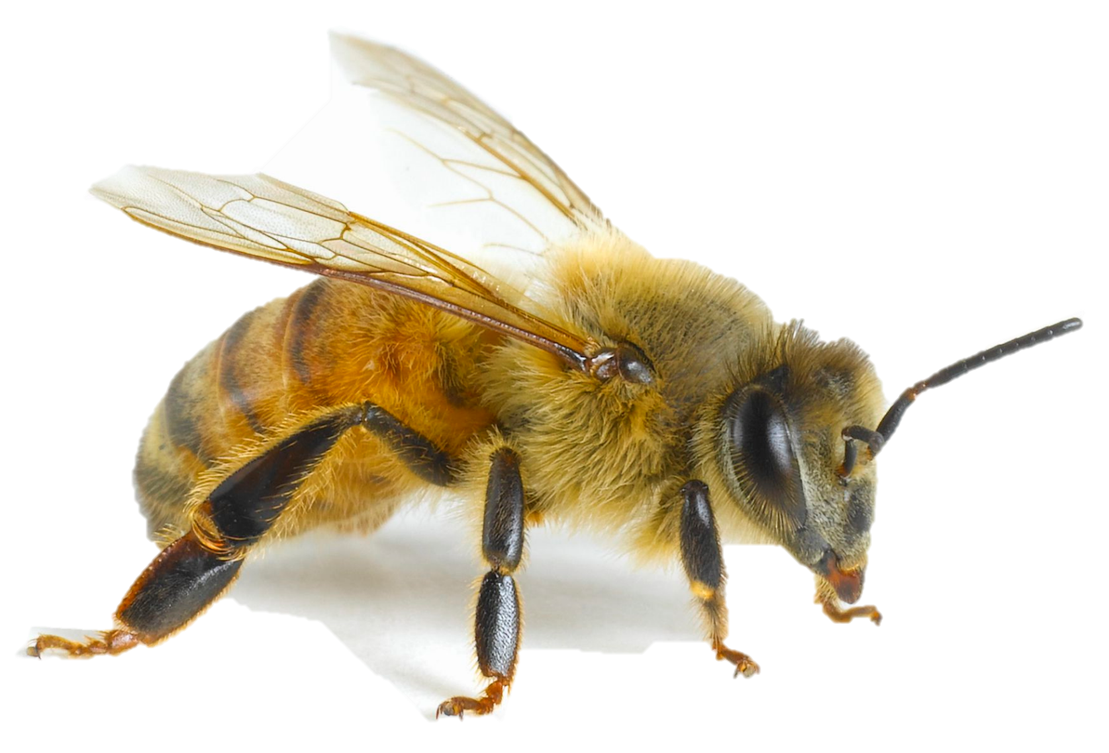
Basic Bee Anatomy
wing
thorax
head
abdomen
ocelli
antennae
compound eye
stinger
pollen baskets
mouthparts/proboscis
fore legs
hind legs
mid legs
Photo: Getty Images
Notes:
As I mentioned when we were discussion classification, honey bees have three segments to their body: the head, thorax, and abdomen. They have three pairs of legs – fore legs, mid legs, and hind legs – for a total of six legs. The hind leg has the pollen baskets. They also have five eyes – two large compound eyes on the side of their head, and three small ocelli right on top of their head. Honey bees have two pairs of wings for four total wings. The front and back wings can actually lock together during flight.
They have two antennae on their head that they use to sense their surroundings. Their mouthparts are actually fairly complex. We will cover some of the structures included in their mouthparts, but we will primarily be talking about their proboscis. Of course, at the back end they have a stinger. It’s also important to note that her entire body is covered in tiny hairs.

Slide 11
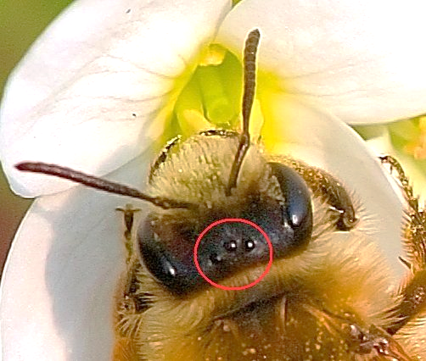
Basic Bee Anatomy
Vision
Compound eyes (2)
Colors, patterns, motion
Multiple lenses
Ocelli / simple eyes (3)
Light intensity
Single lens
Photo: Pixabay/SteemKR
Notes:
Here is a better picture of how the bee’s eyes are arranged on its head. We have the two compound eyes on either side of the head. They have multiple lenses that are for perceiving the more detailed aspects of their environment such as colors, pattern, and motion.
The ocelli, or simple eyes, are a single lens. There are three of them on top of bee’s head, as you can see here. They have a more basic function, which is to determine light intensity. Is it dark outside or is it light outside?

Slide 12
Basic Bee Anatomy
Vision
Can see further into UV than humans
Nectar guides
Photo: Bjørn Rørslett
Notes:
Besides having five eyes, bee vision itself is a bit different from humans.
Honey bees can see further into the ultraviolet wavelengths of light, whereas we cannot. As a trade off, they can’t see as far into the red wavelength as we can. Bjørn Rørslett is a Norwegian photographer that has done quite a bit of work in photographing different flower species and their UV reflectance. Many flower species appear to have a bullseye pattern when viewed with UV-capable equipment. This is very similar to how the flowers would appear to the honey bees, who can see in this range. The UV reflectance pattern on different plants acts as a nectar guide. It says, “Hey, my nectar is right here! Come and get it!”
(Bjørn Rørslett’s UV photography website: http://www.naturfotograf.com/index2.html)

Slide 13
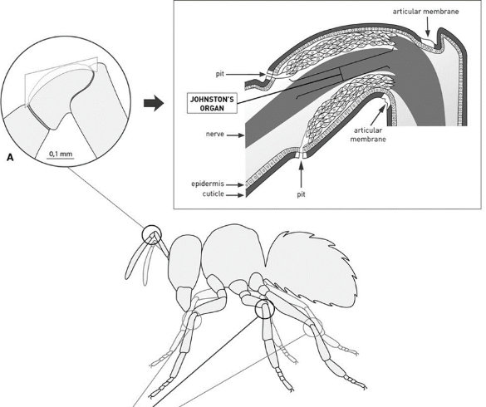
Basic Bee Anatomy
Hearing
Limited hearing
Low frequency (<500Hz)
Johnston’s organ inside antennae
440Hz 250Hz
Diagram: Hunt, J.H. & Richard, F.J. (2013)
Notes:
Honey bees have somewhat limited hearing abilities. They can hear low frequency sounds, less than 500 Hertz. For reference, the higher the number, the higher the pitch. So 1000Hz would be higher pitch than 500Hz. They can do this thanks to their Johnston’s organ that is actually located inside their antennae. There is a series of membranes that can receive the vibrations of the sound and convert it into a nerve impulse that is sent to the bee’s central nervous system.
I have a couple audio clips of two tones that are less than 500Hz so you can get an idea of how low the bees are hearing.
*play 440Hz and 250Hz clips* (5-second clips can be played in PPT editing mode or presentation mode. Click on speaker icon, a “play” button should appear.)

Slide 14
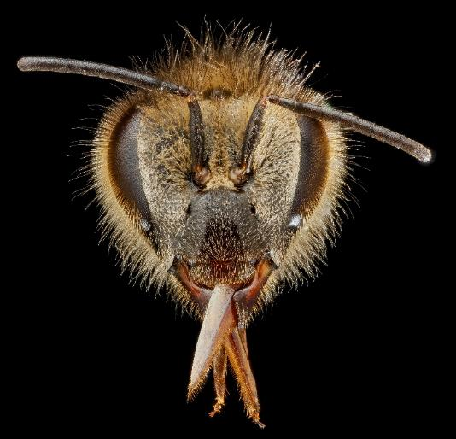
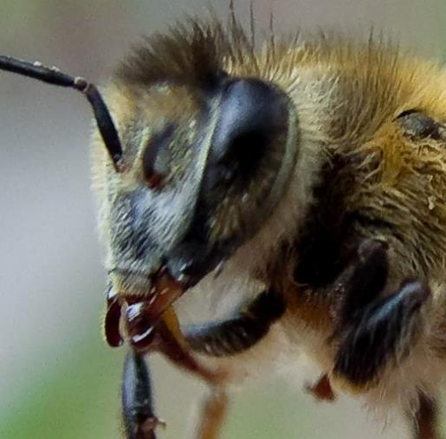
Basic Bee Anatomy
Eating / Mouthparts
Proboscis
Straw for liquids
Mandibles
Holding and moving
Photo: USGS Bee Inventory and Monitoring Lab (top), Adam Siegel (bottom)
Notes:
Honey bee mouthparts are fairly complex, but again we will be focusing on the proboscis and the mandibles for the scope of this class. The proboscis is their tongue and they use it like a straw. They can insert the proboscis into flowers and suck up nectar. The mandibles are more for chewing, holding, and moving things. They will use their mandibles to manipulate wax flakes.
In this picture you can see the bee’s proboscis, and here you can see the mandibles.

Slide 15
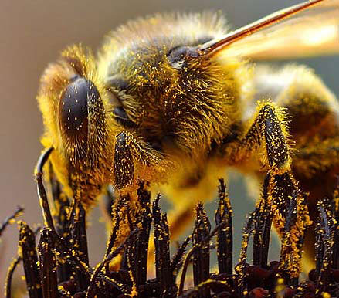
Basic Bee Anatomy
Body Surface
Covered in tiny hairs
Pollen clings to them
Photo: John Sullivan
Notes:
A very important feature of the honey bee is the surface of her body. She is covered in tiny hairs, which allows pollen to cling to her body as she is visiting blossoms. It’s similar to rubbing a balloon on your hair, which generates static cling and your hair then sticks to the balloon.

Slide 16
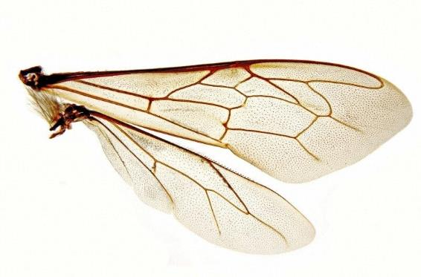
Basic Bee Anatomy
Locomotion / Flight
All connected to thorax
Wings (4)
Front and rear lock together
Create “buzz”
Legs (6)
Claws
Pollen baskets
Photos: Spike Walker (top), Kim Post (bottom)
Notes:
Next we will take a look at their appendages. Their wings and legs are all connected to the thorax, the middle segment of their body. Honey bees have four wings, a front and rear pair that actually lock together during flight. There is a small row of “teeth” on the rear wing that lock into the front wing. I have a slide over here at the microscope that you are all welcome to look at. It is currently lined up show you these “teeth,” which are called hamuli. The bee’s wings are what actually create the “buzz” that we typically associate with bees. Their wings are moving so quickly that it creates the buzzing sound.
Honey bees are insects, so naturally they have six legs. If you recall from that first anatomy slide, the pollen baskets are located on the rear set of legs. The pollen baskets are also known as corbiculae. They are essentially indentations in the bee’s leg that allows her to pack pollen and carry it back to the hive. Another key feature of the legs are these little tarsal claws. These are what allow the bees to grab onto surfaces and climb vertically on the honeycomb.

Slide 17
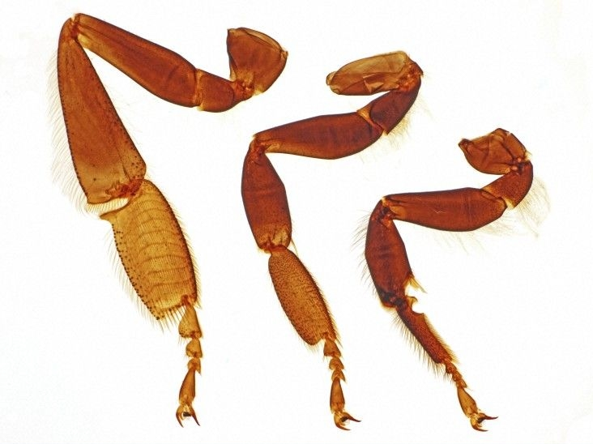
Basic Bee Anatomy
Locomotion / Flight
All connected to thorax
Wings (4)
Front and rear lock together
Create “buzz”
Legs (6)
Claws
Pollen baskets
Photo: Spike Walker
Notes:
Next we will take a look at their appendages. Their wings and legs are all connected to the thorax, the middle segment of their body. Honey bees have four wings, a front and rear pair that actually lock together during flight. There is a small row of “teeth” on the rear wing that lock into the front wing. I have a slide over here at the microscope that you are all welcome to look at. It is currently lined up show you these “teeth,” which are called hamuli. The bee’s wings are what actually create the “buzz” that we typically associate with bees. Their wings are moving so quickly that it creates the buzzing sound.
Honey bees are insects, so naturally they have six legs. If you recall from that first anatomy slide, the pollen baskets are located on the rear set of legs. The pollen baskets are also known as corbiculae. They are essentially indentations in the bee’s leg that allows her to pack pollen and carry it back to the hive. Another key feature of the legs are these little tarsal claws. These are what allow the bees to grab onto surfaces and climb vertically on the honeycomb.

Slide 18
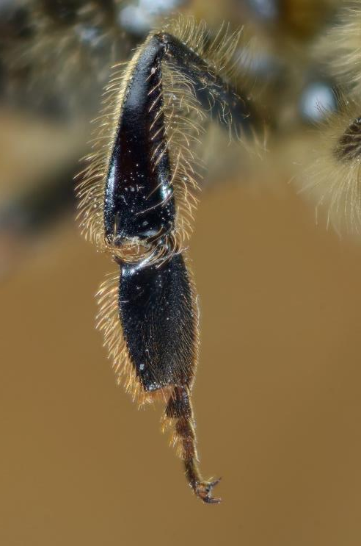
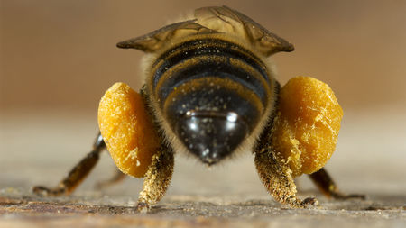
Basic Bee Anatomy
Locomotion / Flight
All connected to thorax
Photo: Heidi & Hans Juergen Koch / Minden Pictures (left), Gilles San Martin (right)
Notes:
This is a rear view of a bee with loaded pollen baskets. They almost look like saddlebags. This is a better image showing the indentation of the pollen basket on the rear legs.

Slide 19
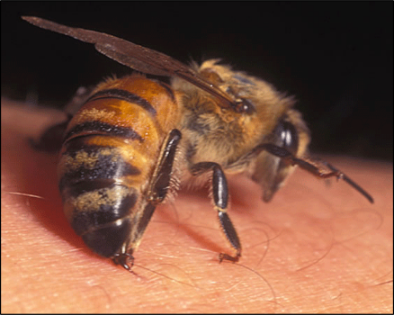
Basic Bee Anatomy
Stinger
Barbed
Pulled out of body after stinging
Bee dies
Photos: Bee Culture (top), Landcare Research (bottom)
Notes:
We all know that honey bees are capable of stinging, but they only get once chance to sting typically. Their stinger is barbed, almost like a fish hook. When they sting us, the barbs get stuck in our skin. The bee tries to fly away and it pulls the stinger out of her body. The venom sac is usually pulled out as well, which is an internal organ. When these are ripped out, she eventually dies.
When she does sting and subsequently dies, this releases alarm pheromone. Alarm pheromone tells all the nearby bees in the hive, “Look out, there is danger! Protect the hive!” Usually if I’m working in my hive and a bee stings my glove, I’ll see other bees start to become agitated and some will land where the sting occurred. Puff a bit of smoke on the sting site if you’re stung; it will help block some of that pheromone communication.

Slide 20
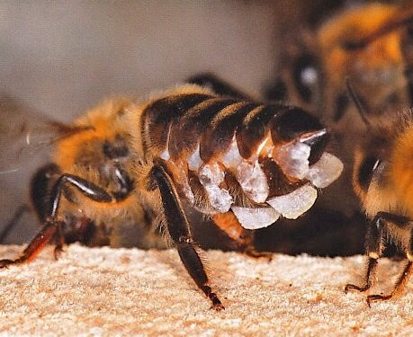
Basic Bee Anatomy
Wax Glands
8 glands
Photos: Helga Heilmann
Notes:
The last pieces of anatomy I want to show you are the wax glands. We are all probably familiar with the concept of honey bees making wax. The worker has eight glands on the underside of her abdomen that each make a tiny flake of wax. The bees needs a good source of energy and nutrients in order to produce this wax. They will then use it to build honeycomb and cap cells when necessary.
Are there any questions about the anatomy of the honey bee before we move on to the types of bees in the hive?

Slide 21
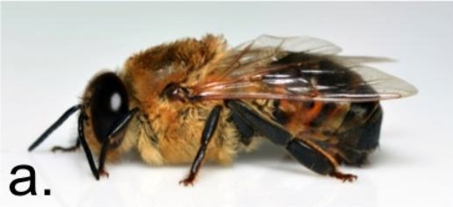
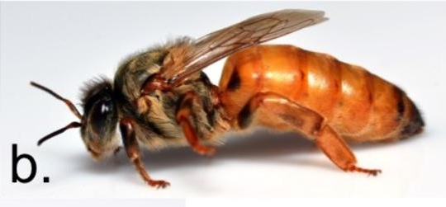
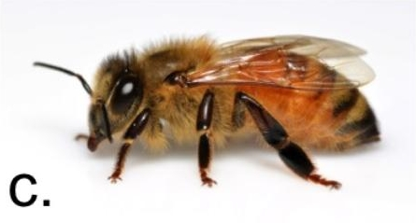
Types of Honey Bees
Castes
Drones (a)
Males, limited functions
Queen (b)
Female, can reproduce
Workers (c)
Female, cannot reproduce
Photos: Mike Bentley
Notes:
There are three types of honey bees that live in the hive, also known as “castes.” They include drones, the queen, and workers. Drones are males that have only one true function within the hive. The queen is the only female that is capable of reproduction, which we cover more on shortly. Workers are all females that carry out the day-to-day operations of the hive.

Slide 22
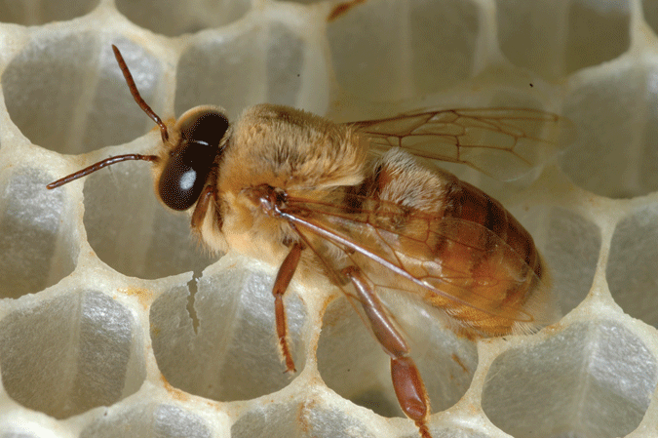
Types of Honey Bees
Drones
Male
Fat bodies
Large compound eyes
Limited function
Photos: Mike Bentley (top), UGA Honey Bee Lab (bottom)
Notes:
Drones have rather thick bodies and their compound eyes take up almost all of their head. This is because their primary function is to visually identify a queen in flight; his vision needs to be top notch. The differences may not seem apparent now, but you will be able to identify drones more readily as you spend more time in your hive.

Slide 23
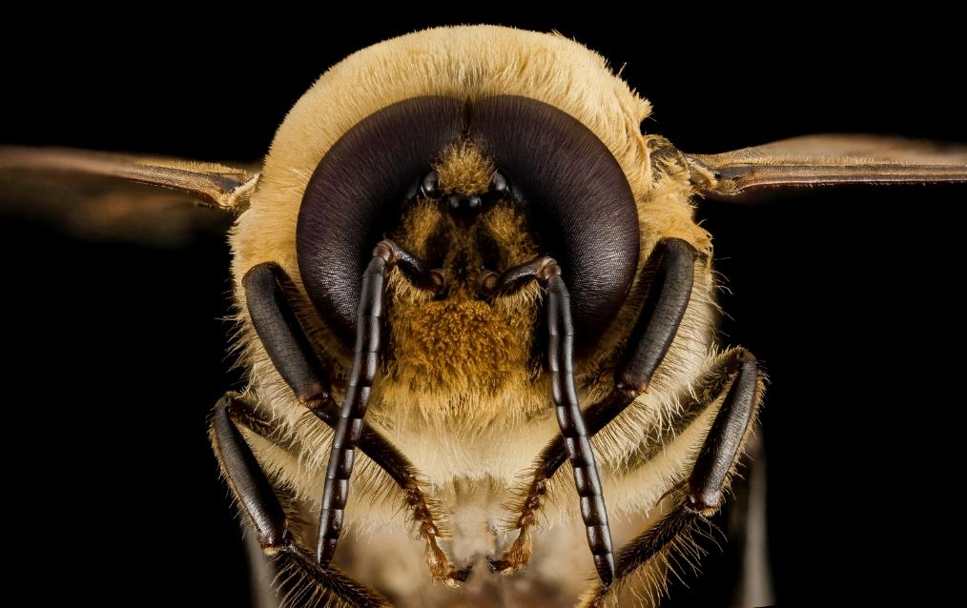
Types of Honey Bees
Drones
Compound eyes meet on top of head
Photo: USGS Bee Inventory and Monitoring Lab
Notes:
Here is a frontal view of a drone, where you can see that his compound eyes actually meet on top of his head. Because of this, his ocelli are located more towards the front of his head than on worker bees. Again, he needs this enhanced vision because he has a very important task…

Slide 24
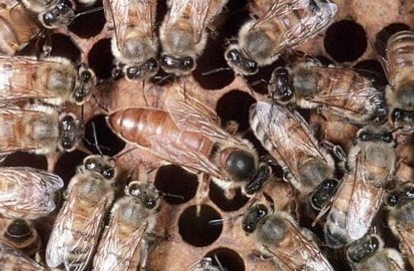
Types of Honey Bees
Queen
Reproductive female
Lays eggs (1,000 – 2,000)
Pheromones
Photo: Mike Bentley
Notes:
… with this lady – the queen. She is much longer than the other bees and she has a smooth cap on her thorax where there are no little hairs. This makes her easier spot in the hive. She is essentially the mother of the hive, because it is her job to lay eggs and produce more bees. She can lay 1,000 to 2,000 eggs per day; she is a very busy lady! She also produces pheromones, or chemical signals, that communicate certain things to the rest of the hive. One pheromone, Queen Mandibular Pheromone (QMP), has a few functions. It gives the bees the feeling of belonging to this queen, it attracts males on her mating flight, and it suppresses reproductive abilities in female workers.

Slide 25
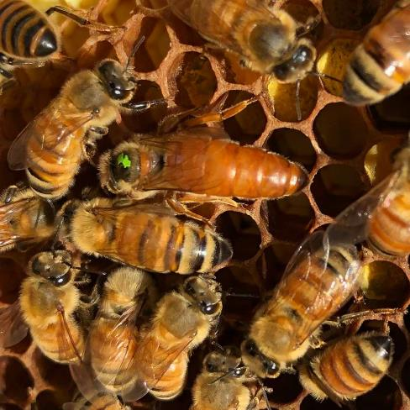
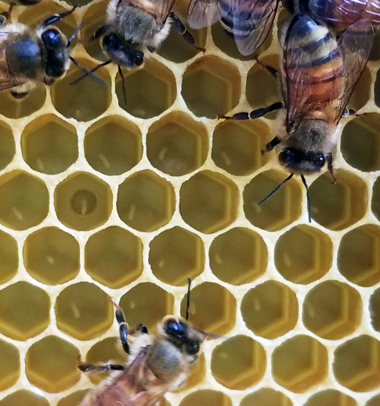
Types of Honey Bees
Queen
One day of breeding at drone congregation area (DCA)
Multiple partners
Eggs
Photos: Kim Post (top & bottom)
Notes:
In order to lay eggs, the queen must be bred. This typically occurs in a drone congregation area. Drone congregation areas are about 100 feet off the ground and will have hundreds or even thousands of males from multiple hives. They are all waiting for virgin queens to arrive. The queen with mate with multiple males, anywhere from 10 to 40 drones. She can actually store this genetic product in an organ called the spermatheca, which allows her to return to the hive and lay eggs without needing to be re-bred each season.
She will lay single egg in each cell of the honeycomb, as you can see here. We will cover more about the life cycle of the honey bee shortly.

Slide 26
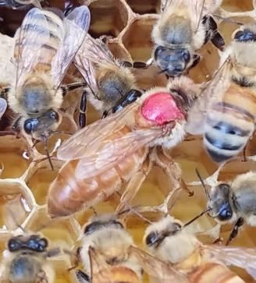
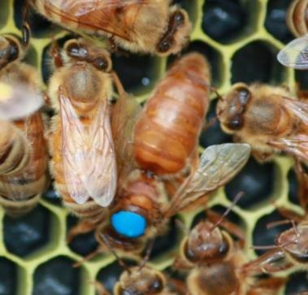
Types of Honey Bees
Marking Queens
International Queen Marking Color
COLOR | YEAR ENDING IN:
White (or Gray) | 1 or 6
Yellow | 2 or 7
Red | 3 or 8
Green | 4 or 9
Blue | 5 or 0
2016
2018
2015
Photos: Becky Jones/Kim Post (top), Kim Post (bottom left & right)
Notes:
A quick note about queen marking. There is an accepted five color rotation for marking queens. The color is associated with the ending digit of the year she was reared. For example, our 2020 queens will be blue, next year they will be white, and so on. This helps keep track of how old our queen is. She will be replaced if she is getting old and not as thrifty or her egg production decreases.
Marking queens is fairly straight forward. You can pick her up off the frame very gently, and mark that smooth cap on her thorax with a paint pen. For those of you that ordered bees, your queens will arrive already marked.

