Slide 1
Geocaching: Fun With Forests Around Us

Slide 2
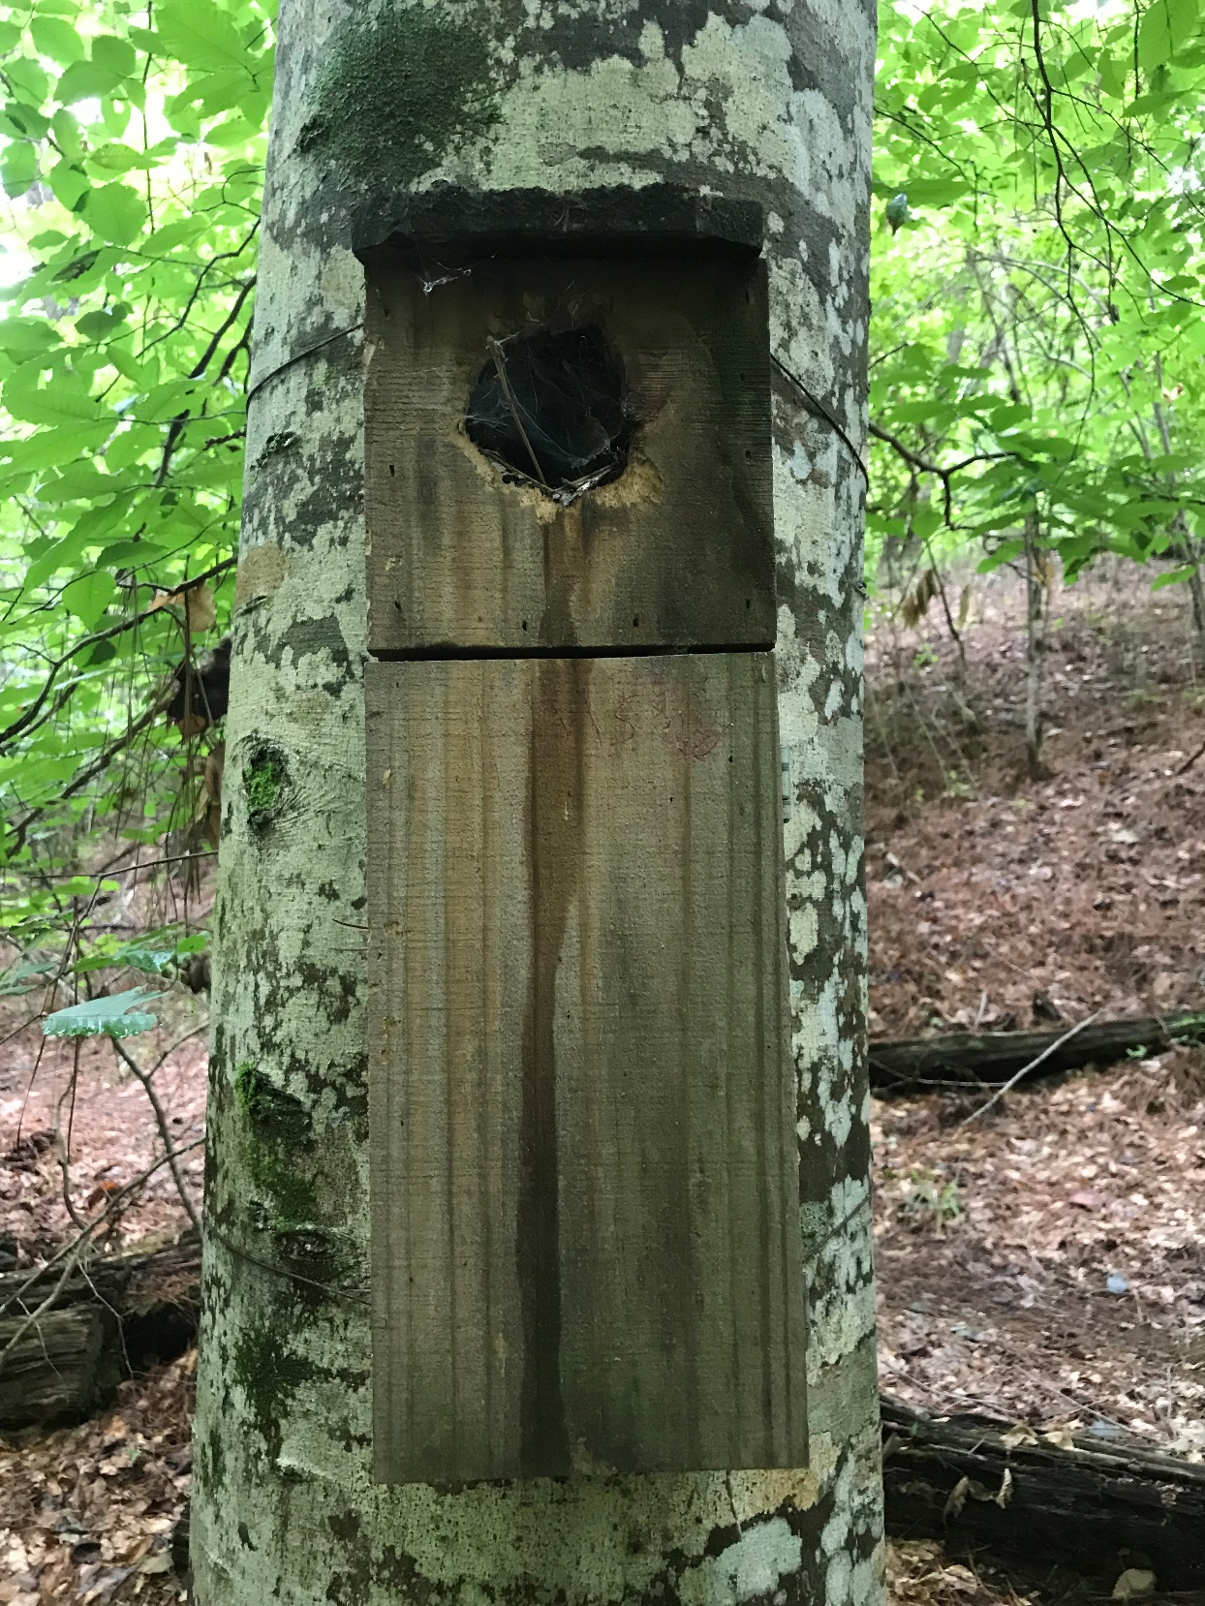
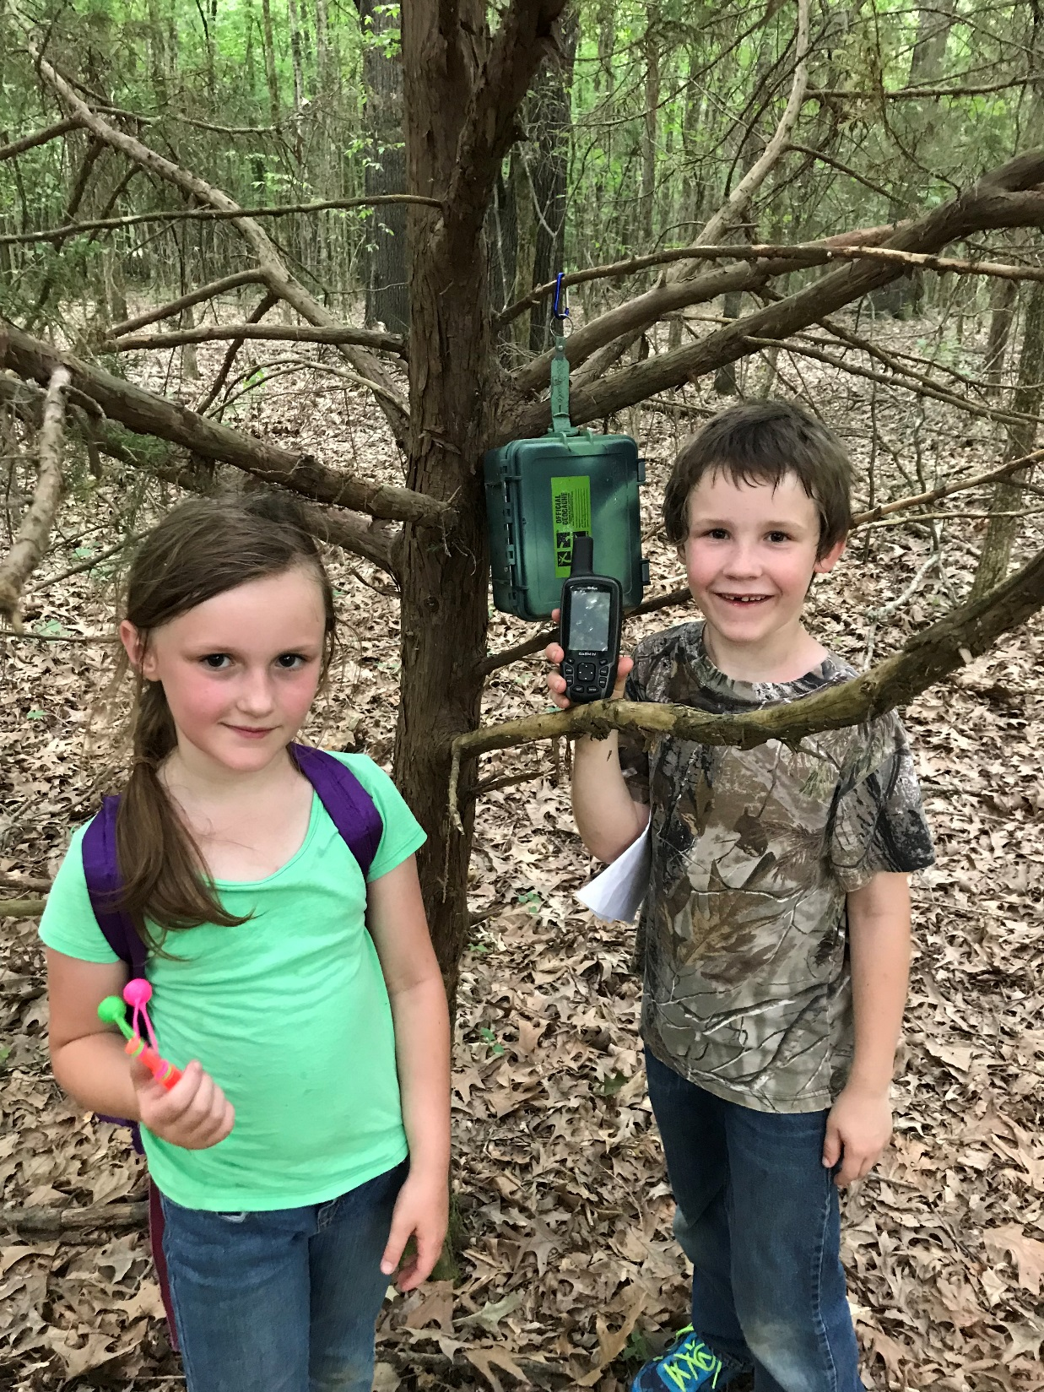
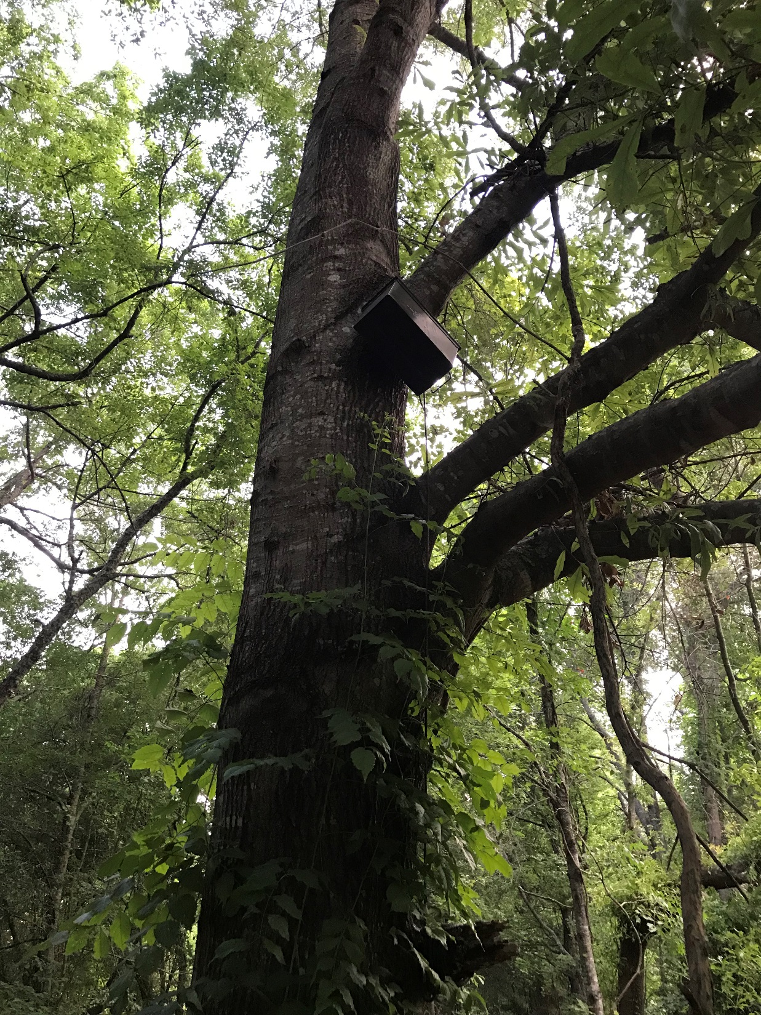
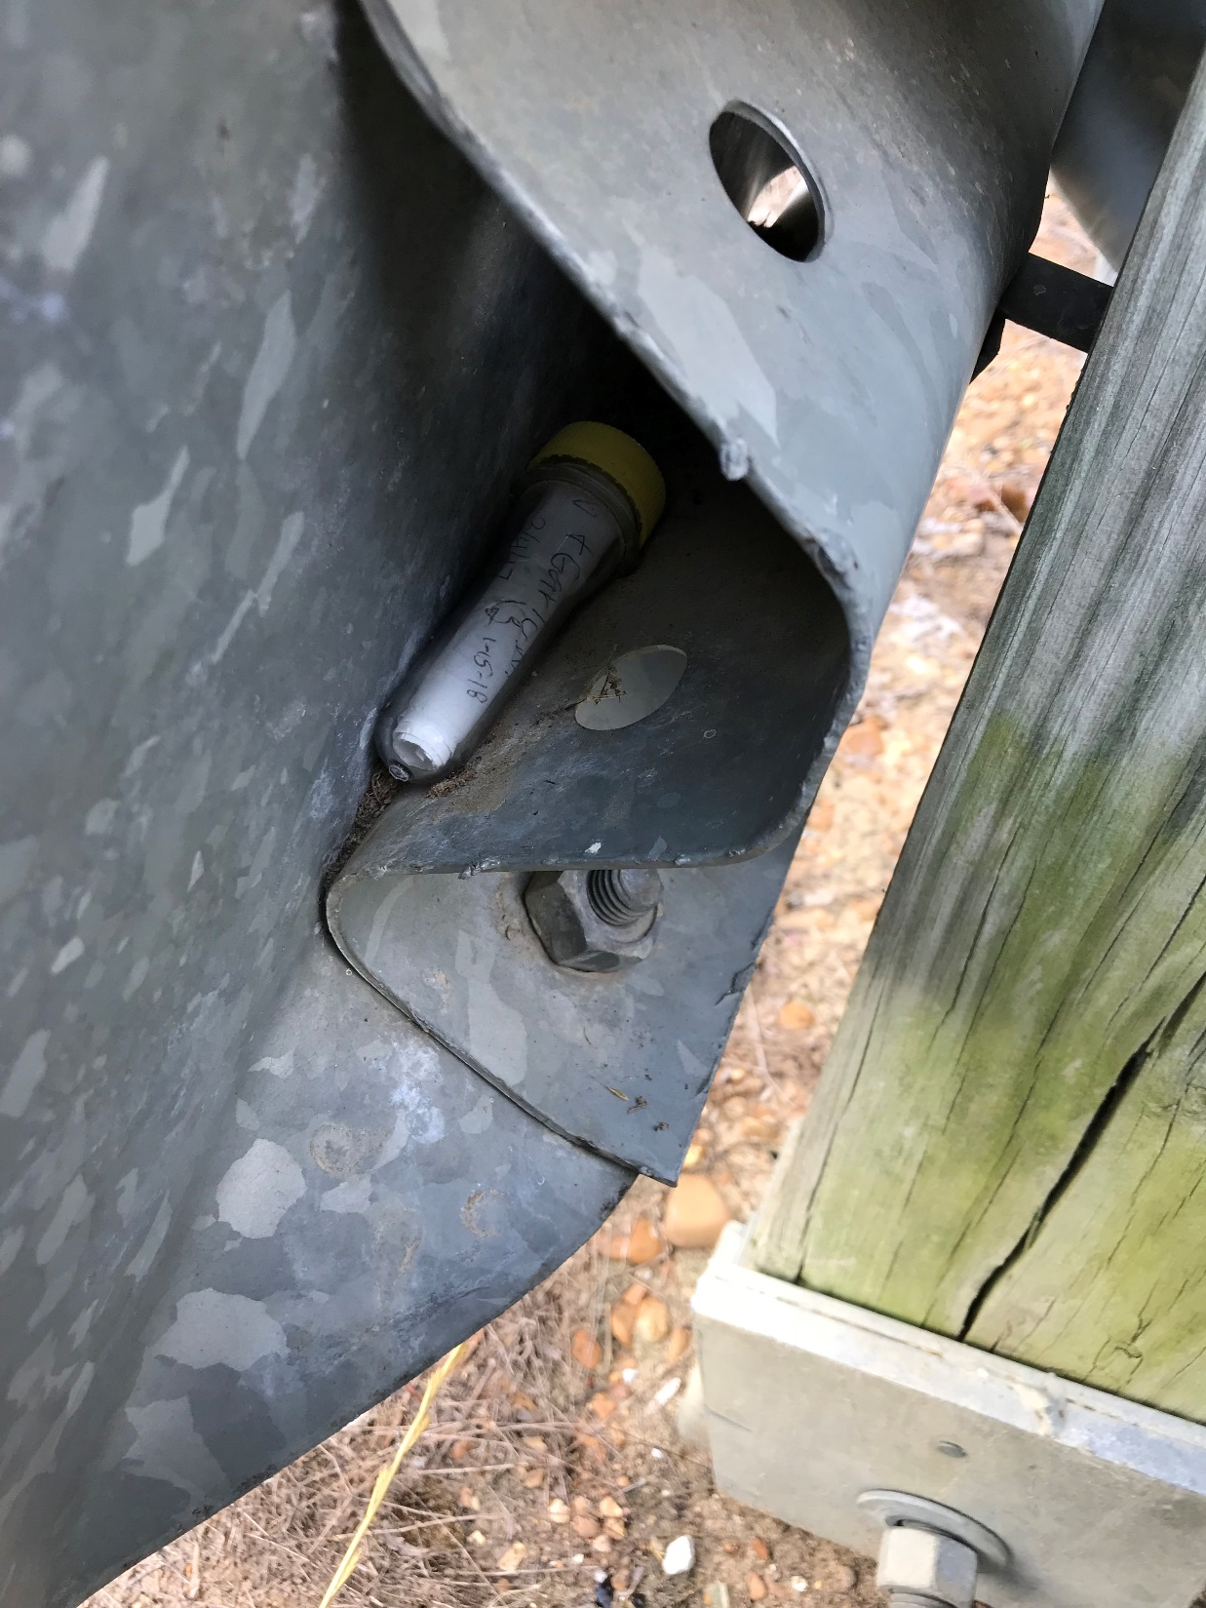
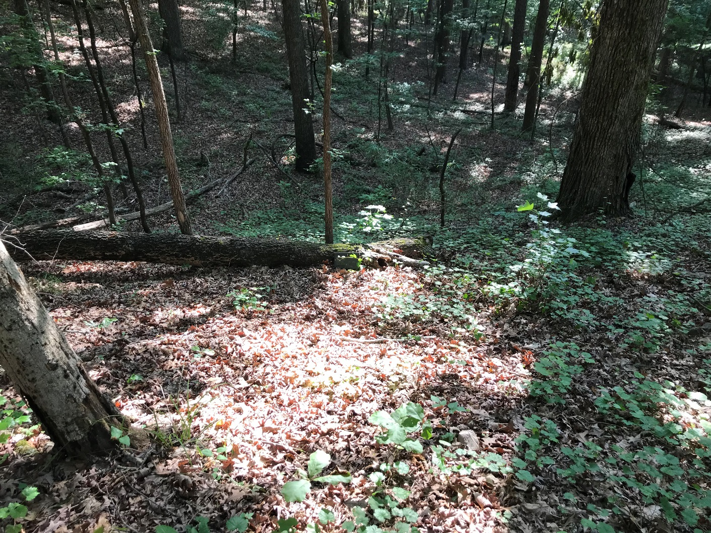
What is Geocaching?
Geocaching is an outdoor treasure hunting game that uses a GPS to guide you. You navigate to a geocache and then try to find it at that location.

Slide 3
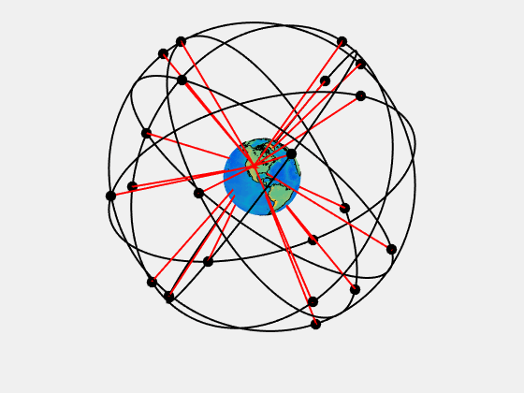
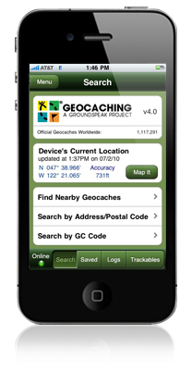
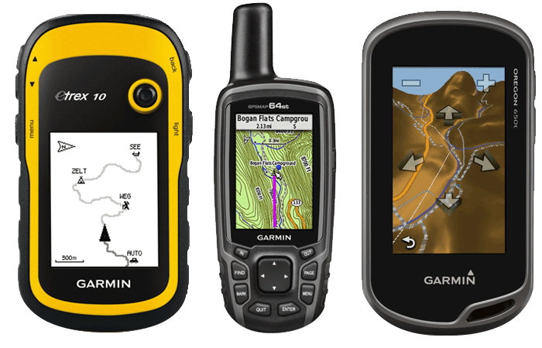
What is GPS?
Global Positioning System (GPS)
Device that finds your location on the planet to within 8-20 feet.
You use GPS to navigate from place to place, or to mark a specific spot.
A GPS receives signals from satellites and uses those to guide you.

Slide 4
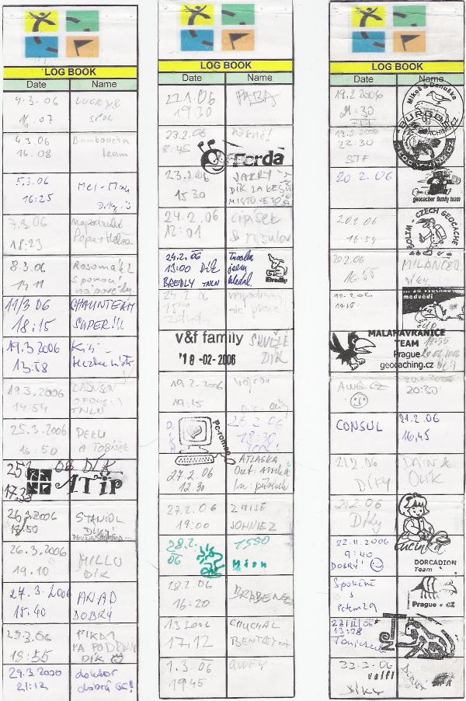
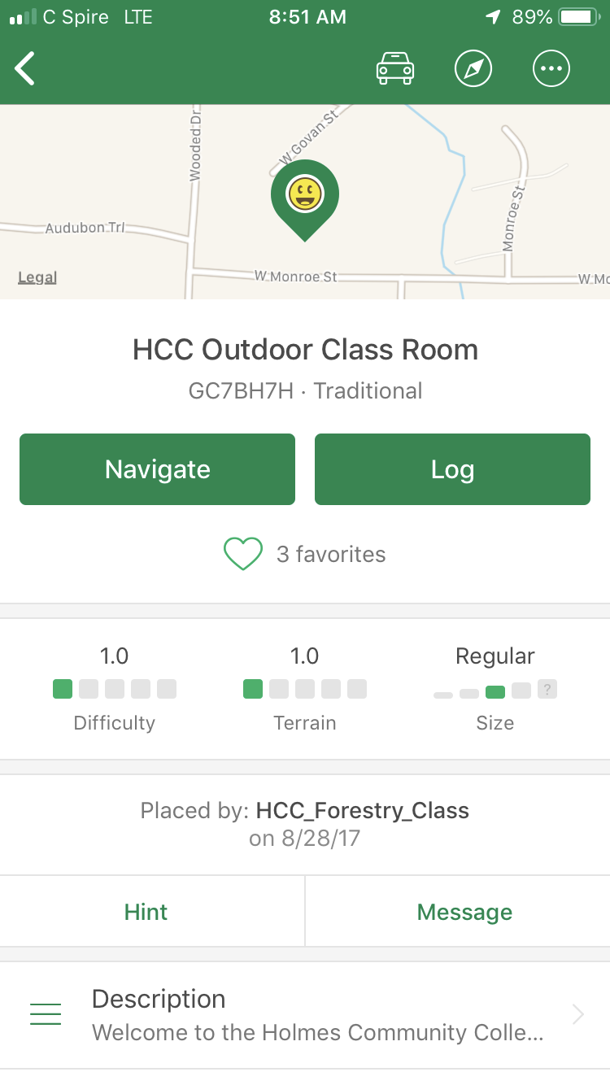
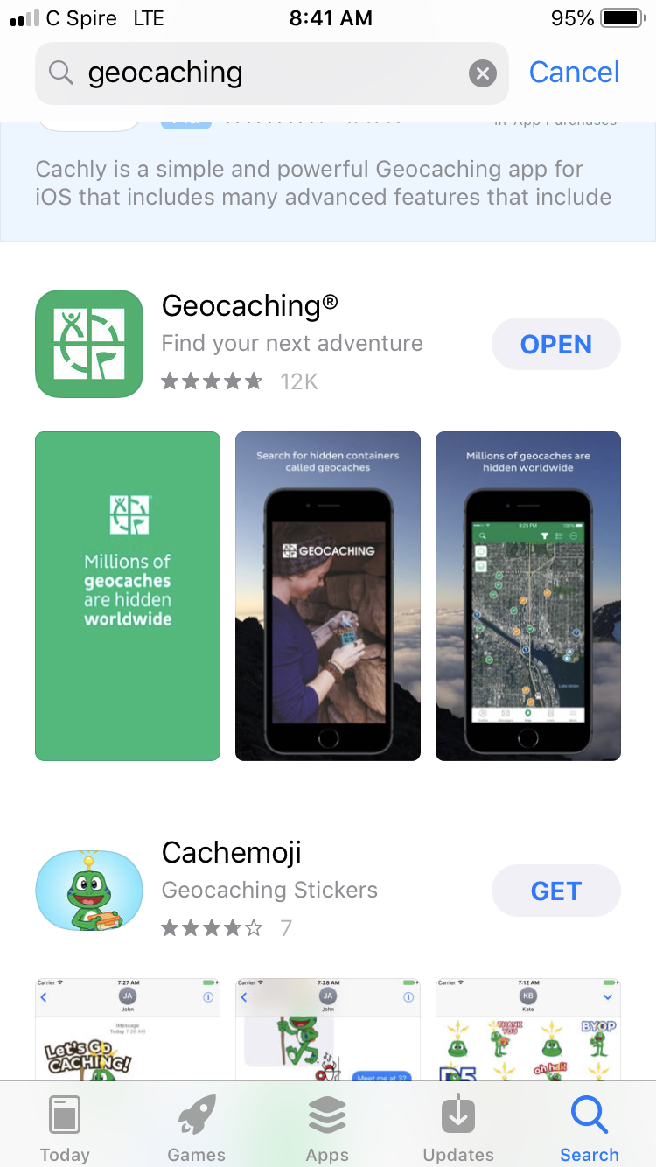
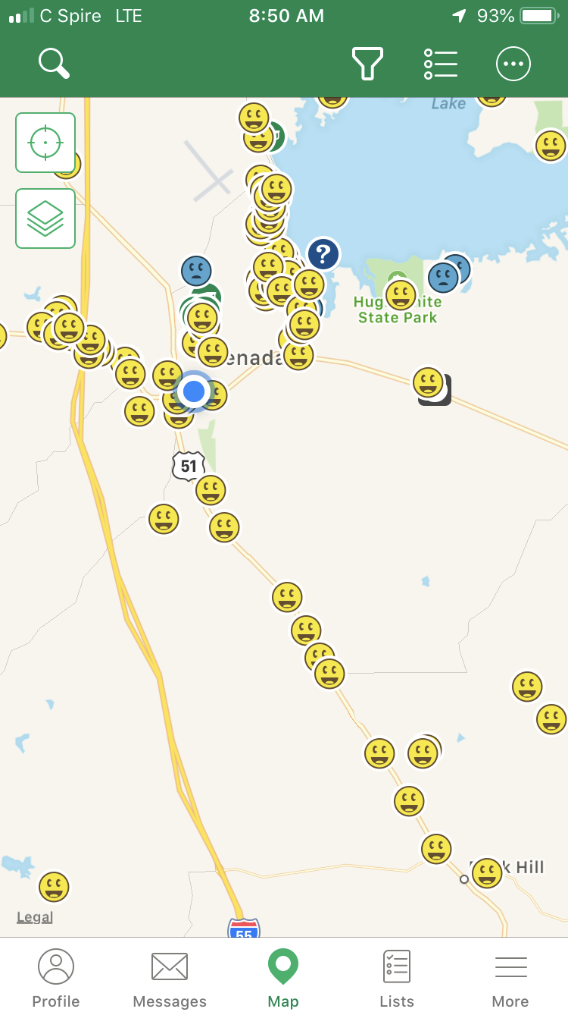
So how do you geocache?
6 steps:
1) Register for a free Basic Membership
(or a premium membership - $30/yr).
2) Download the Geocaching app.
3) Use the map on your phone to find
your location.
4) Choose a geocache from the list and
click on it.
5) Use your phone GPS to guide you to
the hidden geocache.
Bonus step: swap items….
6) Sign the logbook and return the
geocache to its original location.

Slide 5
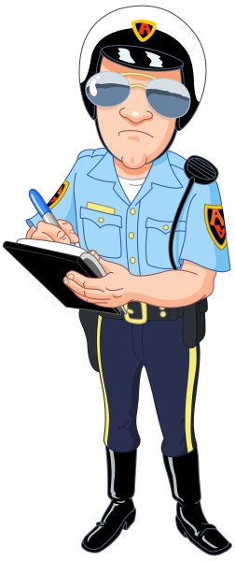
What are the rules?
1) If you take something from the geocache ("cache"),
leave something of like value.
2) Log your visit in the logbook.
3) Log your visit in the app.
What do I need?
A GPS or a GPS-enabled phone so that you can navigate to the cache
A geocaching.com membership (basic or premium)

Slide 6
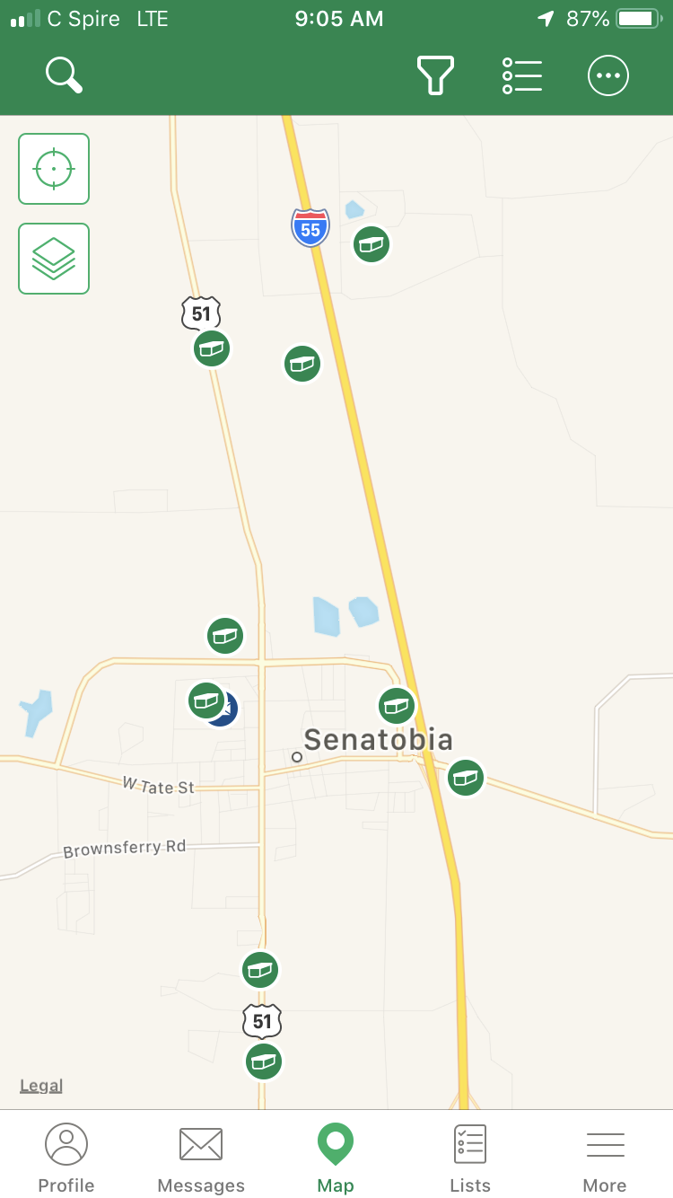
Where are geocaches located?
EVERYWHERE!
Geocaches are all over the world.
Parks, hiking trails, street signs, road sides, on/in/under bridges, cemeteries, businesses, and on and on and on….
Are there different types of
geocaches?
Yes!
Over a dozen different "types".

Slide 7
Geocache Types
Traditional Geocache
Original type and most straightforward. Container at the given coordinates. Different sizes, but will have a logbook. May have items for trade (SWAG).
Multi-Cache
Two or more “stages”, final location being a container with a logbook inside. Find first stage and you get a clue to the second stage, and so on….

Slide 8
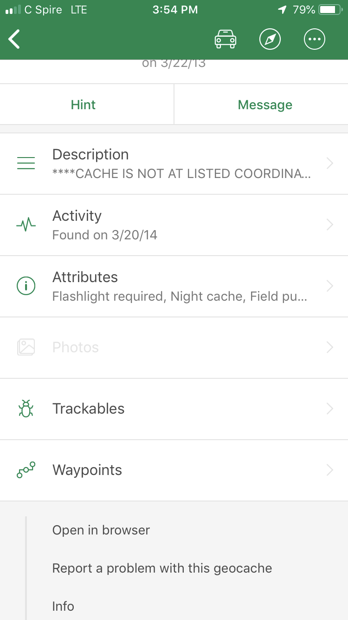
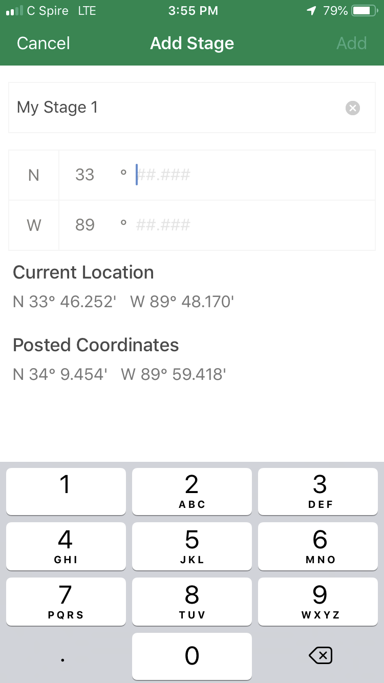
Adding a waypoint for a multi-cache
First navigate to the given coordinates and find the marker
Use the information given to move to the next stage
Clues that you use to put together to get the new coordinates
Ex. dates on a tombstone are used to complete the next coordinates
Clues that lead you to new given coordinates

Slide 9
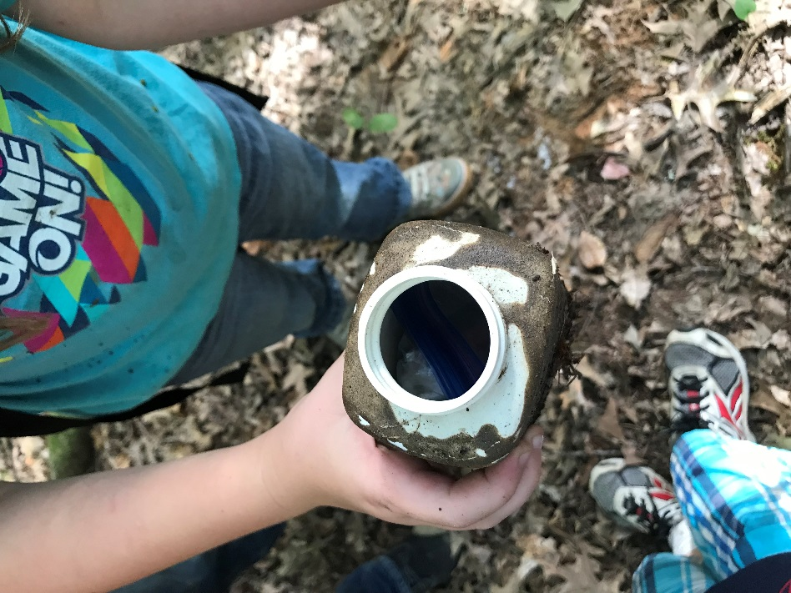
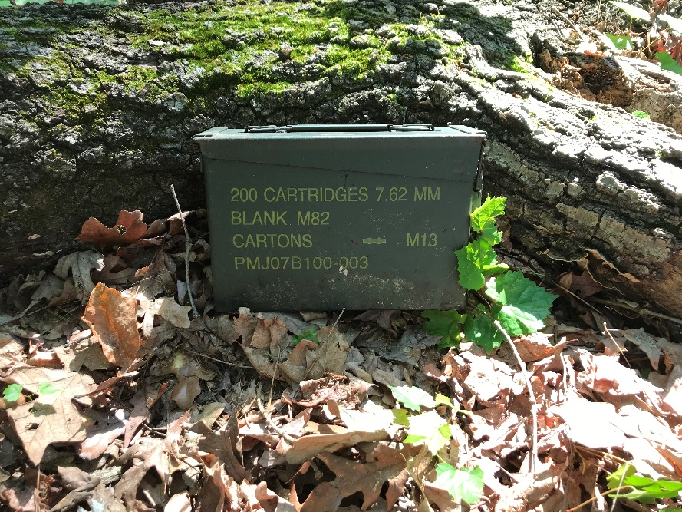
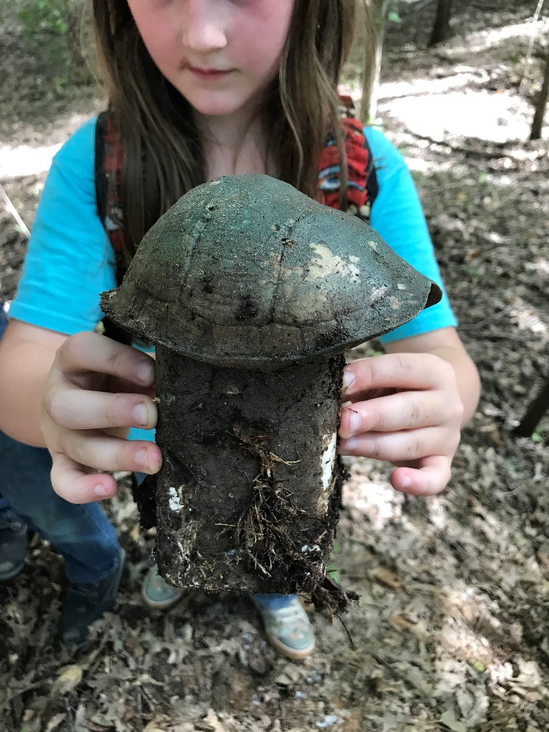
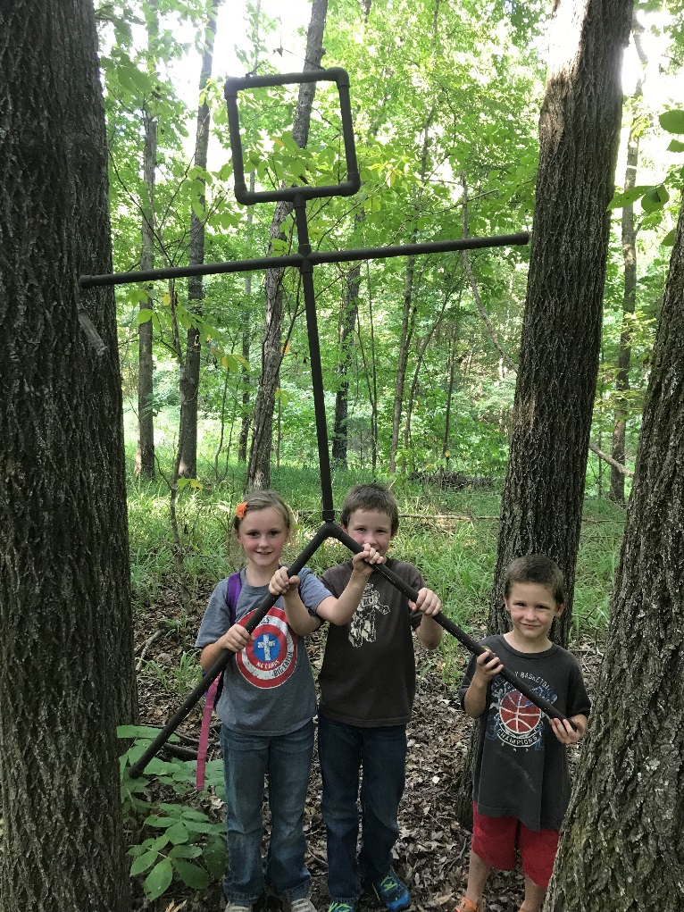
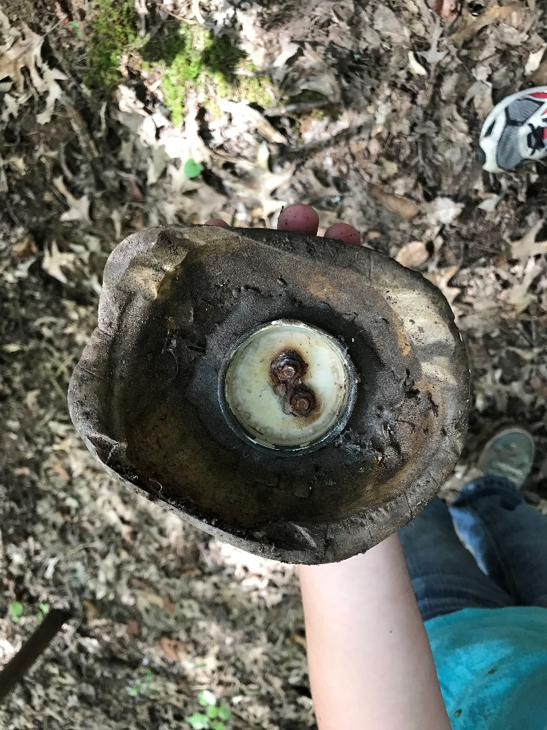
Getting Started
What kind of cache am I looking at?
Cache Type:
Difficulty Rating: 1-5
Cache Size: Micro to Unknown
Have other cachers found it recently?
What does a geocache look like?
Vary in size and appearance. Everything from large, clear plastic containers to fake rocks with secret compartments.

Slide 10
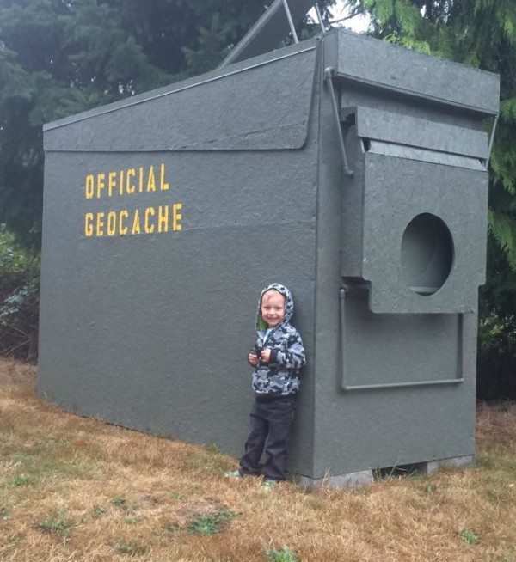
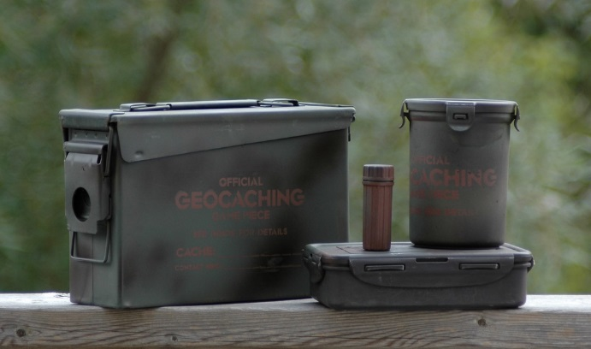
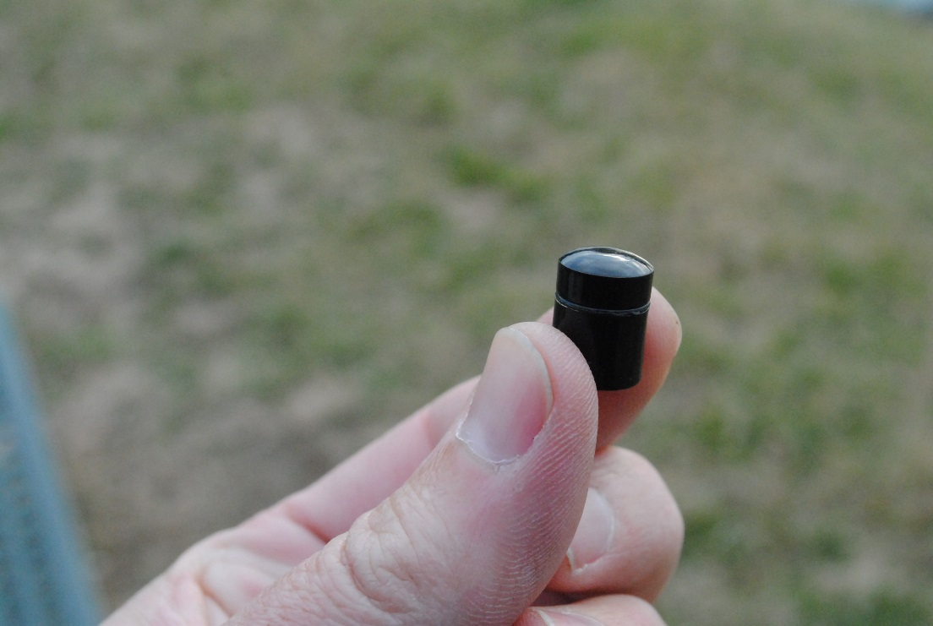
Getting Started
Cache's size is shown on each cache page.
Micro- Very small storage box containing only log.
(Tiny < 10ml (~1/3oz)
Small- Sandwich-sized plastic container or similar.
Regular- Plastic container/ammo can about the size of a shoebox.
Large- 20L or larger. Large bucket.
Other– Read cache description.
Caches typically contain:
Logbook (always) and other items. You never know what has been left behind. SWAG/trackables
Don’t leave things that shouldn’t be left….

Slide 11
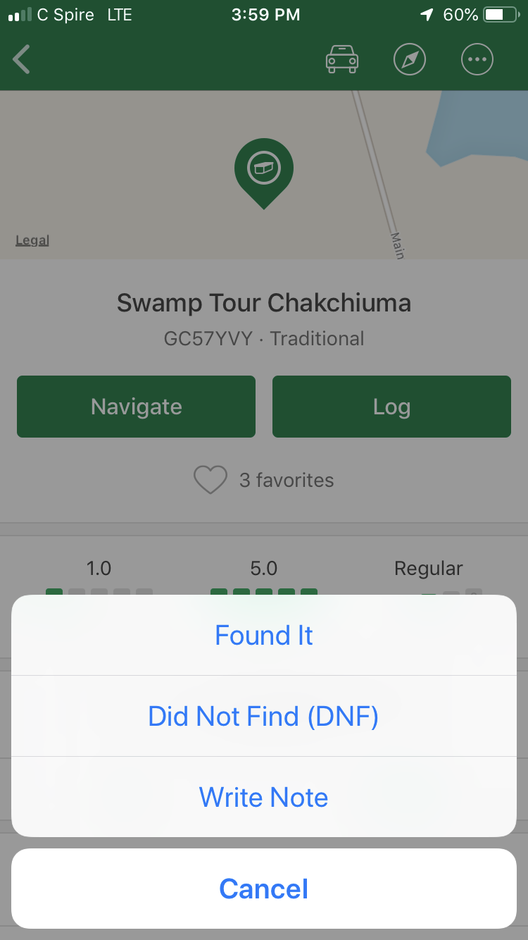
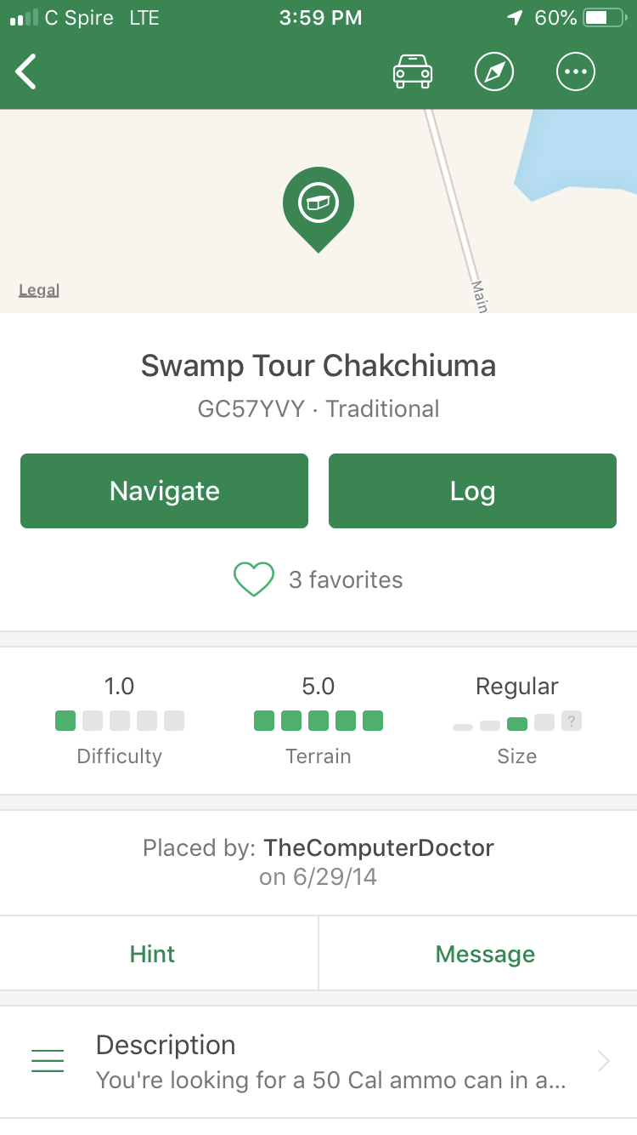
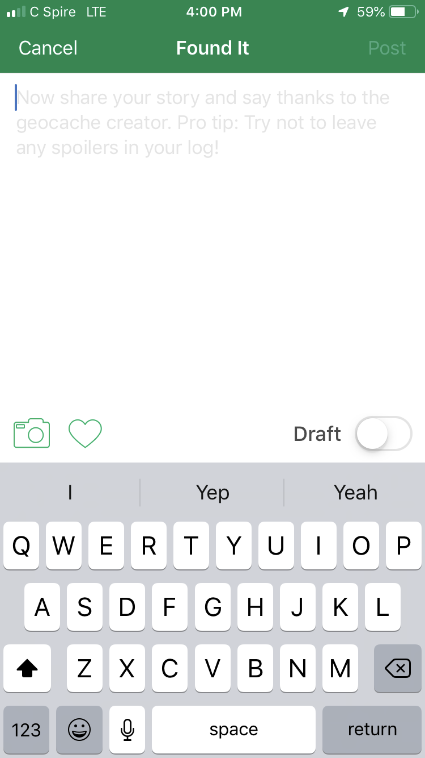
Getting Started
How do I find a cache and what do I do once I have?
There is slight "error" to every GPS device. It will get you close, but not always spot on.
LOOK AROUND!!!
When you find it, follow the rules and put the cache back exactly as you found it…
Log it on the cache page.
What if it’s missing?
Log the cache with a "Didn't find it" log so that the owner is notified.
How do I log my find?

Slide 12
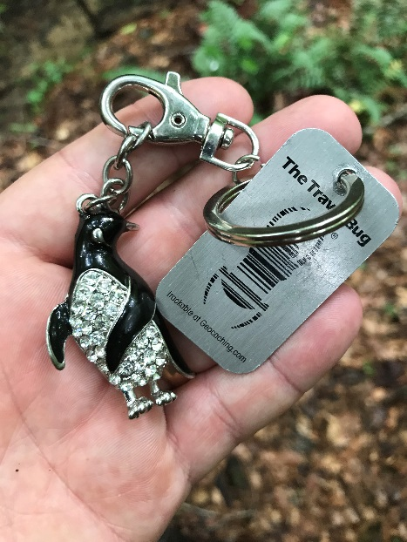
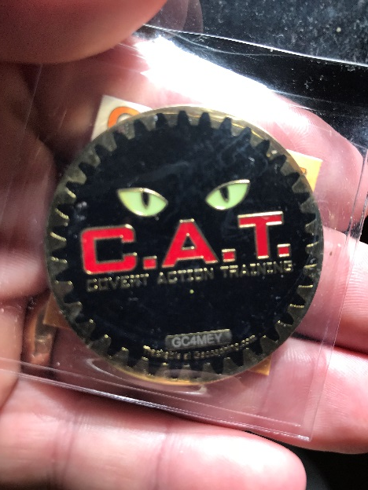
Trackables
A Trackable is a "game piece" placed in caches. Each Trackable is etched with a unique code that is used to track it as it travels.
Typically not tradable.
There are three main types of Trackables:
Travel Bug®, Geocoins, Others
Trackables have goals set by their owner. Ex. “visit every country in Europe” They move from cache to cache with the help of cachers.
What should I do when I find a Trackable?
You are not required to do anything, but you have two action options. (Move it, or “discover” it)

Slide 13
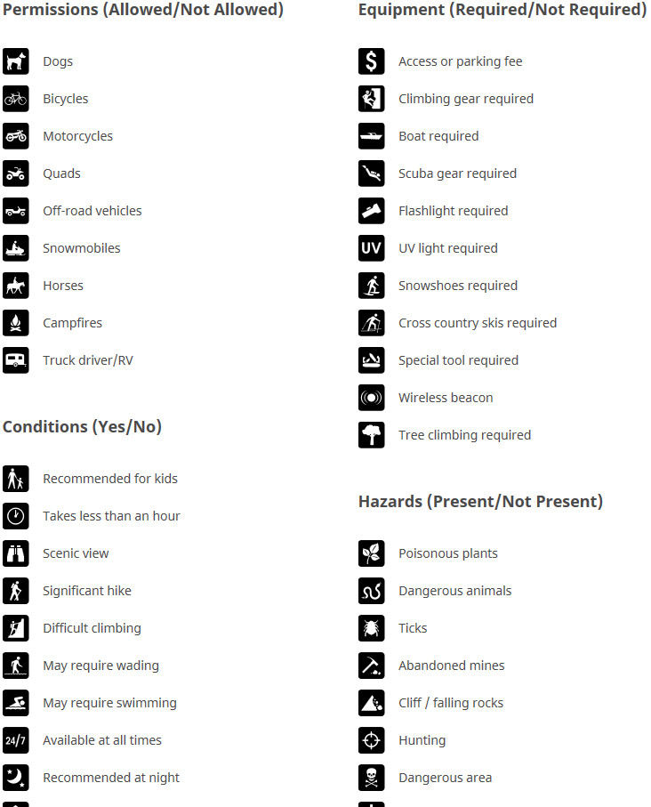
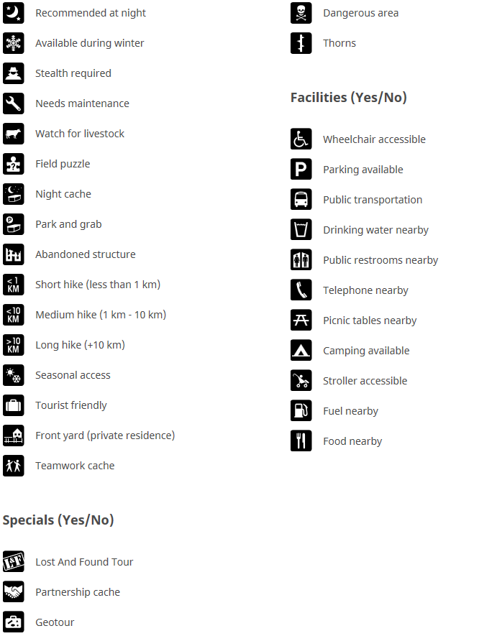
Acronyms, terminology, icons….
Acronyms and terms:
BYOP, TFTC, muggle, etc.- BUNCH of unique terms that you may not know. Geocaching.com has a glossary of terms if you need it.
Icons:
Lot of icons in the geocaching world.
Attributes:
Attributes tell you what to expect at a cache location. Cache owners add attributes to a cache listing before submitting it.

Slide 14
Forests and Forestry in Mississippi

Slide 15
Parts of a Tree
Crown:
Makes the food
Trunk:
Provides support
Transports food and water
Roots:
Anchor the tree
Extract water & nutrients

Slide 16
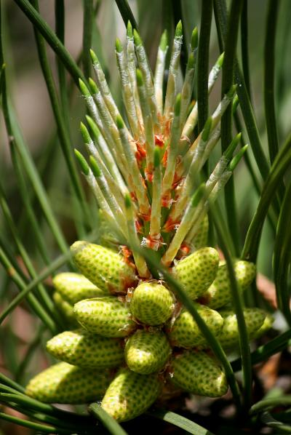
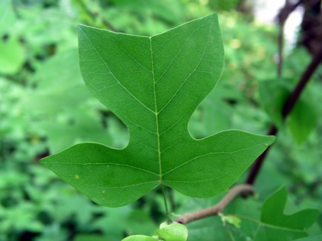
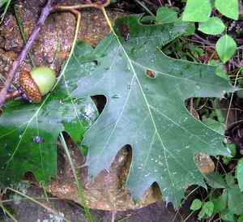
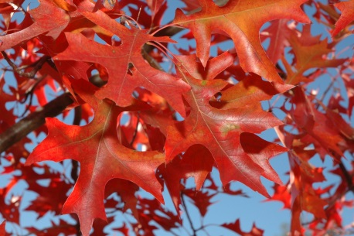
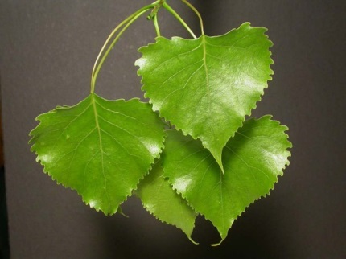
Leaves
Produce food (sugars) through photosynthesis
Use sunlight to convert water, carbon dioxide, and nutrients into carbohydrates and oxygen
H₂O + CO₂ + nutrients +
= Sugar + O₂

Slide 17
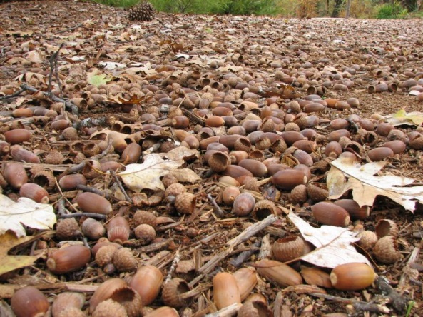
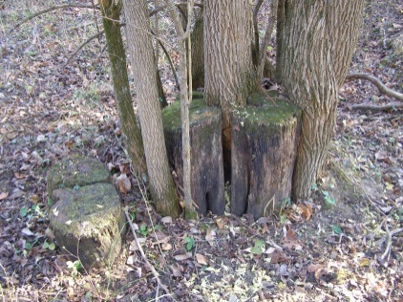
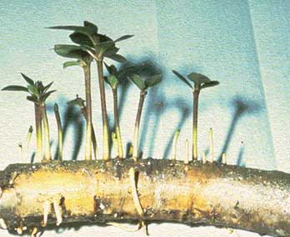
Methods of Reproduction
Seed
Sprouts
Shoots from base of stem
Suckers
Shoots from roots

Slide 18
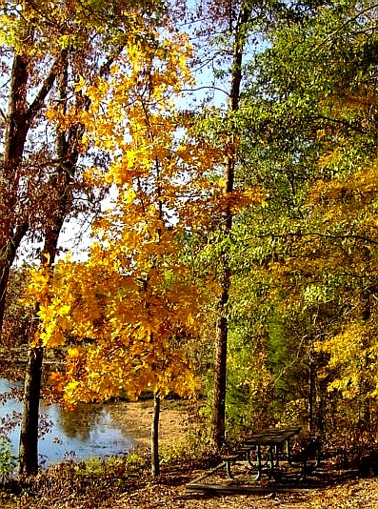
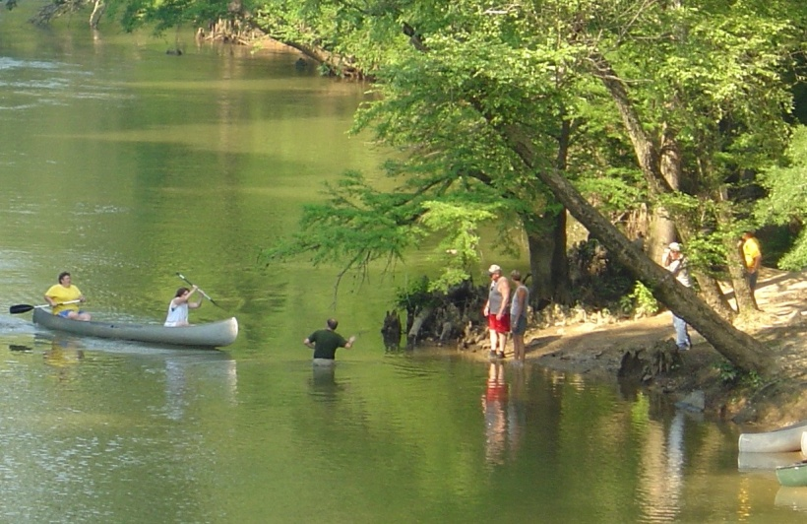
Mississippi Forests and Forest Industry
# 1 Crop?
Timber # 2 crop in MS
~$11 Billion total economic impact
~59,000 jobs in MS are forestry-related

Slide 19
Questions before we go out?

